Slide 1
Citywide Comprehensive Plan
November 13, 2023
City Planning Commission
Alyssa Marcy
Long Range Planner
Notes:
Good evening….

Slide 2
PlanKCK
WHY A COMPREHESNIVE PLAN?
wycokck.org/planKCK
Notes:
Before we get into the specifics of PlanKCK, what it is, what we’ve heard, and how it will change our community for the better, I want to take a moment. A moment to take off my Planners’ hat and speak to you as a neighbor. This endeavor is about us – the people who go to sleep and wake up in KCK. I have heard from thousands of you about our community – about what frustrates us, what keeps us up at night. And all of those things are valid. But what we cannot do - in order to change for the better – is get stuck in the past that got us here. We absolutely need to recognize our mistakes, but we also must learn from them. In order to address the past, we must focus on the future, we must continue to evolve and adapt.

Slide 3
What is Community?
First and foremost, community is not a place, a building, or an organization; nor is it an exchange of information over the Internet. Community is both a feeling and a set of relationships among people. People form and maintain communities to meet common needs.
Stanford Social Innovation Review
Notes:
I had a conversation with DeWayne a couple weeks ago, on a day when he received some bad news about a family member. Yet, his message was: we have to keep moving forward. It’s the only thing we can do. The quote here, is something that DeWayne shared with me. And it gets to the crux of why we need PlanKCK – community it not inanimate, its about the people. And because our community deserves better, and more importantly – our community deserves to dream again. In order to get there, we need to come together under a shared, collaborate vision that focus our energy on strategic steps forward.

Slide 4
“The true melting pot of cultures, and how we celebrate all of them.”
“We are like New York - separate pockets/boroughs; each neighborhood encompasses such a unique and different culture.”
PAGE | 4
Notes:
So, in a community with so many needs, we must focus on our strengths. I want to focus on one of those strengths. When the community was asked the question “What makes KCK unique?” – nearly 47% of the responses were some version of the word diversity – diversity of people, places, history, culture, art, food, things to do – and that is something we can celebrate, but also use to bolster KCK. Diversity is part of our spirit, and it will help us move the needle in our community.

Slide 5
PlanKCK
WHAT IS IT?
Alyssa Marcy, Long Range Planner
wycokck.org/planKCK
Notes:
Many of you have heard what I am about to cover, but I recognize that not everyone was present in my previous presentations.
So what exactly is PlanKCK?

Slide 6
Power of PlanKCK
goDotte Strategic Mobility Plan
Adopted
2022
Economic Development Strategy
Housing Strategy
Historic Preservation Plan
Community Health Improvement Plan
UG Deep Dive (UG Forward)
Mayor’s Task Forces
2024 Budget Process
2023
In Process
PlanKCK is our opportunity to develop a comprehensive, shared vision of the future for KCK.
Neighborhoods
Focused Plans
Public Policy
Implementation
Area Plans
Area Plans
Neighborhood Plans
Zoning Code
Land Bank
Policy Update
Land Entitlement
Grants Working Group
Area Plans
Area Plans
Corridor Plans
Enforcement
RFQ/RFP Process
PAGE | 6
Notes:
It is a comprehensive vision for our future. If we consider everything that must be accounted for, paid for, managed, improved…to provide a livable, vibrant KCK, especially with a constrained budget, strategic alignment is critical. PlanKCK is the northstar that can provide pull the threads together. PlanKCK truly began with the countywide goDotte Strategic Mobility plan adopted in 2022. This first thread serves as the transportation chapter of PlanKCK. And from there, we began to layer in all the other threads: Historic Preservation Plan, Economic Development Strategic Plan, and Housing Strategy, as well as recommendations from the Mayor’s Task Forces, the Health Department’s Community Health Improvement Plan, the 2024 Budget Process, and many more. The strategic alignment of all these elements will serve as an umbrella to guide all future decision making – updating or creating area plans, updating the zoning code, creating a land bank policy, identifying grant pursuits. Decision making, with great needs and little resources, is made harder without a shared desire for the future. It is also important to keep in mind that this is a broad plan, that it has elasticity, and as the future changes, it can evolve with the community.

Slide 7
Scope of PlanKCK
Regional Identity
Economic Development
Housing
Update of 2008 Citywide Master Plan
PlanKCK is considering systemic issues, historic context, and current conditions with lenses focused on equity, access, health and sustainability
Equity
Access
Health
Regeneration
Arts & Culture
Historic Preservation
Environmental Justice & Climate Change
PLANKCK LENSES
Food Systems
Land Use
Parks & Open Space Preservation
Community Safety & Services
PAGE | 7
Notes:
Here are all the threads that make PlanKCK truly comprehensive – 10 elements that outline strategic planning, from economic development to land use to community safety and services. Further, all these elements are designed through four very important lenses: Equity, Access, Health, and Regeneration. We did change sustainability to regeneration to better reflect the need to repair, to prosper, to grow - rather than just sustain.

Slide 8
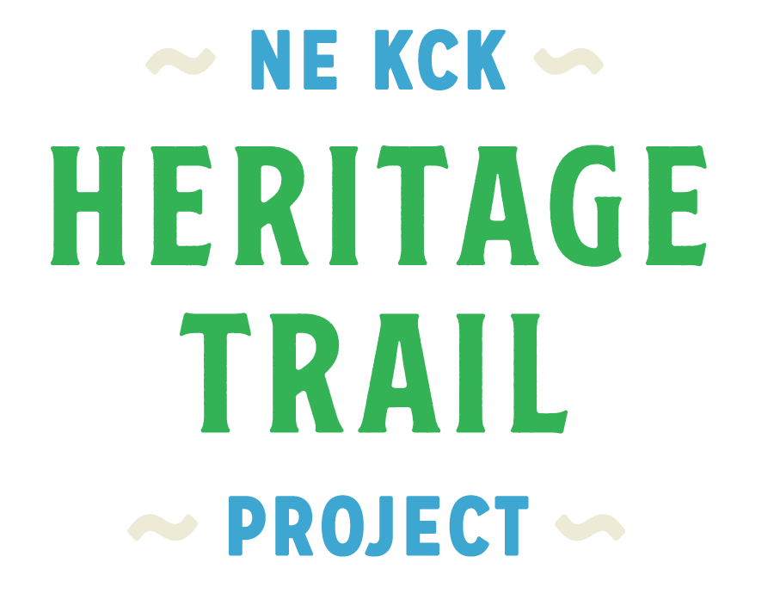
The Broader Context
Comprehensive + Countywide
Specific to an Area
NORTHEAST AREA MASTER PLAN
Plan hierarchy establishes a broader vision which becomes more specific as focused plans address corridors and our neighborhoods.
Focused: Corridor, Neighborhood
Example of the context for adopted plans across KCK.
PAGE | 8
Notes:
Use this slide to demonstrate how to read plan/symbols
Reintroduce strategic initiative

Slide 9
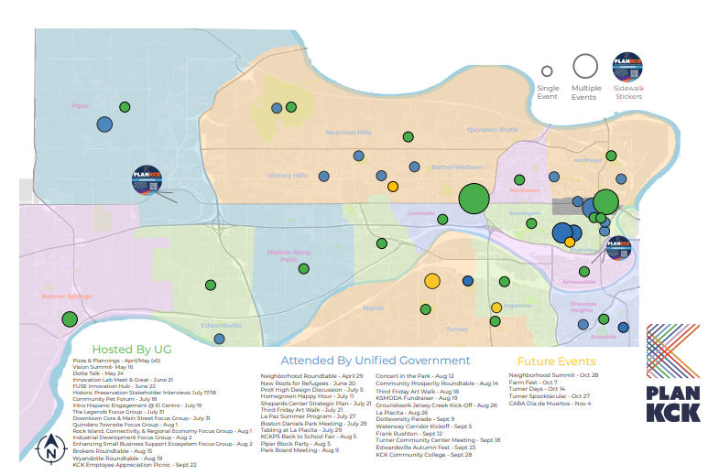
Engagement To Date
UG Leadership | Housing and Economic Development Presentation Special Session (March) PlanKCK Update Presentations to BOC General Engagement (August) Economic Development (September) PlanKCK Overview to Planning Commission (October) Dept. Director Conversations (May through present)
Hosted Events | Neighborhood Resiliency Roundtable (April) Vision Summit (May) Pizza & Planning (Spring) Innovation Lab (June) Focus Groups (Summer to present) Spanish Language Event (July) Community Prosperity Roundtable (August) Brokers Roundtable (August)
Attended Events | Third Friday Art Walk La Placita Shepherd’s Center Strategic Planning New Roots for Refugees Boston Daniels Park Planning Back to School Event Rosedale Concert in the Park Wyandotte Roundtable Groundwork Jersey Creek Kick-off
May - Present 2023
Summer of Outreach
November/December 2023
Approval Process
May 2023 PlanKCK Vision Summit
October 28
Neighborhood Summit
PAGE | 9
Notes:
Engagement truly started with outreach during goDotte Strategic Mobility Plan – we heard the same desires from the community back then: improved streets, reliable frequent transportation, beautiful neighborhoods – access to opportunity. But since then, the PlanKCK engagement process, which started in February of this year, many other elements have been added on. Because you can’t think about addressing your transportation systems without considering how that impacts economic development, the environment, housing, and more.
Our approach included talking to UG leadership and staff, who are not only experts in their fields, but also our neighbors. We hosted events, some on specific topics, others that covered PlanKCK more broadly. And we also attended many events, responding to the feedback we heard to meet people where they are. In total, we attended or hosted over 120 events with more than 5,000 engagements. PlanKCK was also the cover story of the first UG Spotlight delivered to over 66,000 households in October.

Slide 10
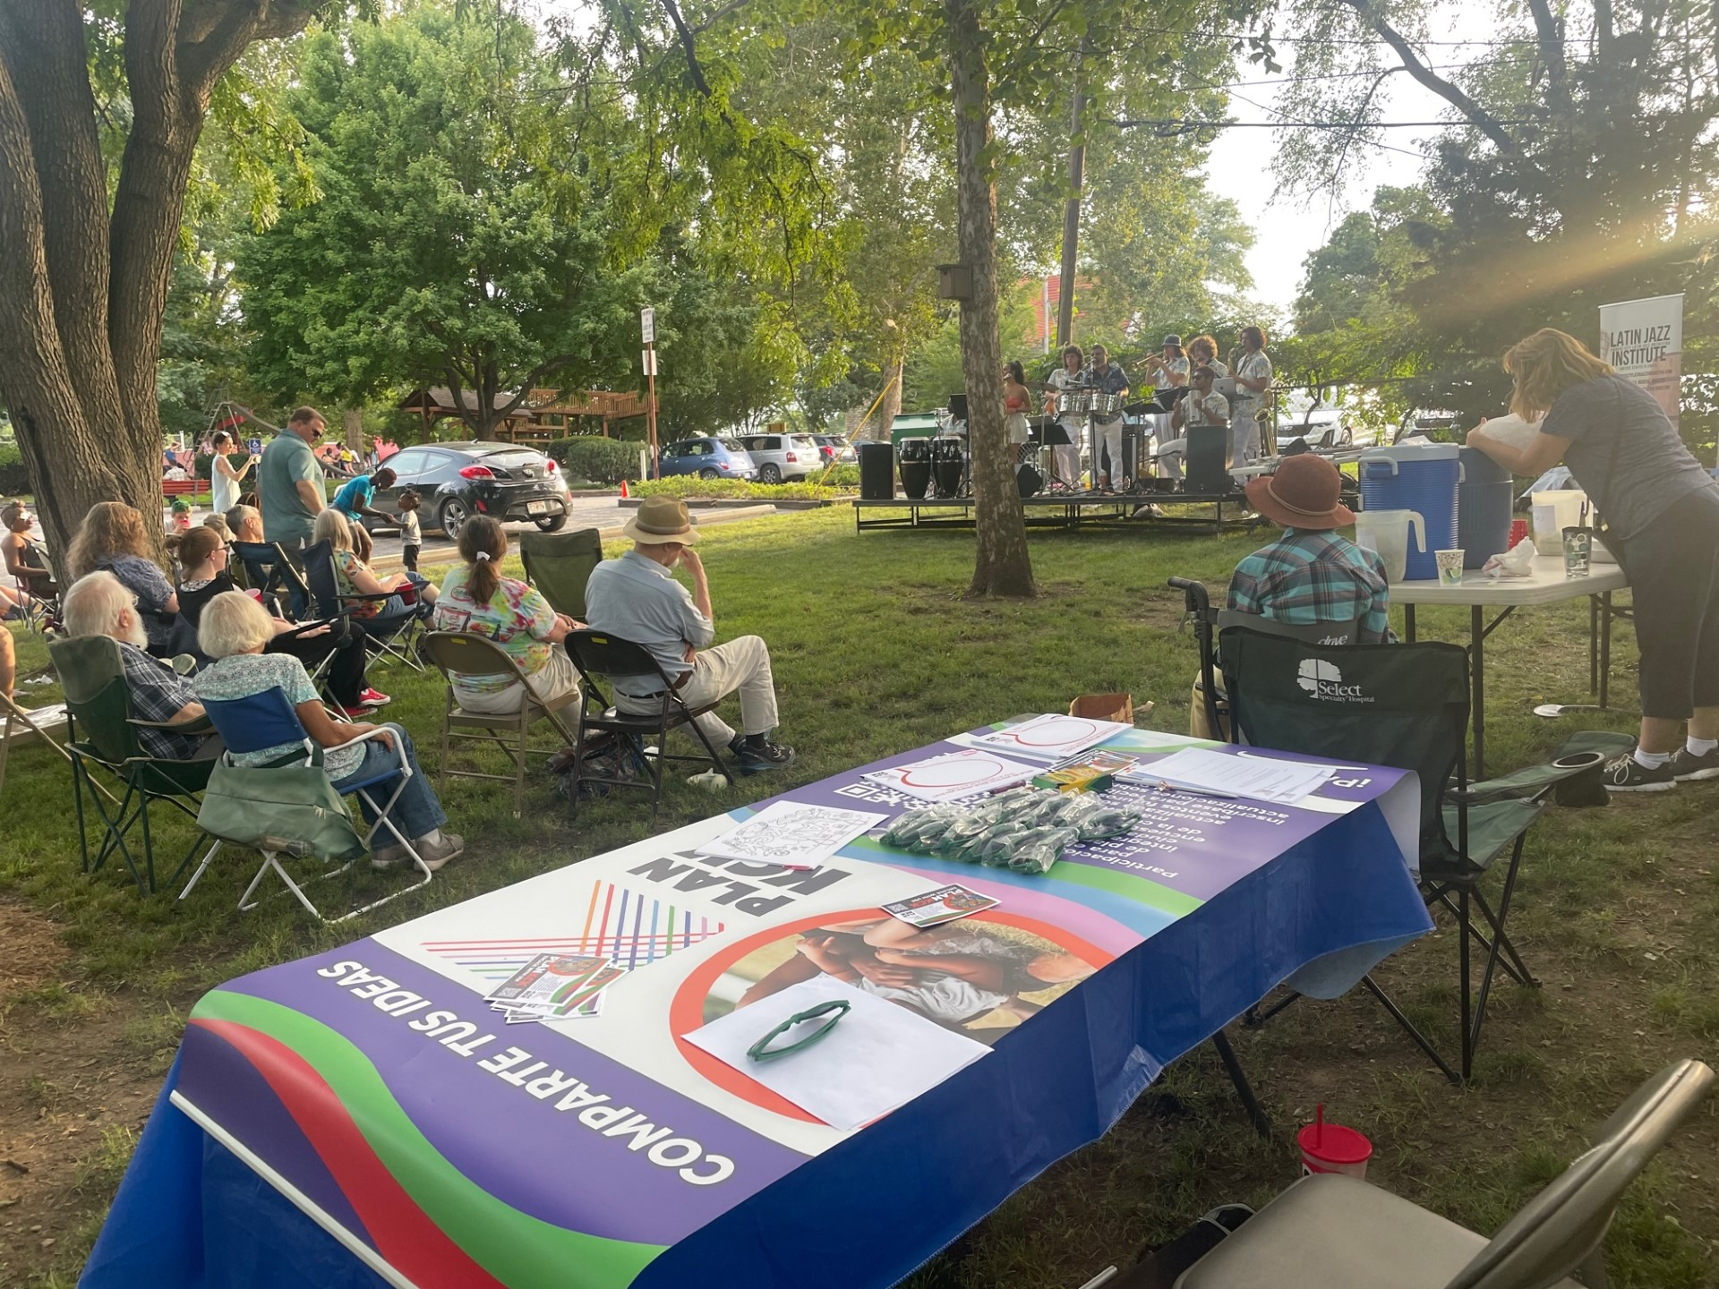
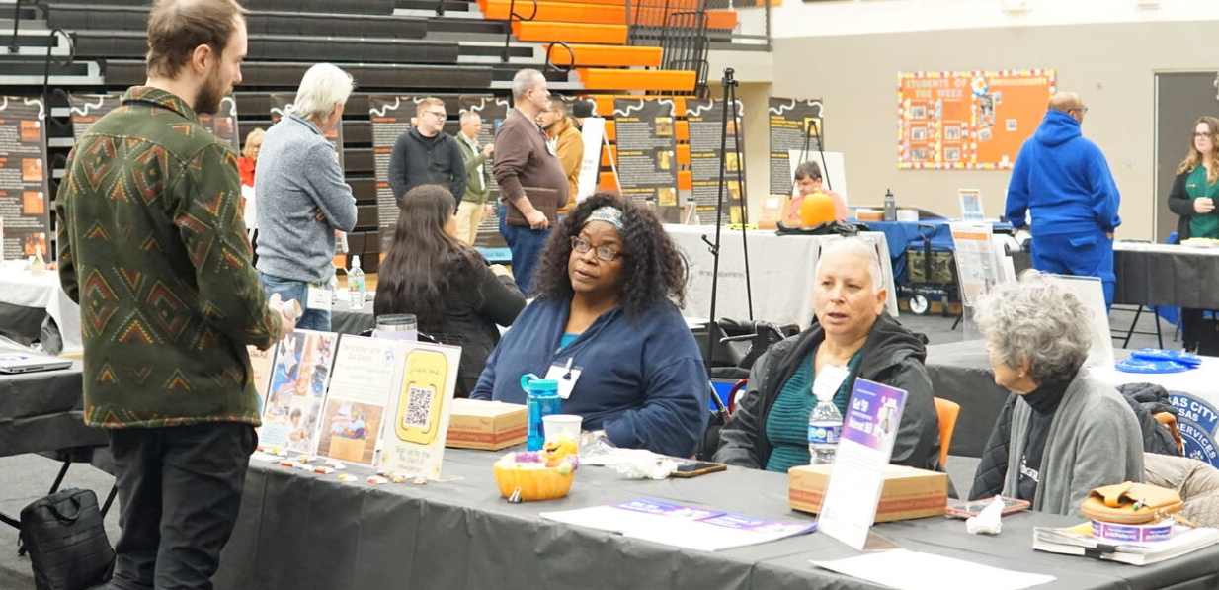
Engagement To Date
Over 120 events attended or hosted
30 attended events
More than 5,000 engagements
300+ survey responses (bilingual)
Front page of UG Spotlight – 66,000 households
950 subscribers to PlanKCK email list
PAGE | 10
Notes:
responding to the feedback we heard to meet people where they are. In total, we attended or hosted over 120 events with more than 5,000 engagements. PlanKCK was also the cover story of the first UG Spotlight delivered to over 66,000 households in October.

Slide 11
PAGE | 11

Slide 12
Engagement What We've Heard
Desire for rapid change in a different direction rather than current course
Provide better basic city services
Quality parks & maintenance
Fair shares of the pie
Quality housing for all income levels
Improved access to healthy foods
Tell our story/history through the preservation of our community
Celebrate our diversity
PAGE | 12
Notes:
Desire for change – a desire for intentional development, strengthening our downtowns, focusing on infill. The market wants to develop out west, but that does not mean that we can’t focus on our urban core too.

Slide 13
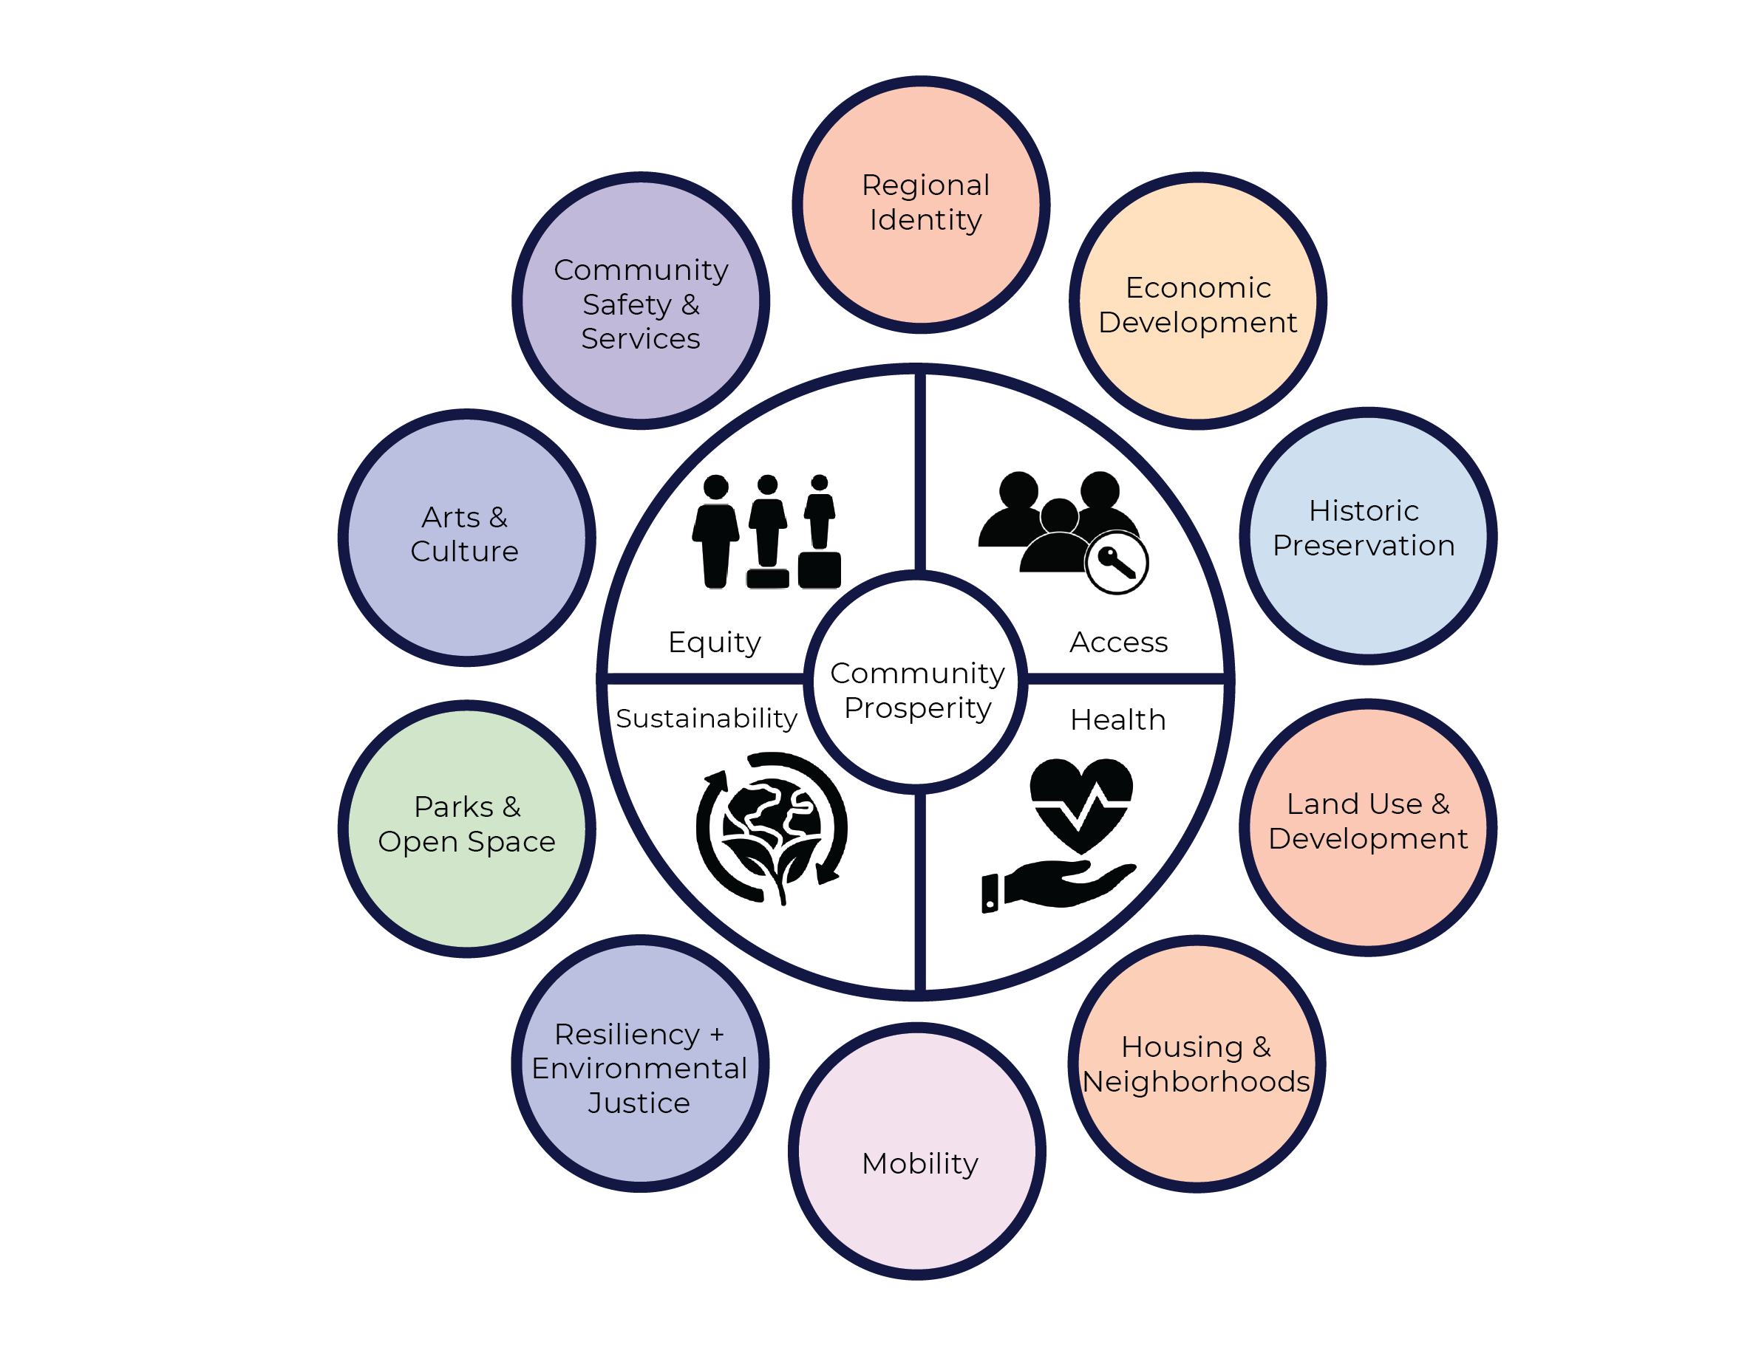
wycokck.org/planKCK
Notes:
Lastly, I am going to take you through a few of the strategic initiatives that are identified in the implementation chapter of PlanKCK. Because the proof is in the plan that never collects dust.

Slide 14
PlanKCK
WHY DO WE NEED A COMPREHENSIVE PLAN?
wycokck.org/planKCK
Notes:
So again, why do we need a comprehensive plan?

Slide 15
PlanKCK
The Impact
Inform Zoning Code and design guidelines updates
Set the stage for policy creation
Prioritize strategies and actions across UG departments
Demonstrate collaboration with the community, partner municipalities, and partner agencies
Guide budget decisions
Unify the community around a common vision of the future
PAGE | 15
Notes:
Because we have a lot of work to do, and it is a lot easier to make decisions when we have a north star. Something to return to. An alignment of both needs and strengths.
Flexible, living document. Must be nimble so we can address our unknowns the best we can.
It’s a policy document that should guide our decision-making to “community prosperity”

Slide 16
PlanKCK
From Planning to Action
wycokck.org/planKCK
Notes:
Lastly, I am going to take you through a few of the strategic initiatives that are identified in the implementation chapter of PlanKCK. Because the proof is in the plan that never collects dust.
Reintroduce strategic initiative – A strategic initiative is a single effort that addresses multiple stated goals. In a world of constrained resources and competing interests, we must be strategic.

Slide 17
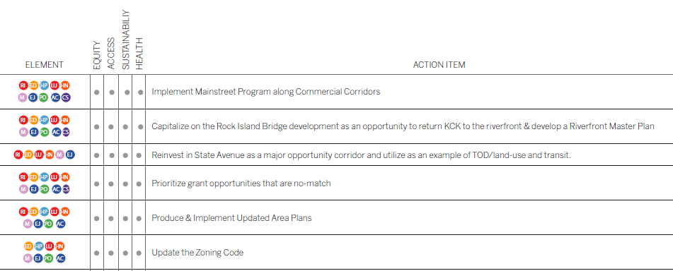
How to Read PlanKCK
ELEMENTS OF THE PLAN
PlanKCK Vision & Lenses
Chapters: 10 Focus Areas
CRITICAL ISSUES | GOALS | STRATEGIES
Example of Action Item Matrix, demonstrating how each action item meets various lenses and address plan focus areas.
Action Items
PAGE | 17

Slide 18
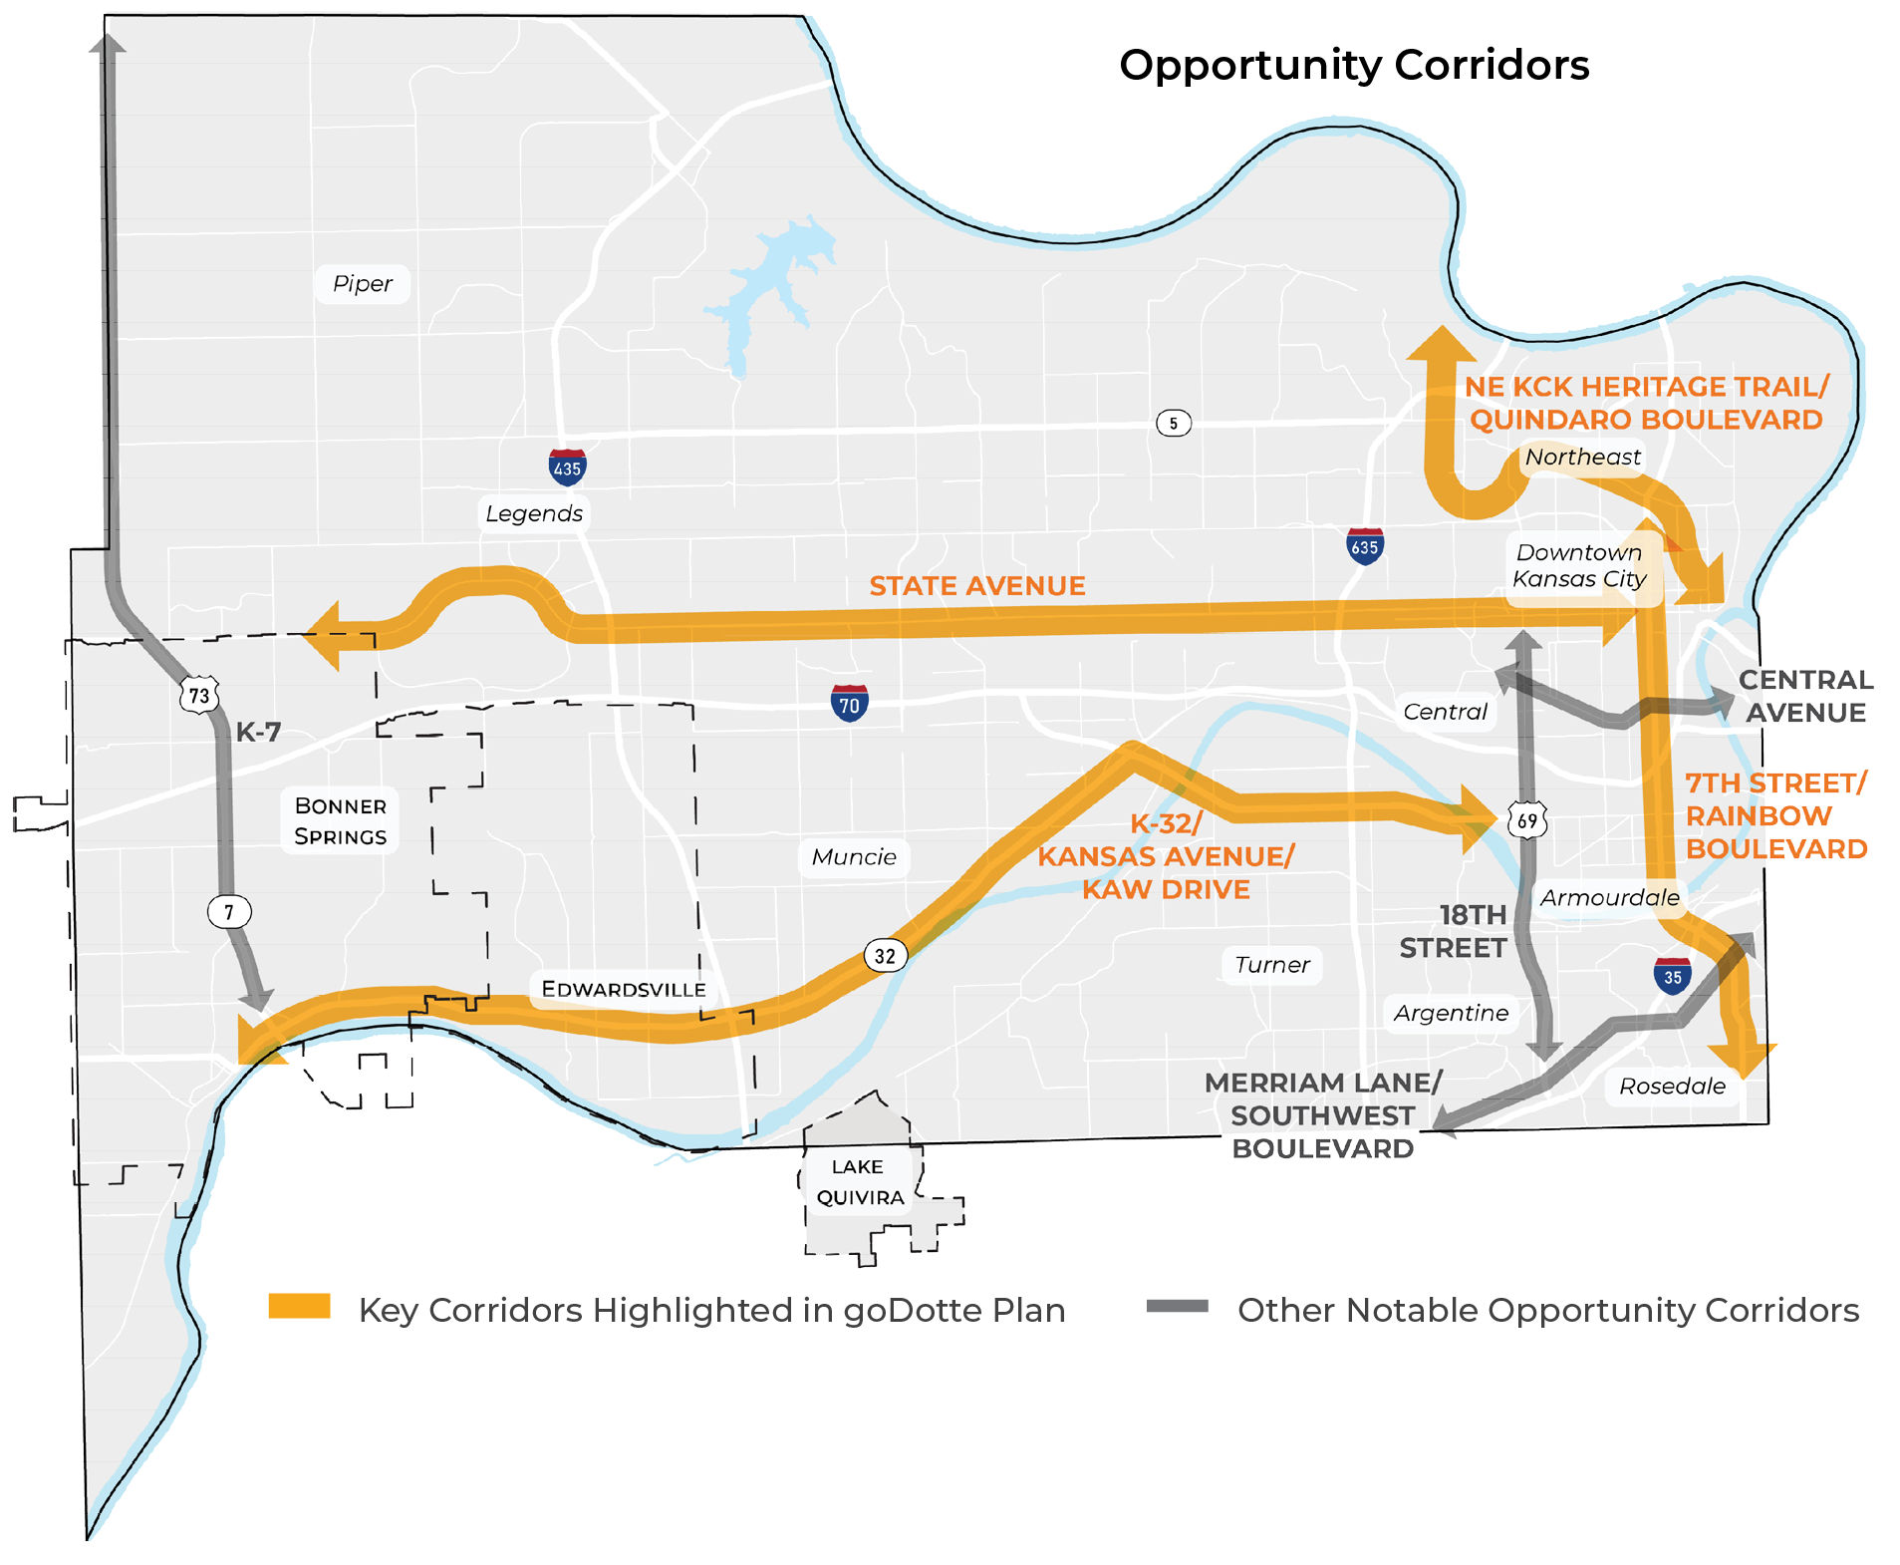
Align the Tri-City River Corridor
Opportunity Corridors
Address deferred maintenance
Connect multiple trail systems within KCK
Reconnect to the River
Notes:
I am going to briefly take you through the three step It was first important to establish a vision of prosperity in KCK – what does it mean to have economic prosperity in our community and what might that look like?

Slide 19
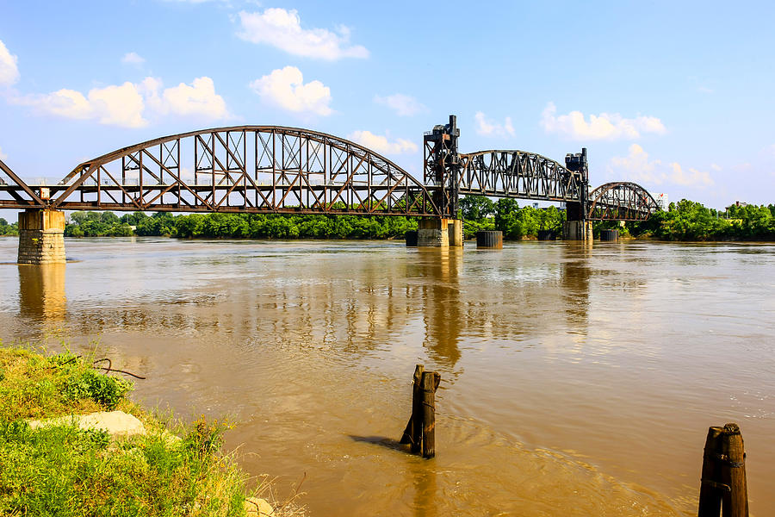
Leverage the Rock Island Bridge
Catalytic economic development project
Connects multiple trail systems within KCK and KCMO
Opportunity to strengthen our regional identity
PAGE | 19
Notes:
The Rock Island Bridge is a catalytic project. But it is one of many planned and ongoing efforts to reconnect to our river front. It is an opportunity to link the NE KCK Heritage Trail, which just received $1.2M for phase 1, to connect to Kaw Point. It is an opportunity to connect to our sister city. And even know, we have submitted grant applications for funding for the Levee trail, which will connect out to K-32 and western Wyandotte.
It is transportation, economic development, regional identity.
It is equity, health, access, and regeneration.

Slide 20
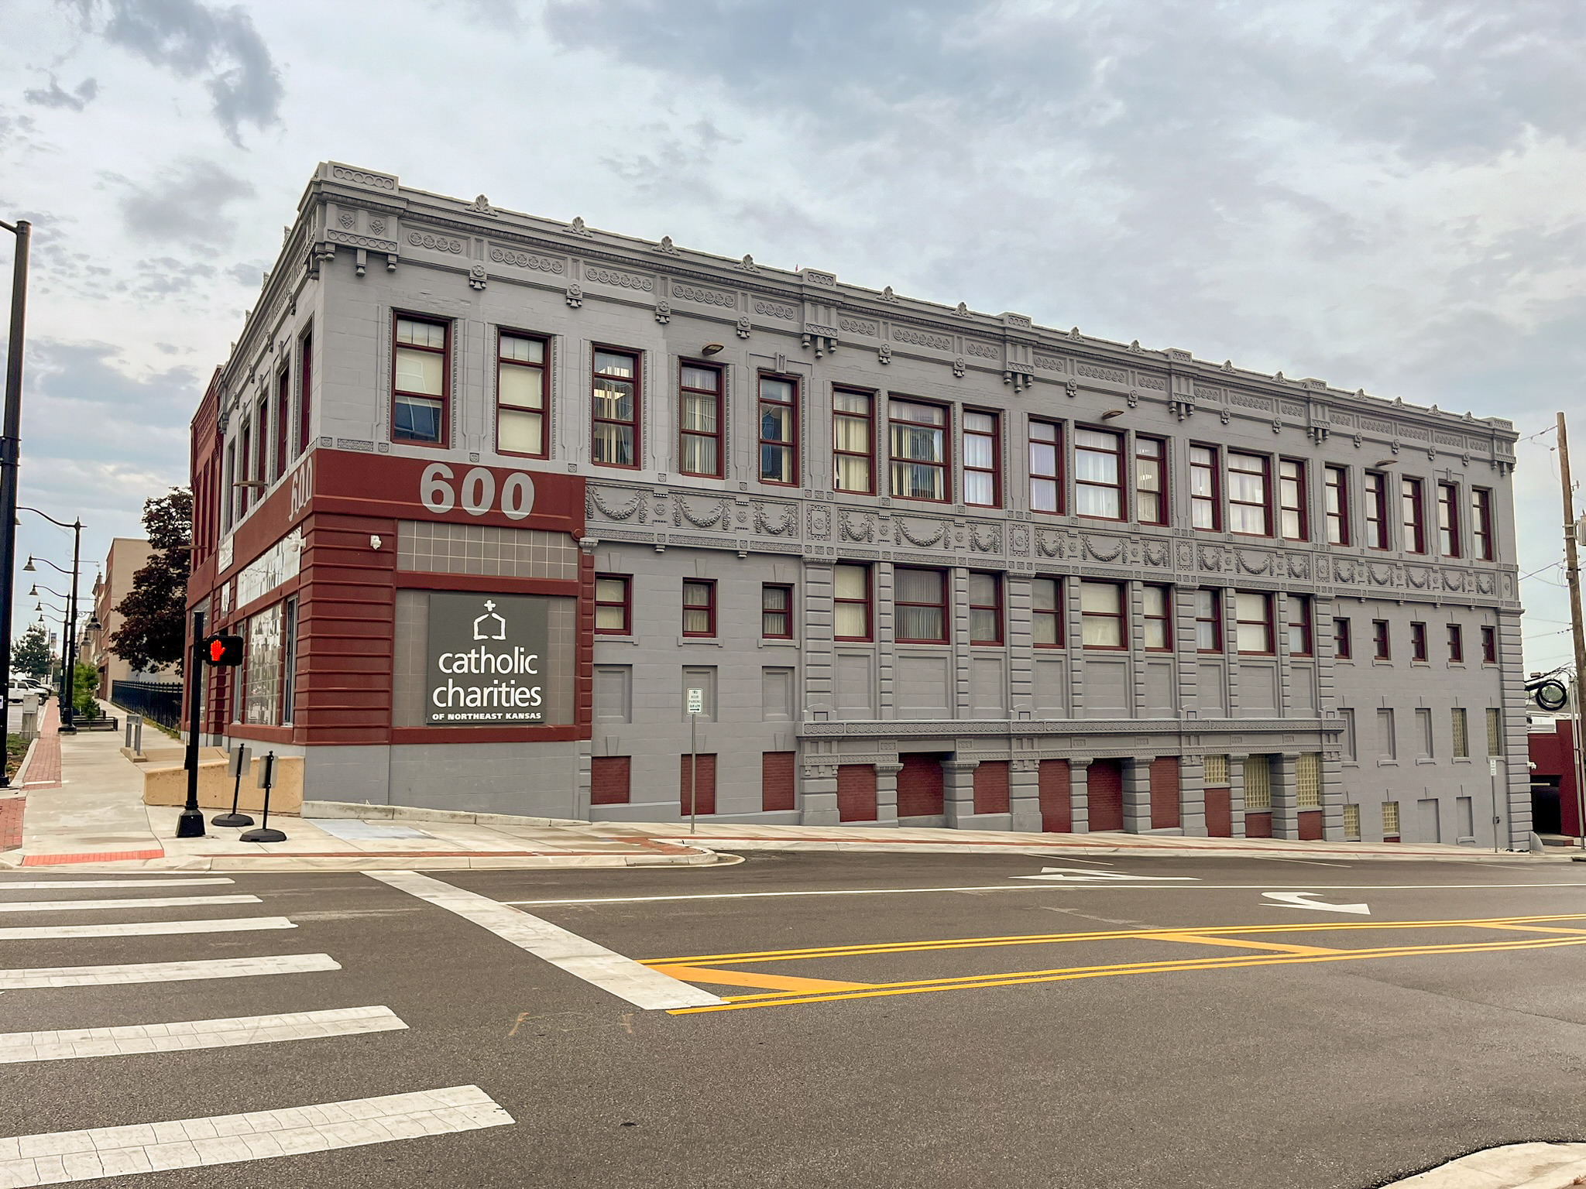
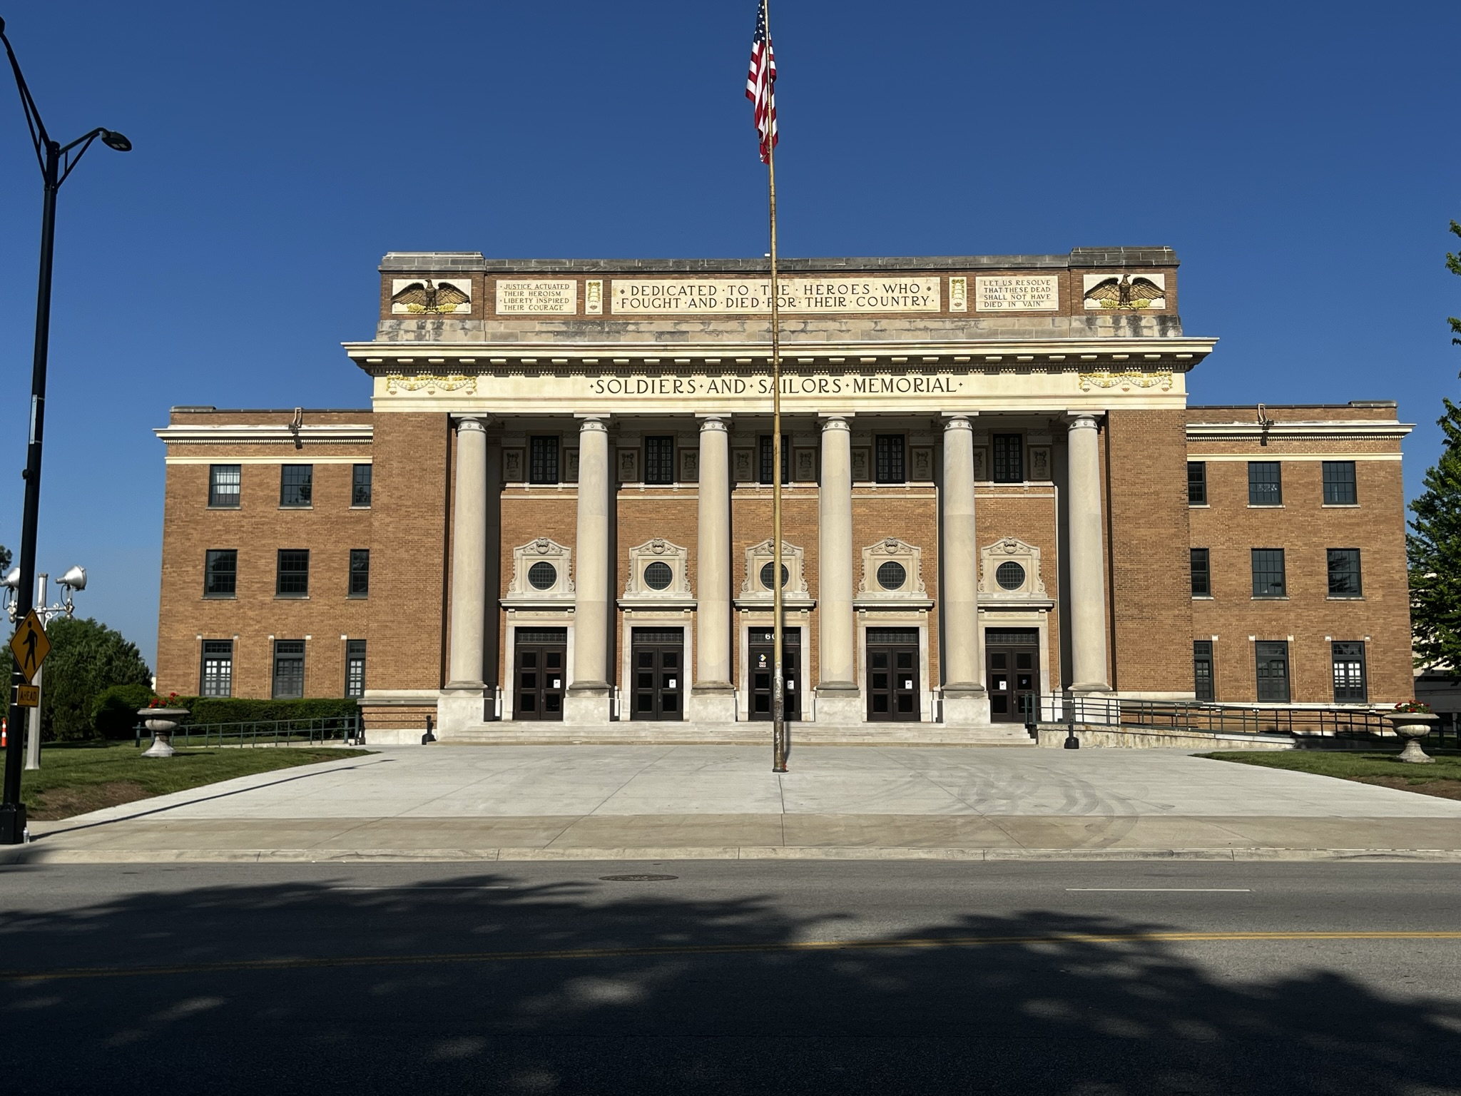
Implement a Downtown
Mainstreet Program
Revitalizes downtown
Bolsters the small business ecosystem
Improves safety
Preserves our history and elevates our identity
PAGE | 20
Notes:
Historic Preservation isn’t only a way to protect and celebrate our history, but it is a mechanism to access economic development funding, it can enhance arts and culture, strengthen regional identity, and preservation is more sustainability than building new.
Has anyone here ever been to Philadelphia? Or Boston? What do you do there, as a tourist? You visit the heritage.
A mainstreet program, is a step towards community prosperity. And our historic preservationist, Randy Greeves, is already assisting our Downtown organizations to establish a mainsreet program right here in downtown KCK.

Slide 21
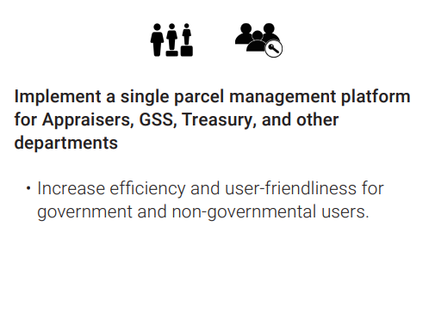
Consolidate UG Systems
Removes redundancies and improves efficiencies
Cuts costs
Strengthens cross-departmental communication
Improves services
PAGE | 21
Notes:
Make sure DOTS oversees all changes and systems to unify

Slide 22
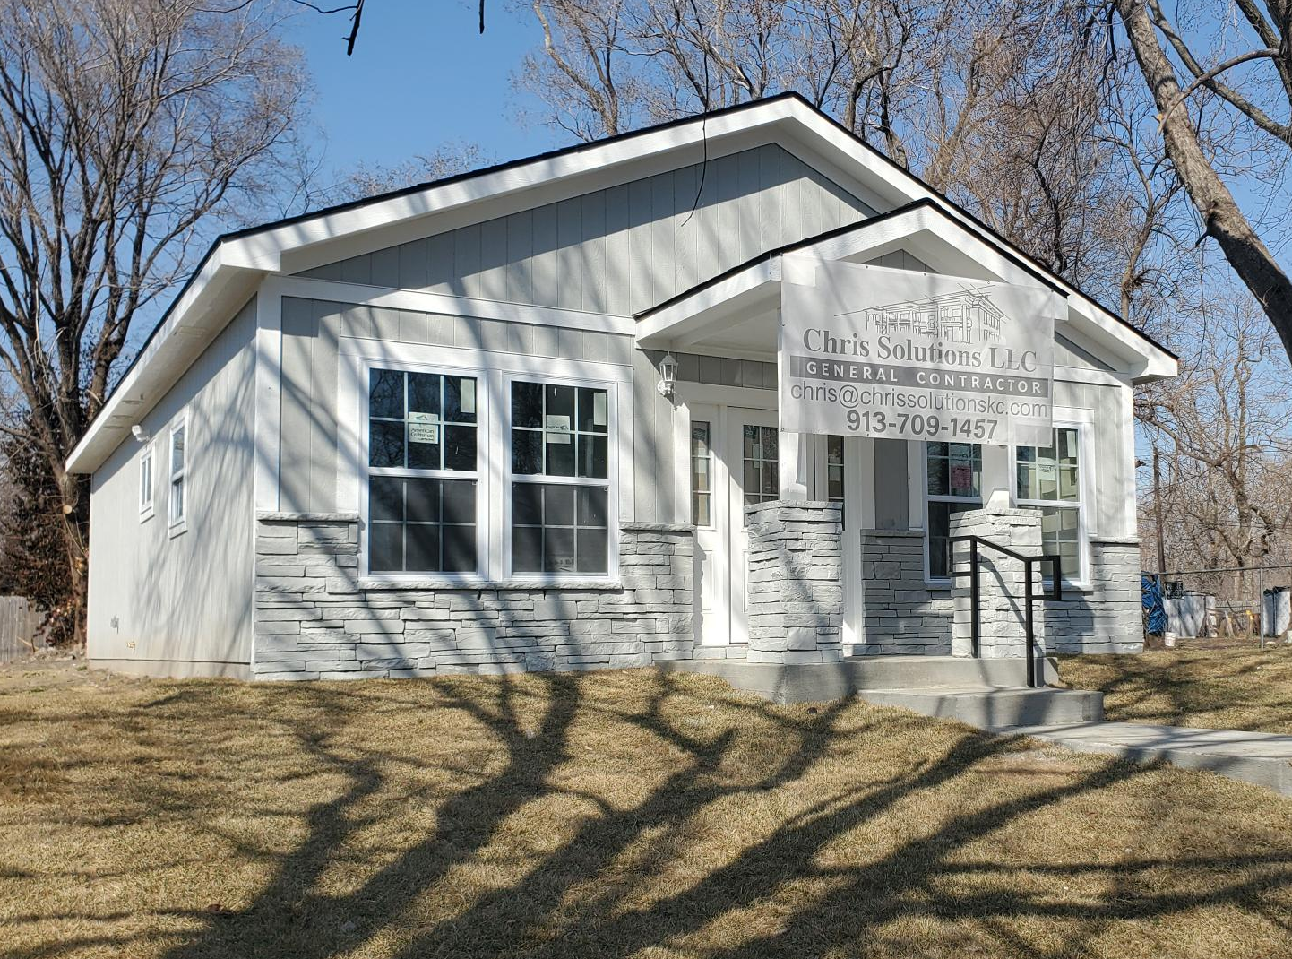
Develop a Robust
Land Bank Strategy
Address blight in our neighborhoods
Utilize as an intentional development tool
Increases tax base and neighborhood amenities
Significant opportunity for the community
PAGE | 22
Notes:
The Wyandotte County Land Bank is the result of historic decisions that deeply impacted our black and brown communities. But it is also an asset – it is an opportunity to bring intentional development into KCK that is led by the community. It can be housing, transportation, commerce, parks – and it can be paired with zero match grant programs to address environmental contamination caused by those historic decisions that put mutliple gas stations and coal storage next to residential area. The Land Bank is an opportunity to regenerate our community.
Prioritize urban ag/community gardens; package up multiple parcels for redevelopment

Slide 23
Example Action Items
wycokck.org/planKCK

Slide 24
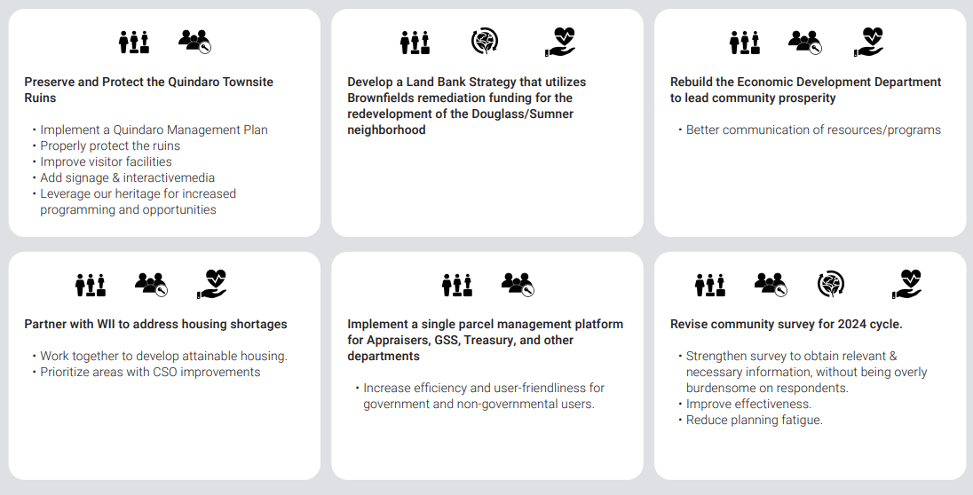
Example Action Items
wycokck.org/planKCK

Slide 25
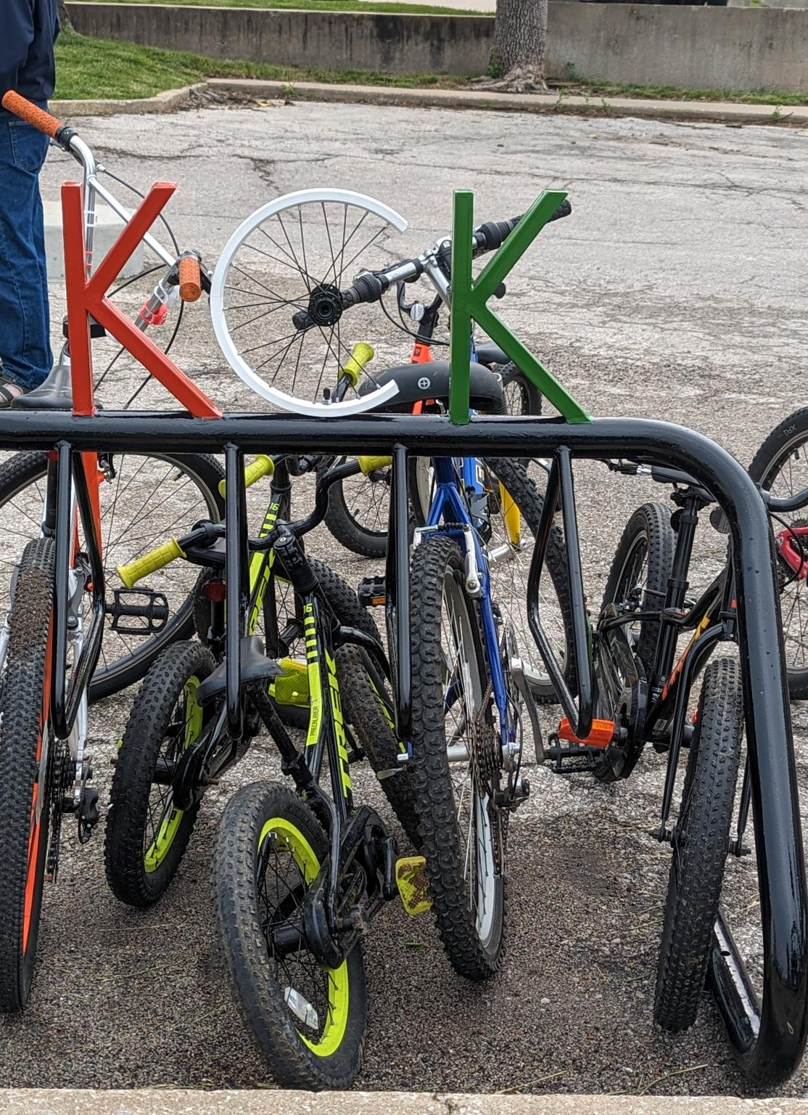
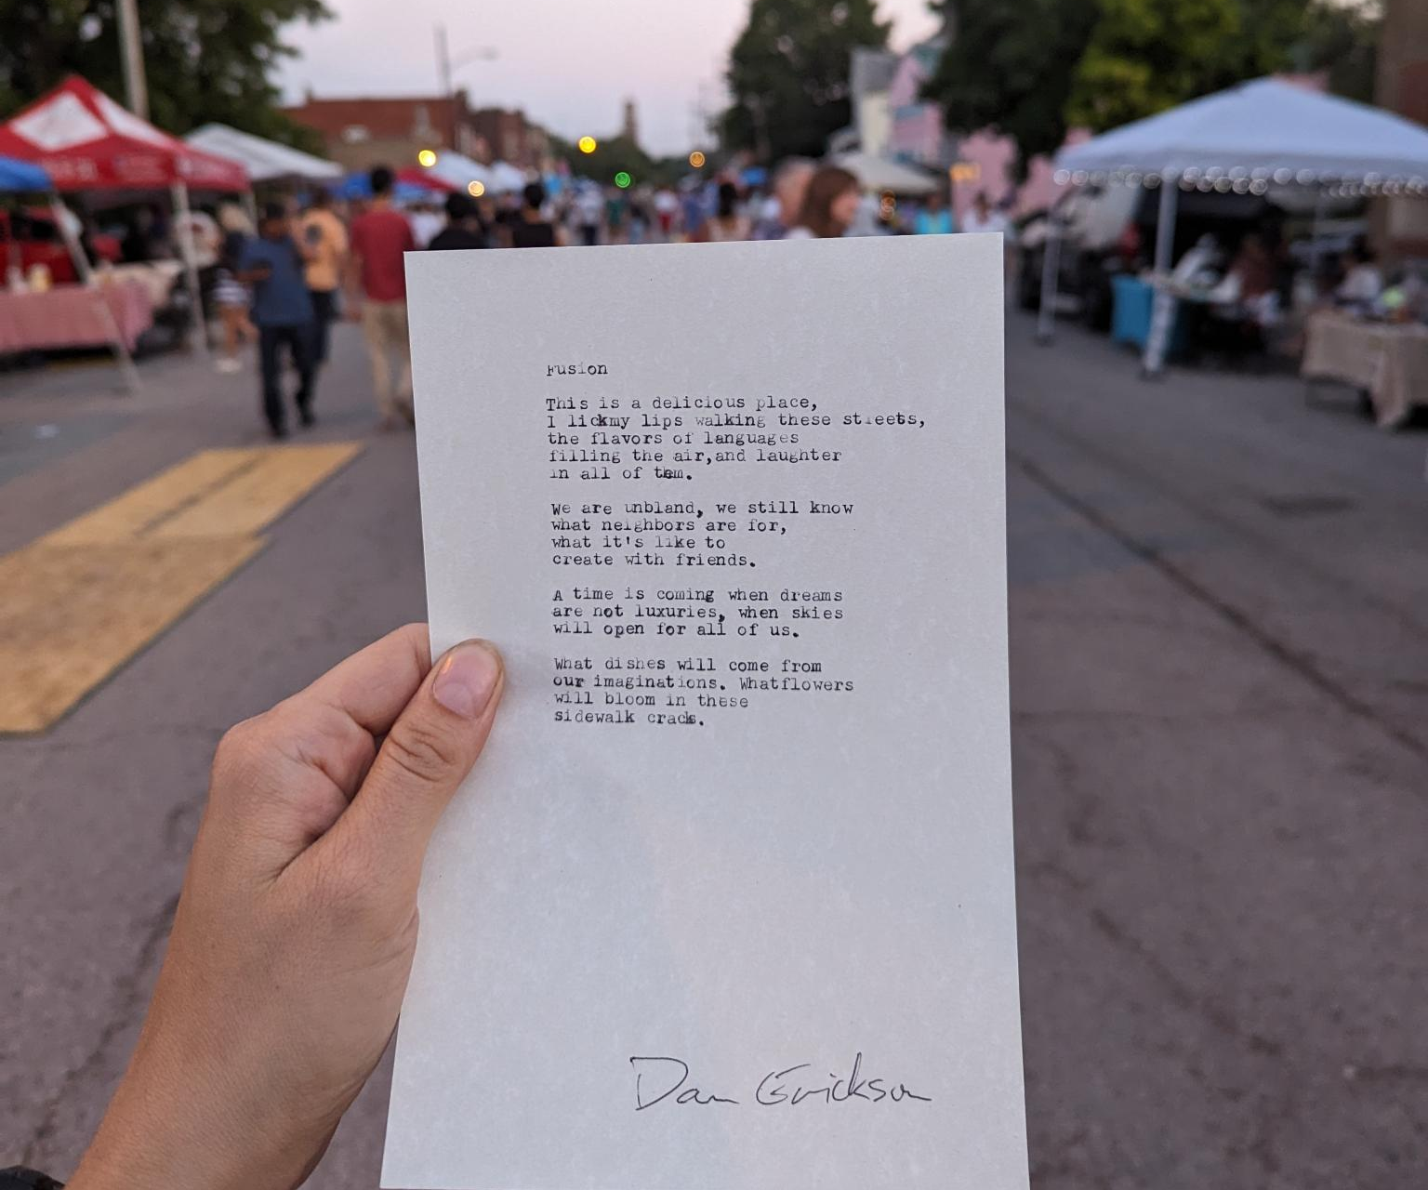
Notes:
And lastly, before I put my planner’s hat back on, I want to share with you a poem written by KCK’s very own, Dan Erickson, at a Third Friday Art Walk when asked to write about KCK’s strengths, and a future that celebrates those strengths. If you’ve ever stopped by a poetry table at an event – it’s a moment when you can ask a poet to write about literally anything. Dan told me he had a poem to finish about Boogie the Pug before he could get to mine. So, right when the sun was setting, I returned to pick up a poem titled “Fusion.” [reads poem]

Slide 26
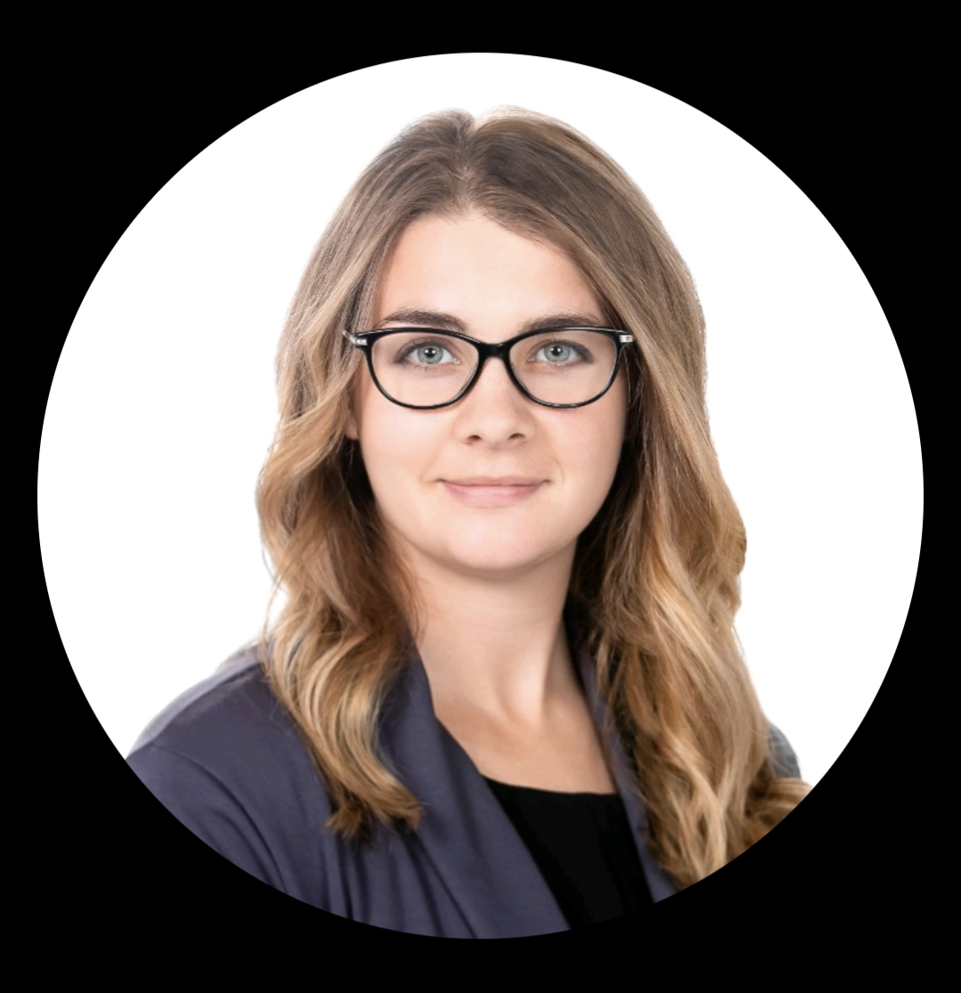
Questions?
Alyssa Marcy Long Range Planner Planning + Urban Design amarcy@wycokck.org
wycokck.org/planKCK
Notes:
Thank you for your time tonight, I would be happy to answer any questions and would love to learn what places in the city are important to you? What do you think deserves to be preserved?

Slide 27
PlanKCK
Approval Process
Board of Commissioners Special Session | October 12
Board of Commissioners Planning & Zoning Hearing | October 26
Planning Commission Meeting Recommendation | November 13
Board of Commissioners Special Session #2 | November 16
Board of Commissioners Planning & Zoning Hearing for Adoption | November 30
Board of Commissioners Hearing | December 7
PAGE | 27
Notes:
I am going to briefly take you through the three step It was first important to establish a vision of prosperity in KCK – what does it mean to have economic prosperity in our community and what might that look like?

Slide 28
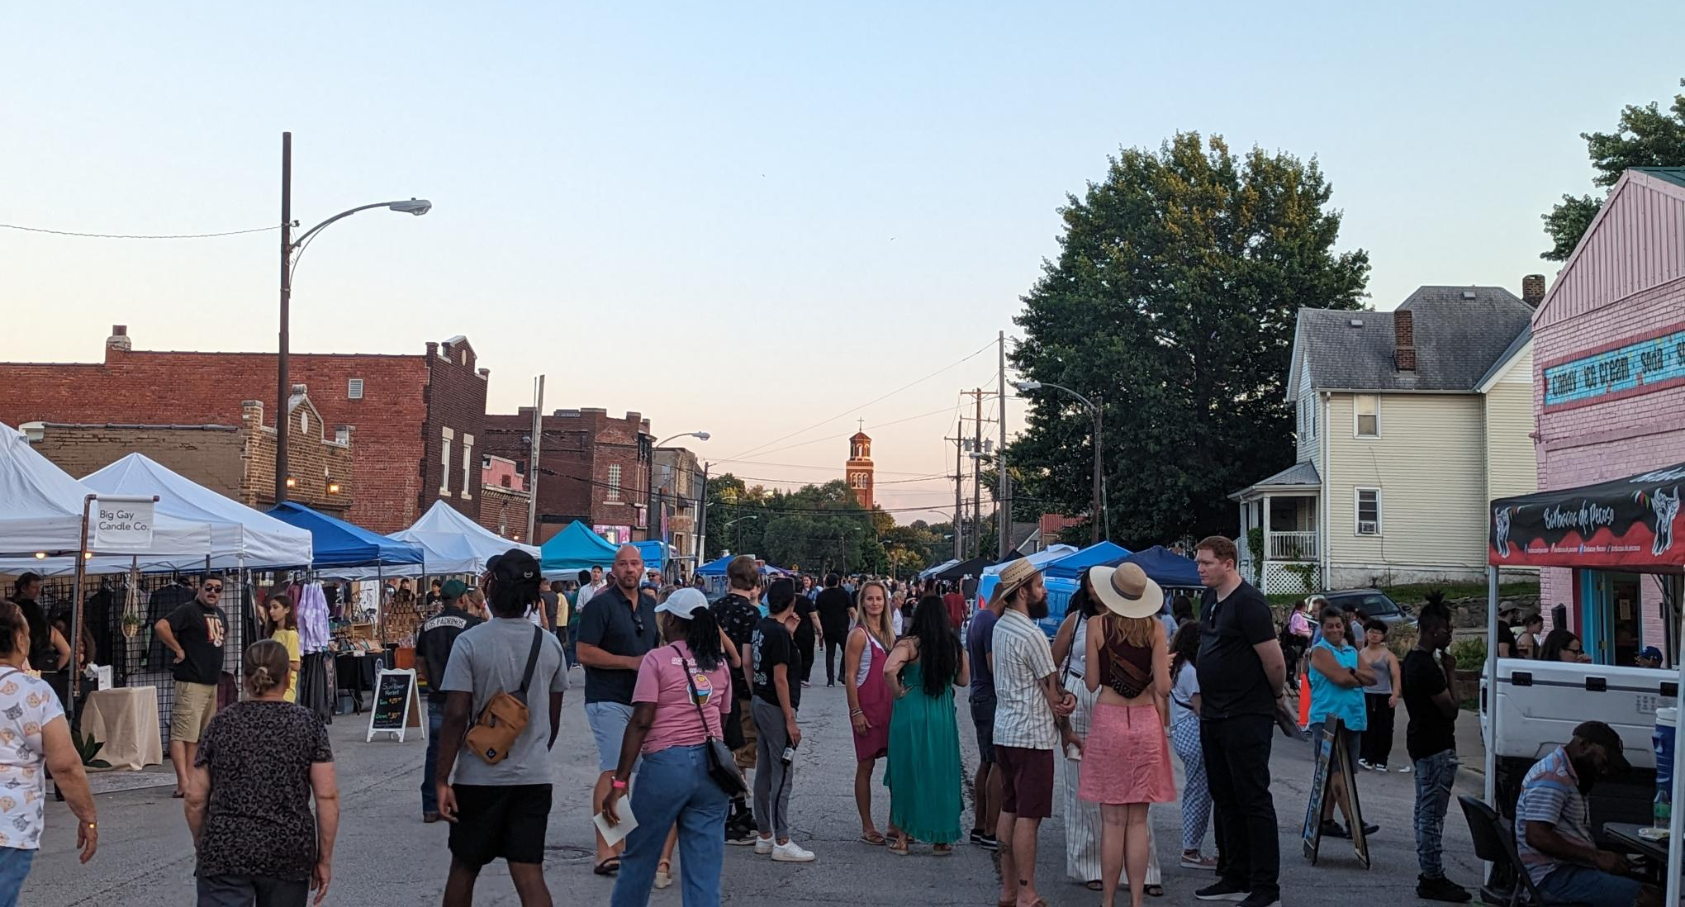
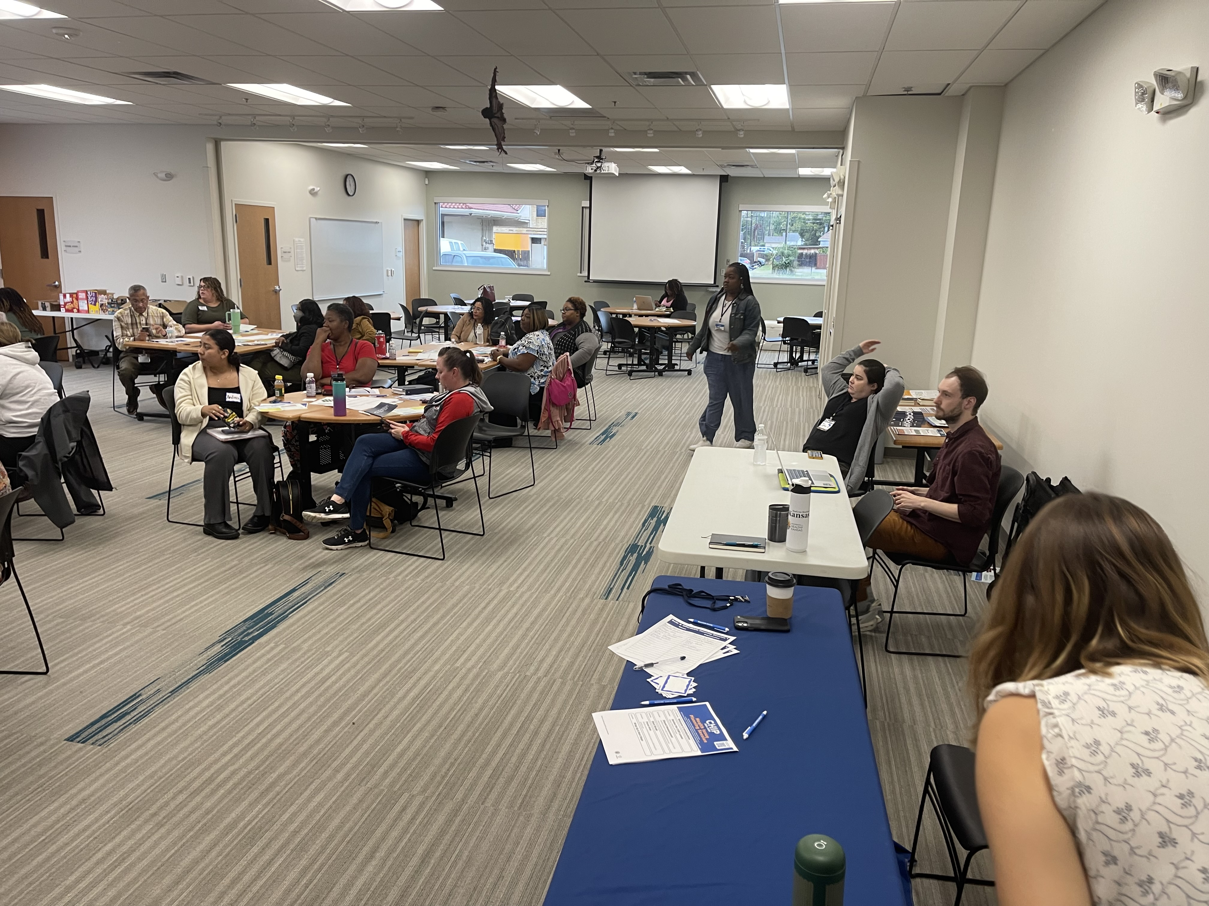
wycokck.org/planKCK
Notes:
We need a clear, united path forward. PlanKCK is the northstar to get us there.

