Slide 1
Y Lofts Project
Economic Development & finance Committee
July 8, 2019

Slide 2
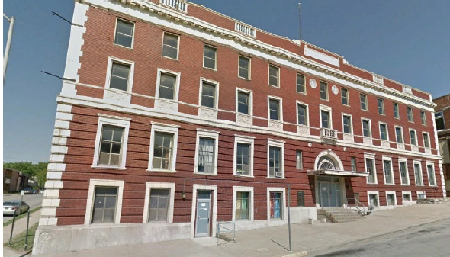
Y Lofts – Major Revitalization

Slide 3
Project Highlights
Prairie Fire Development – Kelley Hrabe, Principle
Investment of approximately $8.9 million
Historic Preservation Tax Credits
Senior living (55+) development of the former YMCA building at 8th & Armstrong
44 units of mixed-income affordable living (between 30%-80% AMI)
Construction to commence in September 2019
Project completion expected in November 2020

Slide 4
NRA – Property Tax Rebate Program
Y Lofts qualify as a Special Project in the NRA Policy
Located in Area 1 (generally east of 635)
Project investment greater than $3 million
Project received historic designation by the State of Kansas
Property Tax Rebate Program
Requires a minimum of 15% assessed value increase
Rebate is 75% and can be increased by 10% for complying with LMW goals
20 years

Slide 5
Action Requested
RESOLUTION: NRA Special Project Application
A resolution approving an NRA Special Project application for the renovation and revitalization of the former YMCA building at 900 North 8th Street.

