Slide 1
COVID-19 Business Town Hall
September 2020

Slide 2
Thank You, Partners!

Slide 3
Agenda
How to respond to COVID in your business
FAQs
Testimonials from Local Businesses
Resources for Employers and Employees
Q & A Session
*Please submit questions anytime in the Q&A box!

Slide 4
Our Panelists
Nicole Garner, MBA, HCA
COVID Program Manager
Unified Government Public Health Department
Janell Friesen, MA
Public Information Officer
Unified Government Public Health Department

Slide 5
Our Panelists
Hailey Shoemaker, MPH, CPH
Epidemiologist
Unified Government Public Health Department
Erin Corriveau, MD, MPH
Deputy Public Health Officer
Unified Government Public Health Department

Slide 6
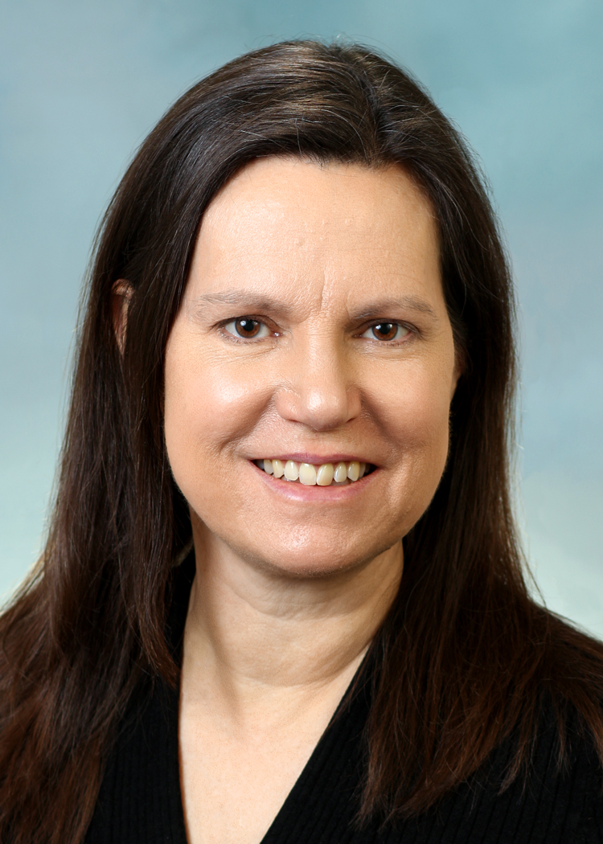
Our Panelists
Kate Webb
Controller
CoreSlab Structures
David Staker
CEO and President
Plastic Packaging Technologies

Slide 7
What to do if an employee tests positive
A step by step guide

Slide 8
My employee has COVID!
1. RESPOND
2. ISOLATE
3. RETURN TO WORK
4. MONITOR

Slide 9
1. RESPOND
Sick employee isolation/Cleaning
Gather Information
Contact the Health Department
Contact Trace

Slide 10
Sick employee isolation + Cleaning
If ill, send home to isolate
Evacuate work area, 24 hrs
Clean employee surfaces
Notes:
Send ill employee home
Evacuate work area, 24 hrs
Clean all surfaces used by employee
*If area can be evacuated for 7 days (e.g. personal office), no cleaning needed
Employee should isolate at home away from other people (more details later)

Slide 11
Gather Information
Date started feeling sick
Date tested
Last day at work
Close contacts at work, carpool, lunch
Notes:
Before calling the health department, gather the following:
When did the employee (student) start feeling sick?
When did the employee get tested?
When was the employee's last day at work?
Did the employee work closely with, carpool with, or eat with anyone else?

Slide 12
Contact the Health Department
Report the information
Hshoemaker@wycokck.org
(913) 573-6733
Ask any questions
HD will give additional guidance

Slide 13
Why Contact Trace?
Prevent spread to vulnerable
Catch people before ill
COVID can spread before you feel sick

Slide 14
Contact Trace
<6', 10 minutes total = close contact
Start two days before symptom onset
Include any day worked sick
=> Any close contacts should quarantine at home for 14 days.

Slide 15
EMPLOYEE QUARANTINE & ISOLATION
2.
Sick/Positive Employees
10 days from symptom onset
72 hours no fever + improvement in symptoms
Contacts of Positive Cases
14 days from last contact
Get tested 7-9 days after exposure
Even if negative test, stay home 14 days
Notes:
Sick/Positive Employees
Minimum 10 day isolation from the onset of symptoms
72 hours no fever, no fever reducing medication
Significant improvement in symptoms
Contacts of Positive Cases
14 day quarantine at home
Get tested 7-9 days after exposure
Even if negative test, stay home 14 days

Slide 16
3. RETURN TO WORK
Meet quarantine/isolation guidelines → return safely
Can ask employee to provide test results
Notes:
After employees meet quarantine and isolation guidelines, they can return to work.
Ask the employee for a return to work letter if you need proof of test results or dates.

Slide 17
4. MONITOR
Increase COVID Mitigation Efforts
Communicate
Monitor and adapt

Slide 18
Increase COVID Mitigation Efforts
Require masks
Refuse entry w/o mask
Paid COVID leave
Symptom screening
Keep employees informed
Sick family members? Stay home!
Notes:
Employee/student masks required
Refuse entry to non-masked customers
Lenient COVID plans (80 hours paid for COVID quarantine/isolation)
Employee symptom screening at the door
Keep employees informed of case count
Employees with sick family members stay home

Slide 19
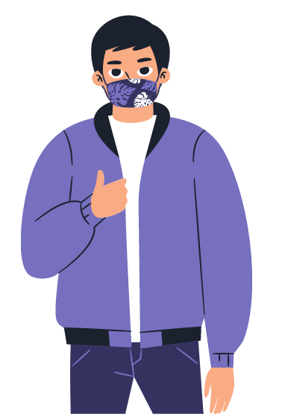
Increase COVID Mitigation Efforts
Employees must wear masks in carpool
Close break rooms
Reduce tables in break rooms
Reduce congregation points

Slide 20
Monitor and adapt
Keep a log of cases and contacts
Report positives to HD
Tricky situations report to HD
Notes:
Keep a log of positive cases, people with symptoms, contacts
When you receive more positive results, report to HD
Tricky situations (household, parties outside of work, etc) report to HD

Slide 21
Business Testimonials
Kate Webb, Coreslab Structures
&
David Staker, Plastic Packaging Technologies

Slide 22
Frequently Asked Questions

Slide 23
When should you send an employee to get tested?
If symptomatic, get tested immediately. (9AM-3PM, 619 Ann Ave.)
If exposed:
Seek testing 7-9 days after exposure.
Kucirka, L. M., Lauer, S. A., Laeyendecker, O., Boon, D., & Lessler, J. (2020). Variation in False-Negative Rate of Reverse Transcriptase Polymerase Chain Reaction–Based SARS-CoV-2 Tests by Time Since Exposure. Annals of Internal Medicine, 173(4), 262–267. https://doi.org/10.7326/m20-1495

Slide 24
Employee Re-Testing?
If positive, do not re-test.
If negative, re-test if:
New exposure
New symptoms
Notes:
If negative, re-test if:
The person has returned to work and was exposed again
The person has developed new symptoms

Slide 25
Exposed employee gets negative test result -come back to work immediately?
No
Remain at home for 14 days
Full quarantine period
Exposure
Get tested
Return to Work
Notes:
Yes, you can and should require employees to get tested if they were exposed to COVID or have symptoms
Be careful of faulty/fake test results- check with UGPHD

Slide 26
Do I need to shut down my business and get everyone tested?
Likely, no
Only close contacts need to quarantine
If enough non-exposed employees are available, you can remain open with those employees
Exposed
Not Exposed
COVID- Positive
Quarantine
No quarantine
Notes:
Yes, you can and should require employees to get tested if they were exposed to COVID or have symptoms
Be careful of faulty/fake test results- check with UGPHD

Slide 27
Can an employer require an employee to get tested?
No
Can require employees to stay home per guidelines if the employee does not want to be tested
Notes:
Yes, you can and should require employees to get tested if they were exposed to COVID or have symptoms
Be careful of faulty/fake test results- check with UGPHD

Slide 28
How can I get a letter/proof of test results for my employee?
If the positive test was <14 days ago:
Reach out directly to UGPHD, (913) 573-6733
We can confirm / send a letter to you directly
If the test was negative or >14 days ago
We can send a letter to the employee only
Notes:
If the positive test was <10 days ago: reach out directly to UGPHD, (913) 573-6733, and we can confirm / send a letter to you directly
If the test was negative or >10 days ago, we can send a letter to the employee via email or USPS

Slide 29
Can I just follow the CDC guidelines and be OK?
Only if
you are fire response, police, a hospital, or other direct health care provider
AND you cannot keep the business open without having exposed persons at work
Defer to Wyandotte County Health Department
Notes:
Only if you are fire response, police, a hospital, or other direct health care provider AND you cannot keep the business open without having exposed persons at work
Defer to the guidelines of the Wyandotte County Health Department

Slide 30
Exceptions to the 14-day quarantine for essential businesses?
Only hospitals/direct patient care, firefighters, police, EMS, and other first responders are exempt
All other businesses MUST quarantine exposed employees for 14 days
Notes:
Only hospitals/direct patient care, firefighters, police, EMS, and other first responders are exempt
All other businesses MUST quarantine exposed employees for 14 days UNLESS both employees wore fit-tested N-95 masks at time of exposure

Slide 31
Resources
For Employers and Employees

Slide 32
Employer Resources
KeepWyCoWell.com

Slide 33
Employer Resources
CARES Act
https://alpha.wycokck.org/UG-CARES-Act-Working-Group
https://home.treasury.gov/policy-issues/cares

Slide 34
Employee Resources
www.healthcare.gov
If you have recently moved, gotten married, or lost insurance, you can sign up for a government-subsidized health insurance plan right away
3-1-1 (913-573-5311)
COVID questions and assistance
Community Health Workers
Also can answer many employer questions
Notes:
Resources on our website for businesses, including our business toolkit
Resources for individuals, such as:
-Testing info
-Food needs request
-Resource list for wide array of resources, updated weekly
-Can also get assistance by calling 3-1-1

Slide 35
Employer and Employee Resources
wycokck.org/COVID-19
Notes:
Resources on our website for businesses, including our business toolkit
Resources for individuals, such as:
-Testing info
-Food needs request
-Resource list for wide array of resources, updated weekly
-Can also get assistance by calling 3-1-1

Slide 36
Questions?
Thank you!
Type questions into the Q&A.

