Slide 1
Boulevard Lofts Project
Economic Development & finance Committee
July 8, 2019

Slide 2
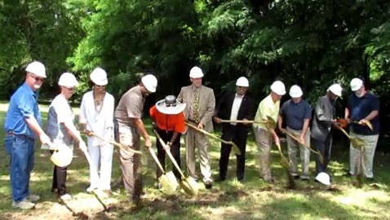
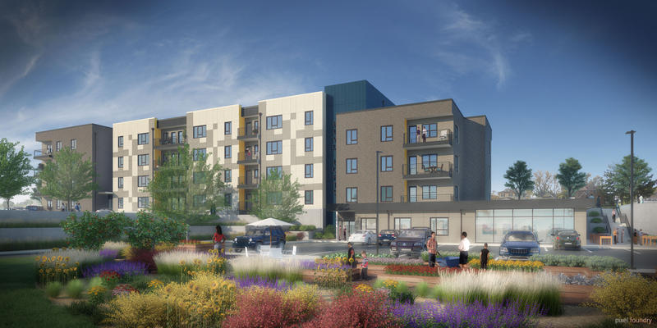
Boulevard Lofts

Slide 3
Project Highlights
Co-developers: Prairie Fire Development & CHWC
Located on Washington Boulevard between 7th & 8th Street
Investment of approximately $11 million
50 units of mixed-income living
Affordable Housing tax credit project – 80% of units will be income-restricted and 20% will be market rate (between $500 to $1,100 a month)
Construction to commence in July 2019; Project completion in late summer 2020
First new housing development in downtown in decades

Slide 4
Property Tax Reimbursement
Boulevard Lofts Project has received no assistance from the UG prior to this request
KHRC approved rent structure but investor reduced rates due to lack of comps
Resulted in a last minute shortfall in financing
BPU awarded project with $250,000 from their Economic Development Fund
Project requested some property tax reimbursement from the UG to make up the remaining shortfall

Slide 5
Property Tax Reimbursement Structure
Reimbursement affects solely the 46.28% UG portion of property tax
If annual gross rent is less than or equal to Investor approved rent, then receive a reimbursement of 100% of the UG property tax portion.
If annual gross rent in between the Investor approved rent and the KHRC approved rent, then receive a reimbursement of 75% of the UG property tax portion.
If annual gross rent is greater than or equal to KHRC approved rent, then receive a reimbursement of 50% of the UG property tax portion.
Up to 10 years with a $200,000 reimbursable project cost cap
Required compliance with LMW goals or reimbursable project cost cap decreases 25%

Slide 6
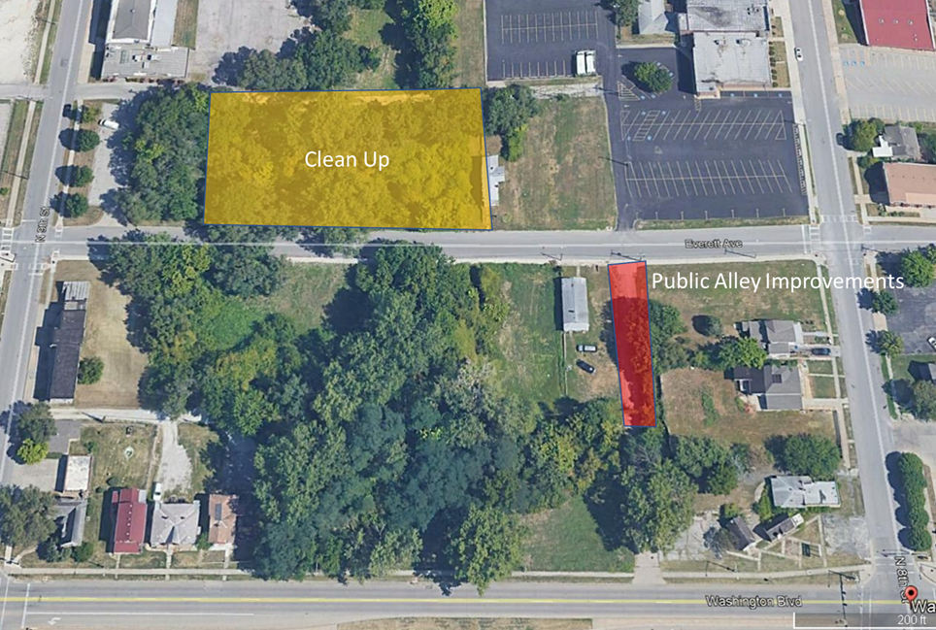
Property Tax Reimbursement

Slide 7
Action Requested
ORDINANCE/RESOLUTION: Home Rule Economic Development Incentive and Development Agreement for the Boulevard Lofts Project
Ordinance and Resolution approving and adopting a Home Rule Economic Development Incentive and adopting the development agreement for the Boulevard Lofts Project.

