Slide 1
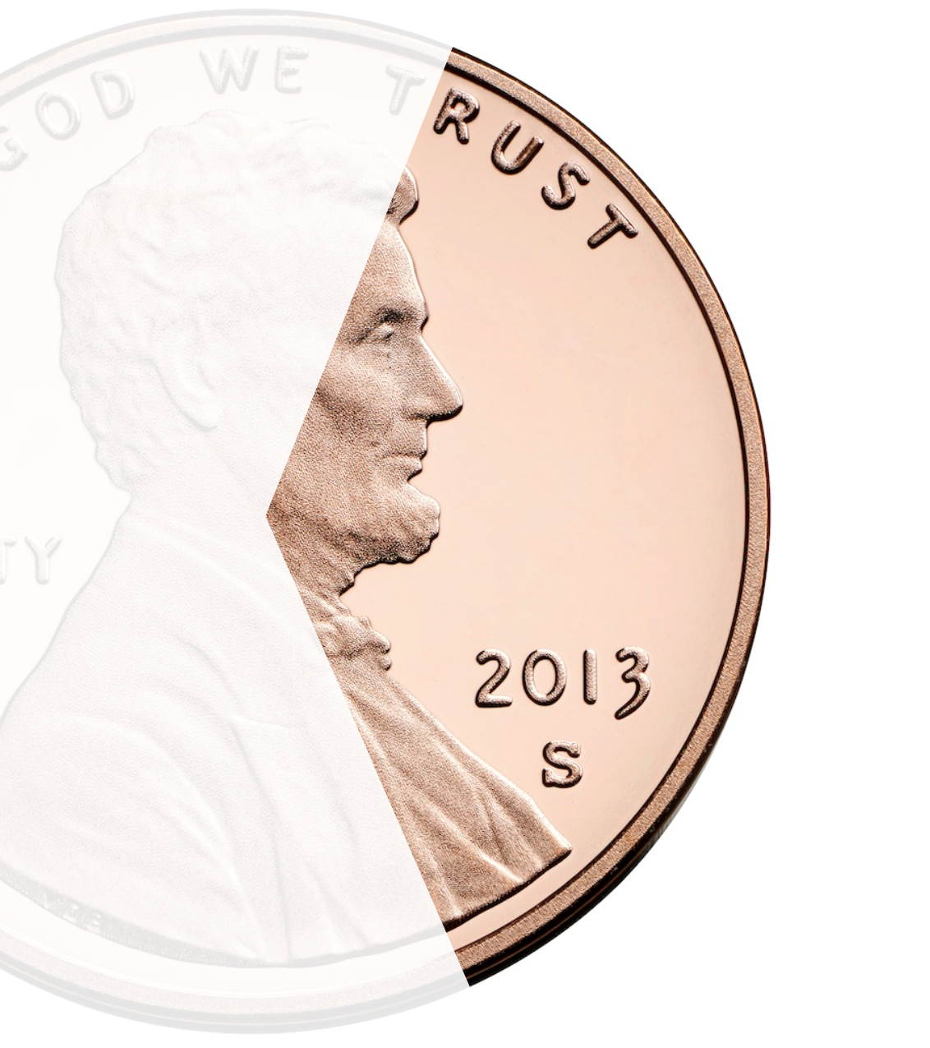
Public Safety & Neighborhood Infrastructure Dedicated Sales Tax continuance
Unified Government of Wyandotte County & Kansas City, Kansas
KCK Chamber Legislative Meeting
May 11, 2018

Slide 2
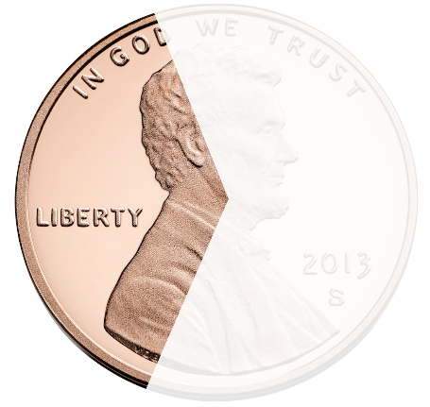
Investing in Our Future: what sales tax continuance means
If approved by voters, the Public Safety & Neighborhood Infrastructure sales tax continuance will:
NO TAX INCREASE – Maintain the current sales tax rate
Dedicate 3/8th cent to Public Safety & Neighborhood Infrastructure
August 7, 2018 election
Continues from July 1, 2020 – remains in effect for ten years
Expenditures approved annually by the Board of Commissioners

Slide 3
History of the Public Safety & Neighborhood Infrastructure dedicated sales tax
Passed in April 2010 with 70% voter support
City tax – only collected within Kansas City, Kansas
10 year original term, expires June 30, 2020
Collection started July 1, 2010
More than $54M collected to date, expect $80M by 2020
Funds can only be used for public safety and neighborhood infrastructure as specified in the ballot language

Slide 4
Where does the sales tax come from?
All retail sales within Kansas City, Kansas collect the dedicated 3/8 cent tax
Village West receives 12 million visitors per year - sales tax is paid by tourists and visitors, benefitting all KCK residents
Continuance of the Public Safety and Neighborhood Infrastructure dedicated sales tax will keep sales tax rate unchanged

Slide 5
Kansas city Kansas current sales tax
9.125%

Slide 6
Sales Tax Compared to other areas

Slide 7
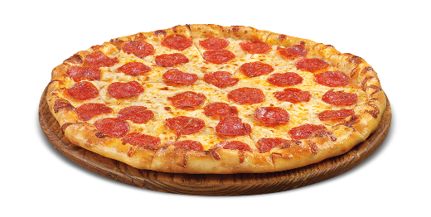
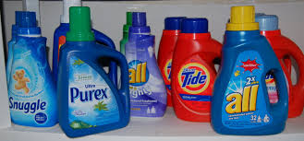
How much does 3/8 cent cost?
$15 Large Pizza = 6¢
$2.50 Coffee = 1¢
$12 Laundry Detergent = 5¢
$100 groceries = 38¢
$20 clothing = 8¢

Slide 8
2018 dedicated sales tax allocation
Neighborhood Infrastructure
Fire
Police
35%
30%
35%
$3.9 Million
$3.3 Million
$3.9 Million

Slide 9
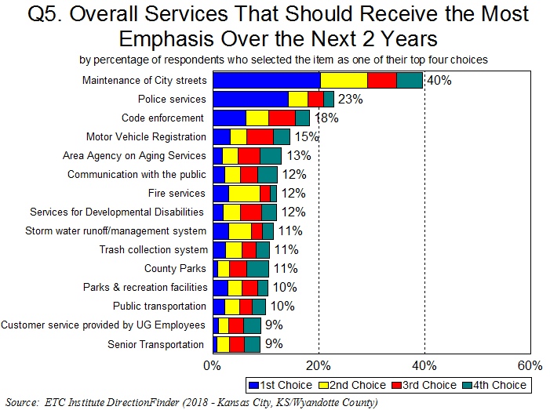
Resident survey: Services that should receive the most emphasis over next two years
#1 Priority – Streets
#2 Priority – Police

Slide 10
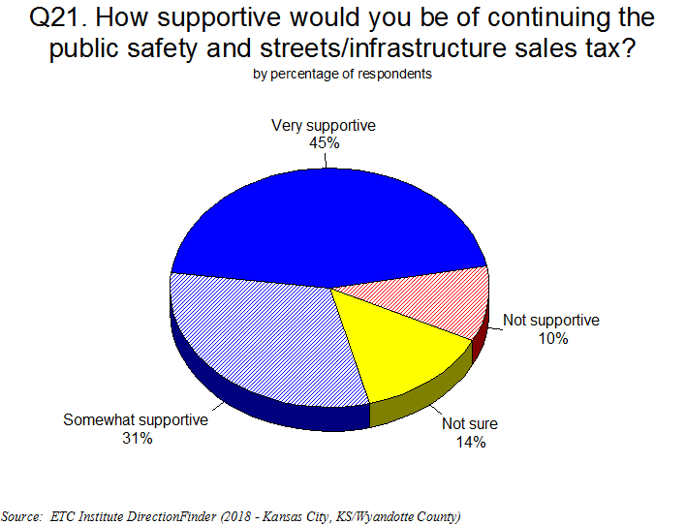
Resident support for continuance
2018 Resident survey
76% of residents supportive of continuing dedicated sales tax

Slide 11
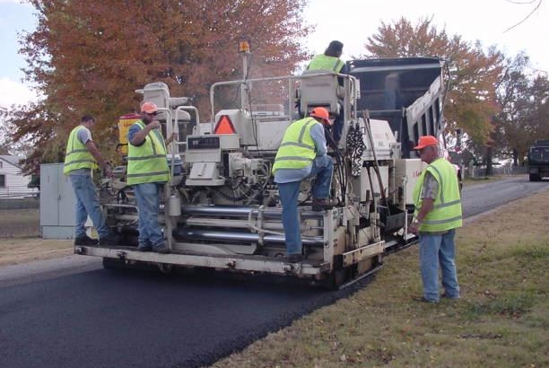
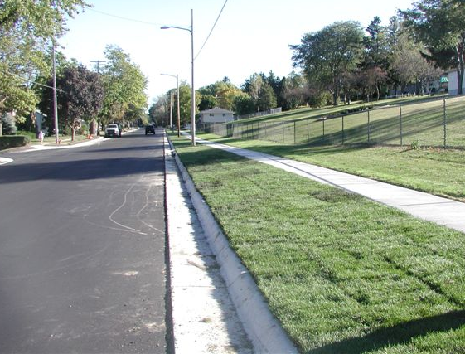
Neighborhood Infrastructure
Streets
Commission neighborhood improvement projects (CNIP)
Safe routes to schools
Community centers
Curbs
Sidewalks
Parks

Slide 12
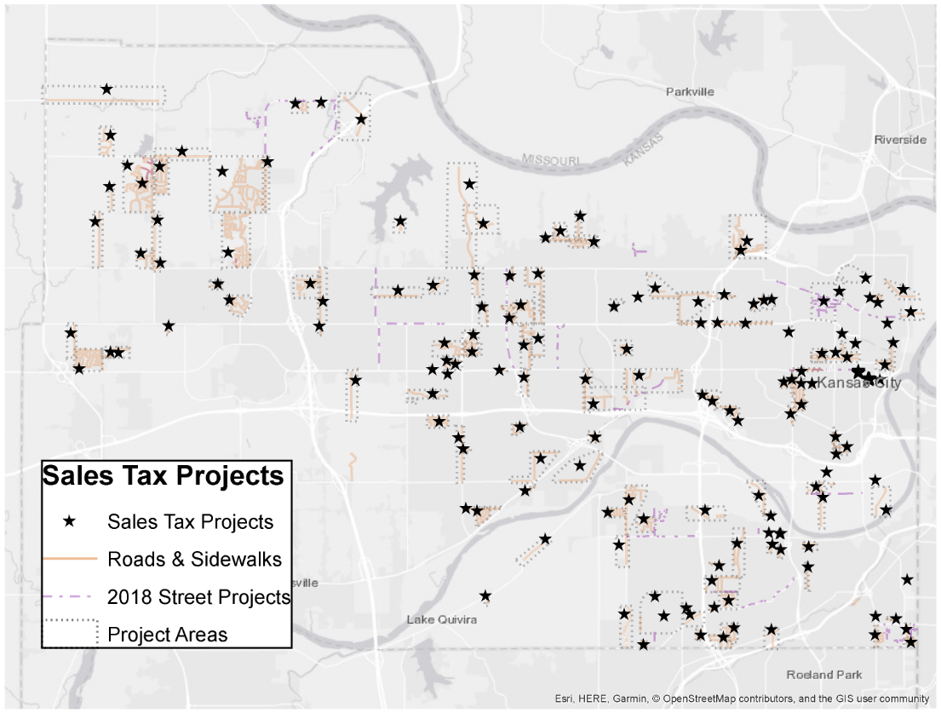
Map of Infrastructure Projects

Slide 13
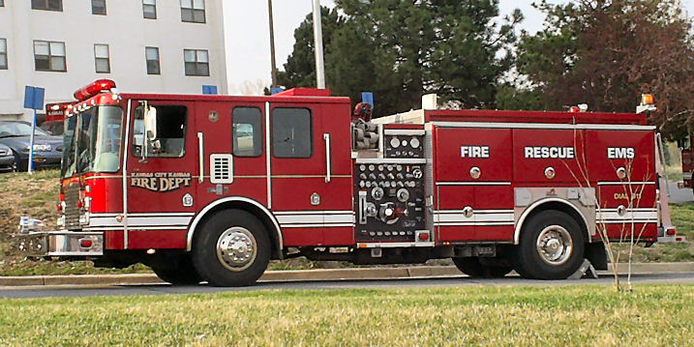
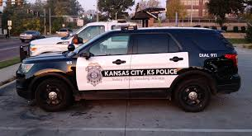
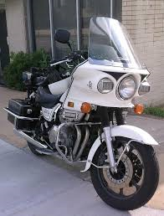
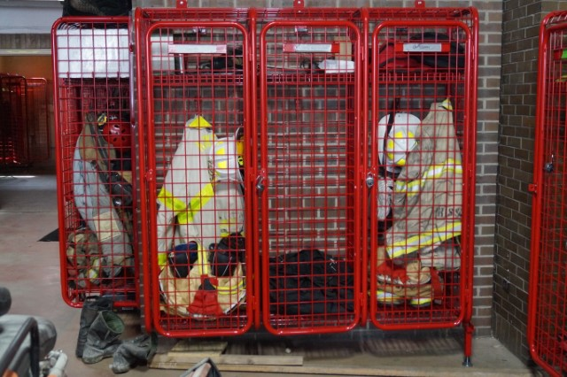
Public Safety Equipment
50 Police Patrol Vehicles
15 Fire vehicles and ambulances
8 Police motorcycles
Police vehicle and body cameras

Slide 14
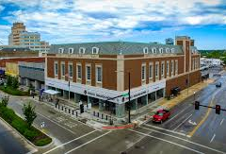
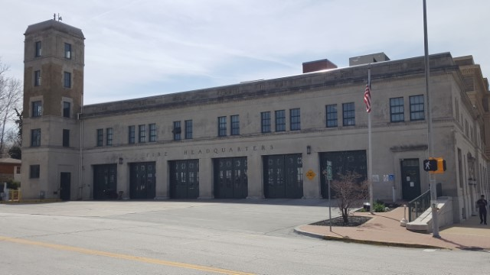
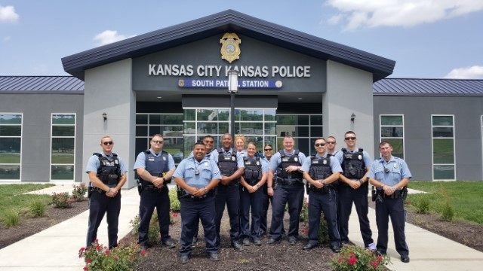
Public Safety Facility improvements

Slide 15
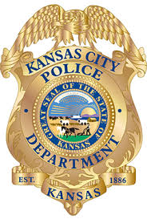
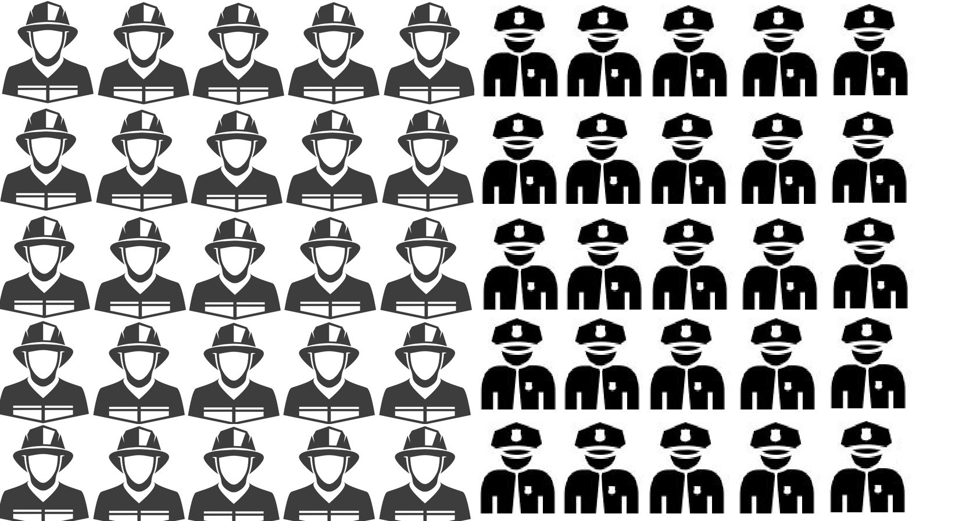
Public Safety Operations
Sales tax maintains funding for 50 public safety positions annually
25
Fire
Personnel
25.25
Police
Personnel

Slide 16
How is the dedicated sales tax managed? Where is the accountability?
UG Commission approves all appropriations
UG Commission reviews revenues and expenditures annually
Residents have input into annual budget
Expenditure information is available on UG open-data website – www.wycokck.org/SalesTax

Slide 17
Recap of Public Safety & Neighborhood Infrastructure Dedicated Sales Tax
NOT A TAX INCREASE – retains current 3/8 cent dedicated sales tax
Paid by millions of annual visitors
Generates over $10 million annually
Funds Neighborhood Infrastructure improvements, including streets, sidewalks, safe routes to schools, and parks
Funds Police and Fire operations, facilities, equipment & technology
10-year continuance period – July 1, 2020 through June 30, 2030
www.wycokck.org/SalesTax

Slide 19
Ballot Language
Shall the City of Kansas City, Kansas be authorized to impose an additional three-eighths of one percent citywide retailers’ tax, the proceeds of which shall be used for the purposes of financing Public Safety operations and Neighborhood Infrastructure improvements, including the construction, repair, and maintenance of roads, curbs and sidewalks, the collection of such Sales Tax commencing on July 1, 2020, or as soon thereafter as permitted by law, and terminating ten years after its commencement?

