Slide 1
Economic Development Strategic Plan Process Update Aug 31, 2023 Alyssa Marcy – Planning + Urban Design
Notes:
Overview of community engagement and input and draft strategy development to date. This component of PlanKCK is led by the FutureIQ consultant team.

Slide 2
A VISION FOR COMMUNITY PROSPERITY IN KCK
STEP 1
Notes:
I am going to briefly take you through the three step It was first important to establish a vision of prosperity in KCK – what does it mean to have economic prosperity in our community and what might that look like?

Slide 3
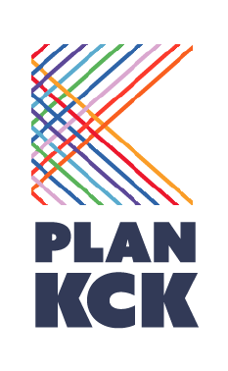
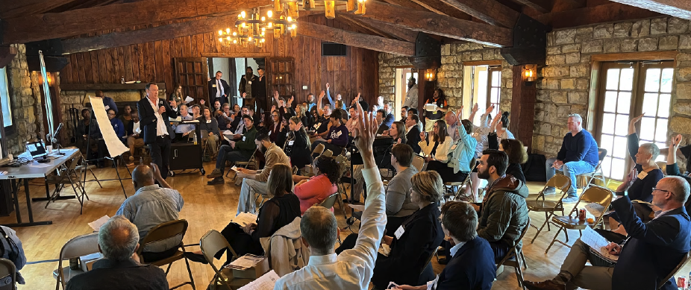
PlanKCK
Vision Summit – May 16, 2023
Notes:
The kick off for the economic development strategy began in May 2023 with the Vision Summit. This engagement event invited community members, business owners, developers, and government staff to explore different economic futures.

Slide 4
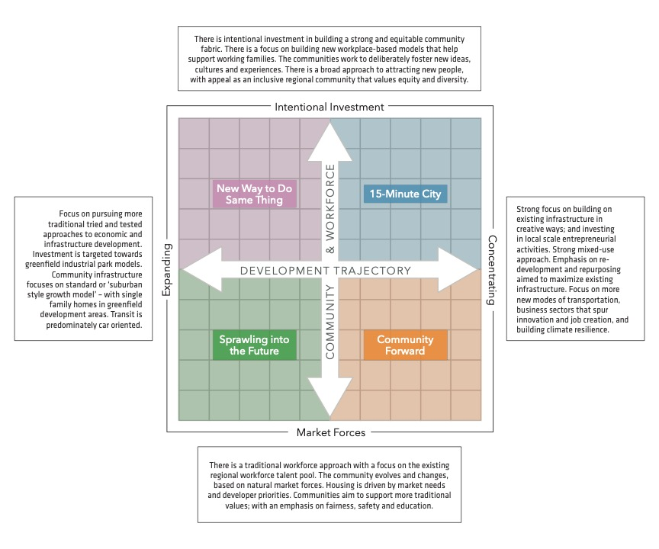
PlanKCK
Vision
Summit
Explored Future Options and Scenarios
Notes:
Vision Summit asked participants to partake in an exercise to define very different economic futures, challenging community members to think about how different economic approaches might look.

Slide 5
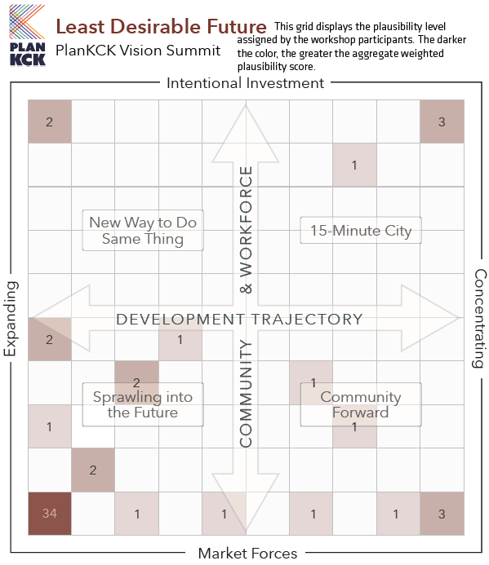
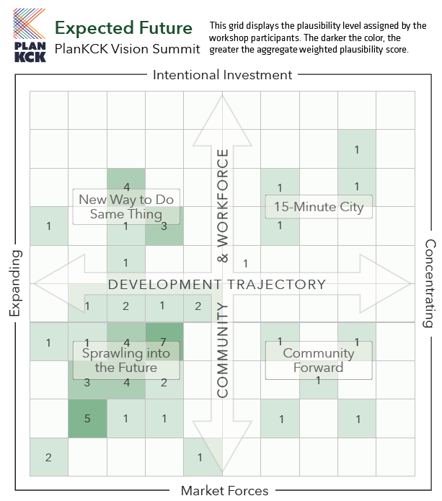
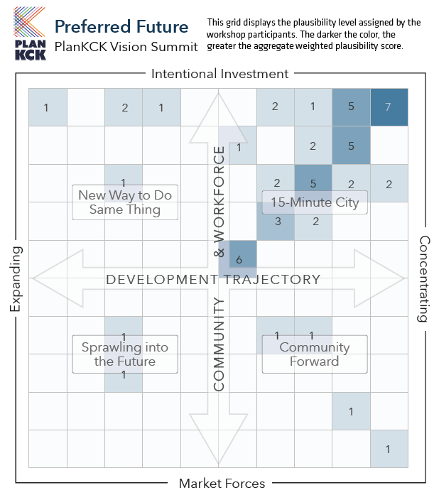
STRONG DESIRE FOR LOCAL NEIGHBOURHOOD REGENERATION
Creating the 15-minute City concept
Notes:
From here, attendees were asked to select their least desired future, the expected future if we continue on our current path, and a preferred future. Once all information was aggregated, it showed that our expected future differs drastically for our current future. Not only that, but it shows that the community has appetite for change.

Slide 6
Focus Groups and Surveys July - August, 2023
STEP 2
Notes:
From here, FutureIQ held multiple focus groups with developers, business owners, and economic development organizations across Wyandotte County. A bilingual small business survey was also circulated.

Slide 7
Notes:
The focus groups themselves looked at six “strategic pillars” six areas or topics identified as important elements to an economic development strategy, particularly as they relate to the preferred future identified at the Vision Summit. These pillars were selected based on the results of stakeholder interviews and market trends.

Slide 8
Community Prosperity Roundtable August 14, 2023
STEP 3
Notes:
Following the focus groups, the Community Prosperity summit served as the final economic development specific event for PlanKCK.

Slide 9
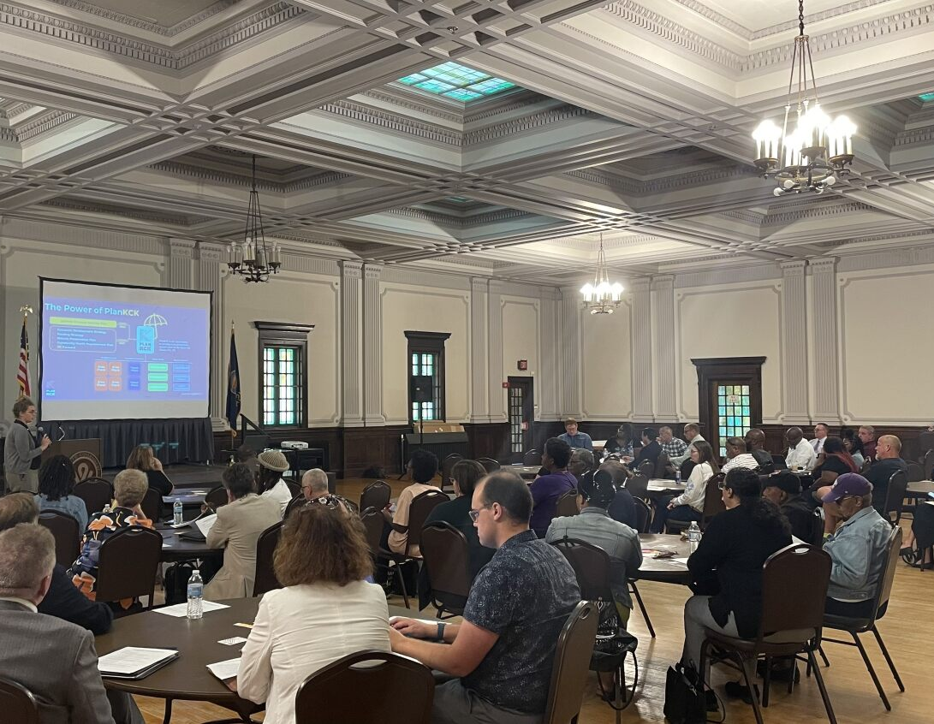
Community Prosperity Roundtable BUILDING BLOCKS for a RESTORATIVE and REGENERATIVE ECONOMY in KCK
Notes:
The strong desire of the community is increasing economic development that benefits all community members, revitalizes our neighborhoods, and equitably distributes benefits. We reviewed results of the countywide market analysis, which will be finalized by the end of this month, and asked attendees to prioritize actions related to the strategic pillars.

Slide 10
Community Prosperity Roundtable
Strong support for small business development and entrepreneurship
Desire to better connect Legends/Village West with urban core
Downtown KCK and Main Street are seen as key to regeneration of community and economy
Interest in fostering a ‘River City’ approach including affordable housing
High interest in historic preservation, specifically Quindaro Townsite and its cultural importance and economic potential
Notes:
Overall, there was an overwhelming desire to support small business, to build up both Downtown KCK and the Legends area but connect the two. There was also a lot of interest in building up along the river and making that regional connection as well. Another important theme in the discussion was the importance of cultural heritage related to the Quindaro ruins and townsite.

Slide 11
Notes:
On

Slide 12
Feedback?
Alyssa Marcy Long Range Planning UG Planning + Urban Design amarcy@wycokck.org
wycokck.org/planKCK
Notes:
On

