Slide 1
Title VI Program Overview
Unified Government Transportation Department

Slide 2
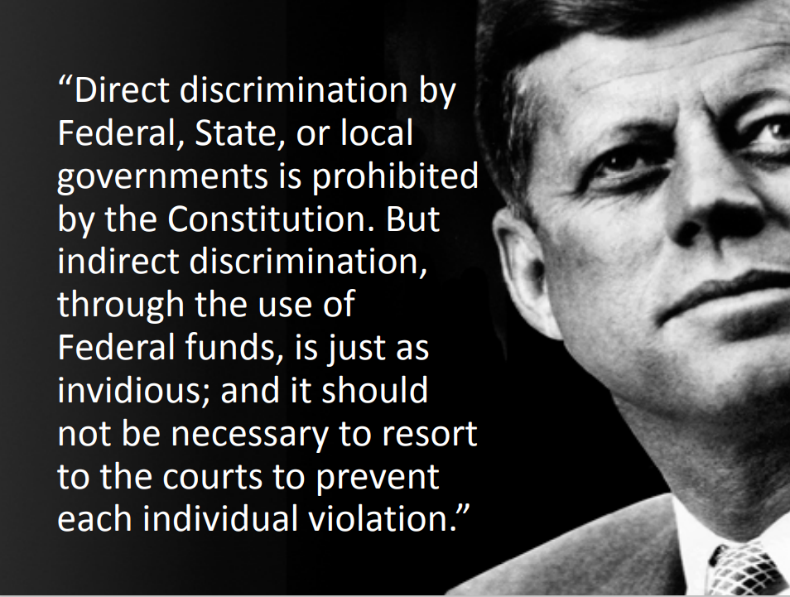
AGENDA
Title VI of the Civil Rights Act
Additional Related Nondiscrimination Authorities
Discrimination
Who is protected
Ensure Compliance
Penalties for Non-Compliance
Assurances
Complaint Process
Reporting Process
2

Slide 3
Title VI of the Civil Rights Act
The Civil Rights Restoration Act of 1987
Clarified the original intent of Congress for Title VI
Written to include ALL programs and activities of Federal-Aid recipients, sub-recipients and contractors
Applies to programs and activities whether they are federally assisted or not
Heart of Title VI: No person in the United States shall, on the grounds of race, color, or national origin, be excluded from participation in, be denied the benefits of, or be subjected to discrimination under any program or activity receiving Federal financial assistance.
Discrimination: Within the Civil Rights context, discrimination is an act (action or inaction), whether intentional or unintentional, through which a person in the United States is subjected to disparate treatment or impact because of their race, color, national origin, sex, age, religion, or disability.
Implementing Regulations
49 CFR 21 (USDOTs Regulation)
23 CFR 200 (FHWAs Regulation)
FDOTs Title VI Policy
FDOTs Title VI Assurances
FDOT Procedure 275-010-010
49 CFR Part 303 (FMCSA Regulation)
CEO

Slide 4
Nondiscrimination Laws and Executive Orders
• Title VI of the Civil Rights Act of 1964*
• Civil Rights Restoration Act* (1987)
• Rehabilitation Act (1973)
• American with Disabilities Act (1991)
• Age Discrimination Act (1975)
• Uniform Act (1970)
• Federal Aid Highway Act (1973)
• Executive Order – 13166: Limited English Proficiency (LEP)
• Executive Order - 12898: Environmental Justice (EJ)
CEO

Slide 5
What is Discrimination?
The act (action or inaction), whether intentional or unintentional, through which a person in the U.S. solely because of distinguishing protected attributes is subjected to disparate treatment or impact, in any program or activity receiving Federal financial assistance from FHWA Under 23 USC and FMCSA under 49 USC.
CEO

Slide 6
Types of Discrimination
•Denial of Program Service, Financial Aid, or Benefits
•Providing Different Types of Program Services, Financial Aid
•Providing Groups Services in a Different Manner
•Segregating or separately treating Individuals or groups in any matter relating to the receipt of any program service, financial aid or benefit
•Imposing impacts to groups for the benefit of another group
CEO

Slide 7
Disparate Treatment
Refers to actions that result in situations where similarly situated persons are intentionally treated differently than others because of their race, color, national origin, etc.

Slide 8
Disparate Impact
Refers to actions in which the recipient, in violation of agency regulations, uses an unbiased procedure or practice that has adverse effects on members of a group based on race, color, national origin, etc.; such practice lacks a substantial legitimate justification.

Slide 9
Who is protected
Individuals
Community Groups
U.S. Citizens
All people documented and undocumented

Slide 10
Compliance
Who MUST comply?
Recipients of federal financial aid must comply with the various Title VI nondiscrimination laws and regulations.
A recipient is any entity or individual to whom Federal assistance is provided (23 CFR 200.5(n)).
Subrecipients and contractors, regardless of tier, are REQUIRED to prevent discrimination and ensure nondiscrimination in all of their programs and activities.
Federal aid or Federal assistance can be in the form of:
• A grant and direct funding
• Grant or donation of Federal property
• Equipment and training
• Detail of Federal personnel
• Sale, lease, permission to use Federal property

Slide 11
Compliance
In order to be in compliance with Title VI sub-recipients and contractors must:
• Appoint a Title VI Program Coordinator
• Develop a Title VI Implementation/Program Compliance Plan
• Limited English Proficiency
• Environmental Justice
• Public Participation Plan
• Provide Title VI training for all of its employees
• Develop a Title VI Program Policy Statement
• Have signed Title VI Program Assurance document
• Have a grievance/complaint procedure in place
• Monitor sub-recipients and sub-contractors for Title VI Program
compliance

Slide 12
How do we ensure compliance with title vi
We must make sure all recipients receive:
Equal Treatment
Equal Access
Equal Rights
Equal Opportunities
This should be the case regardless of the recipient’s race, color, or national origin, which includes any applicable limited English proficiency!

Slide 13
Penalties for Non-Compliance with Title VI
Failure to comply with Title VI Program requirements may lead to:
Federal funds being withheld from Wyandotte County until compliance is achieved and/or
Federal funds being canceled, terminated, or suspended in whole or in part.
Compliance is necessary! Failure to comply will result in a detrimental impact on services provided to Wyandotte County citizens.

Slide 14
Unified Government Policy Assurances
Unified Government of Wyandotte County/Kansas City, Kansas (UG) certifies its commitment to ensure that no person shall on the basis of race, color, national origin, sex, age, disability, low income, or Limited English Proficiency (LEP) be excluded from participation in, denied benefits of, or otherwise be subjected to discrimination under any and all programs, services, or activities administered by UG. As a recipient of federal financial assistance, UG will ensure full compliance with Title VI of the Civil Rights Act of 1964; comply with 49 C.F.R. part 21 and 49 C.F.R. part 303 and all related nondiscrimination authorities.
The Civil Rights Restoration Act of 1987 clarified Title VI and related nondiscrimination authorities to specify that entire institutions receiving Federal Funds must comply with Federal civil rights authorities, rather than just the particular programs or activities that receive funds.
Unified Government of Wyandotte County/Kansas City, Kansas gives this ASSURANCE in consideration of and for obtaining any Federal grants, loans, contracts, agreements, property, and/or discounts, or other Federal-aid and Federal financial assistance

Slide 15
Title VI Complaint Process
If you are contacted or informed that someone would like to file a Title VI complaint, please explain the process and provide the relevant forms without hesitation.
All complaints must be in writing and signed by the complainant! The forms are available in Appendix F of the Title VI plan, by website at https://www.wycokck.org/Departments/Transportation or by calling 913-573-8351.
Forms can be completed and submitted online at https://www.wycokck.org/Departments/Transportation
Complaints must be received within 180 days of the alleged incident.
If the complainant needs language assistance, UGT will coordinate translation services.
The complaint form must be completed in its entirety. The information requested is necessary to process the complaint. Assistance with completing the form is available upon request.
Forms can be mailed and/or emailed.

Slide 16
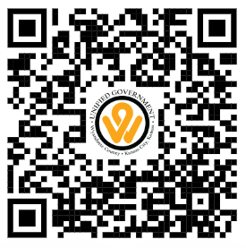
REPORTING A TITLE VI VIOLATION OR COMPLAINT
Please forward all Title VI violations or complaints to:
Unified Government Transportation Department
Deasiray Bush, Transportation Director & Title VI Coordinator
5033 State Avenue
Kansas City, Kansas 66104
Email: UGTransit@wycokck.org
Telephone: 913-573-8351
For more information, please review UGT website or scan QR code
Website: https://www.wycokck.org/Departments/Transportation

Slide 17
Limited English Proficient (LEP) Persons – Public Participation Plan
UGT is committed to including Limited English Proficiency (LEP) individuals in the public participation process; specific actions include:
On all public notices, include a statement where interpretation or other communication aids can be provided with advance notice. This statement will be provided in Spanish as well as English.
Advertise public participation opportunities with media organizations that reach minority and ethnic populations to help ensure representation in the planning process.
If a proposed service change will impact a geographic area that is known to have a large LEP population, UGT will coordinate with municipal governments and community organizations to determine needed language assistance measures and translation services.

Slide 18
Title vi Educational video

Slide 19
Unified Government Transportation Department
Unified Government Transportation Department
Deasiray Bush, Transportation Director & Title VI Coordinator
5033 State Avenue
Kansas City, Kansas 66104
Email: UGTransit@wycokck.org
Telephone: 913-573-8351
Website: https://www.wycokck.org/Departments/Transportation

