Slide 1
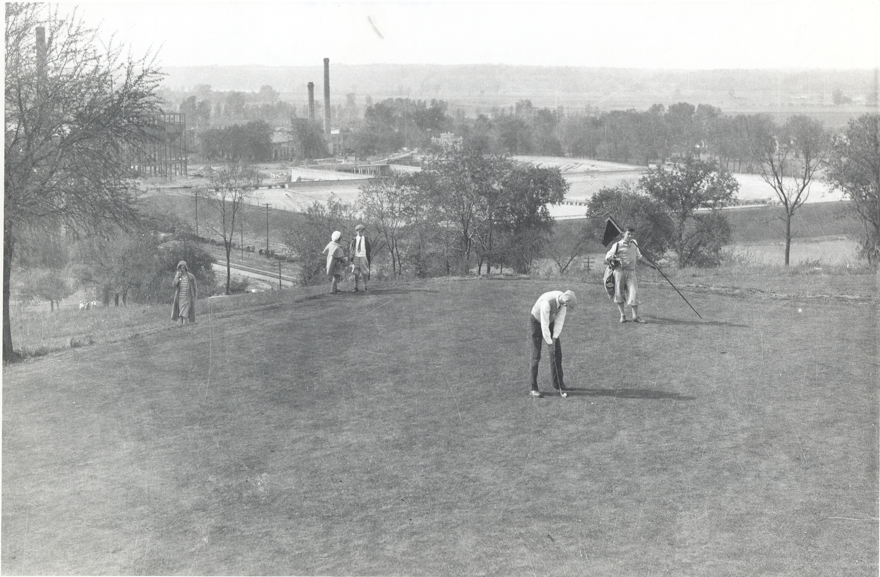
Fun and Entertainment
Social Events
Parks
Movie Theaters
Sports
Watch Babe Ruth at League Park in Chicago in 1920
Notes:
Image of Fairfax Golf Course
2-minute video shows 1920 Baseball - Babe Ruth Strike Out at League Park in 1920. The Cleveland Indians Vs New York Yankees.
1920s music in background
In 1919, Babe Ruth shocked the baseball world by becoming the first player to hit 29 home runs in a season. Prior to Ruth's explosion at the plate, most batters had employed a slower, more strategic swing to produce singles and doubles that would advance the runners. Ruth famously swung for the fences every time and had the stats to prove it, despite the wretched condition of the game ball in 1919.
This trunk is provided by the Wyandotte County Museum
This trunk is made possible through a Freedom Frontier National Heritage Area grant on behalf of the Mary Cohen Trust.
These documents are free to use for educational purposes.
Please contact the museum directly for additional classroom aids, comments, or questions.

Slide 2
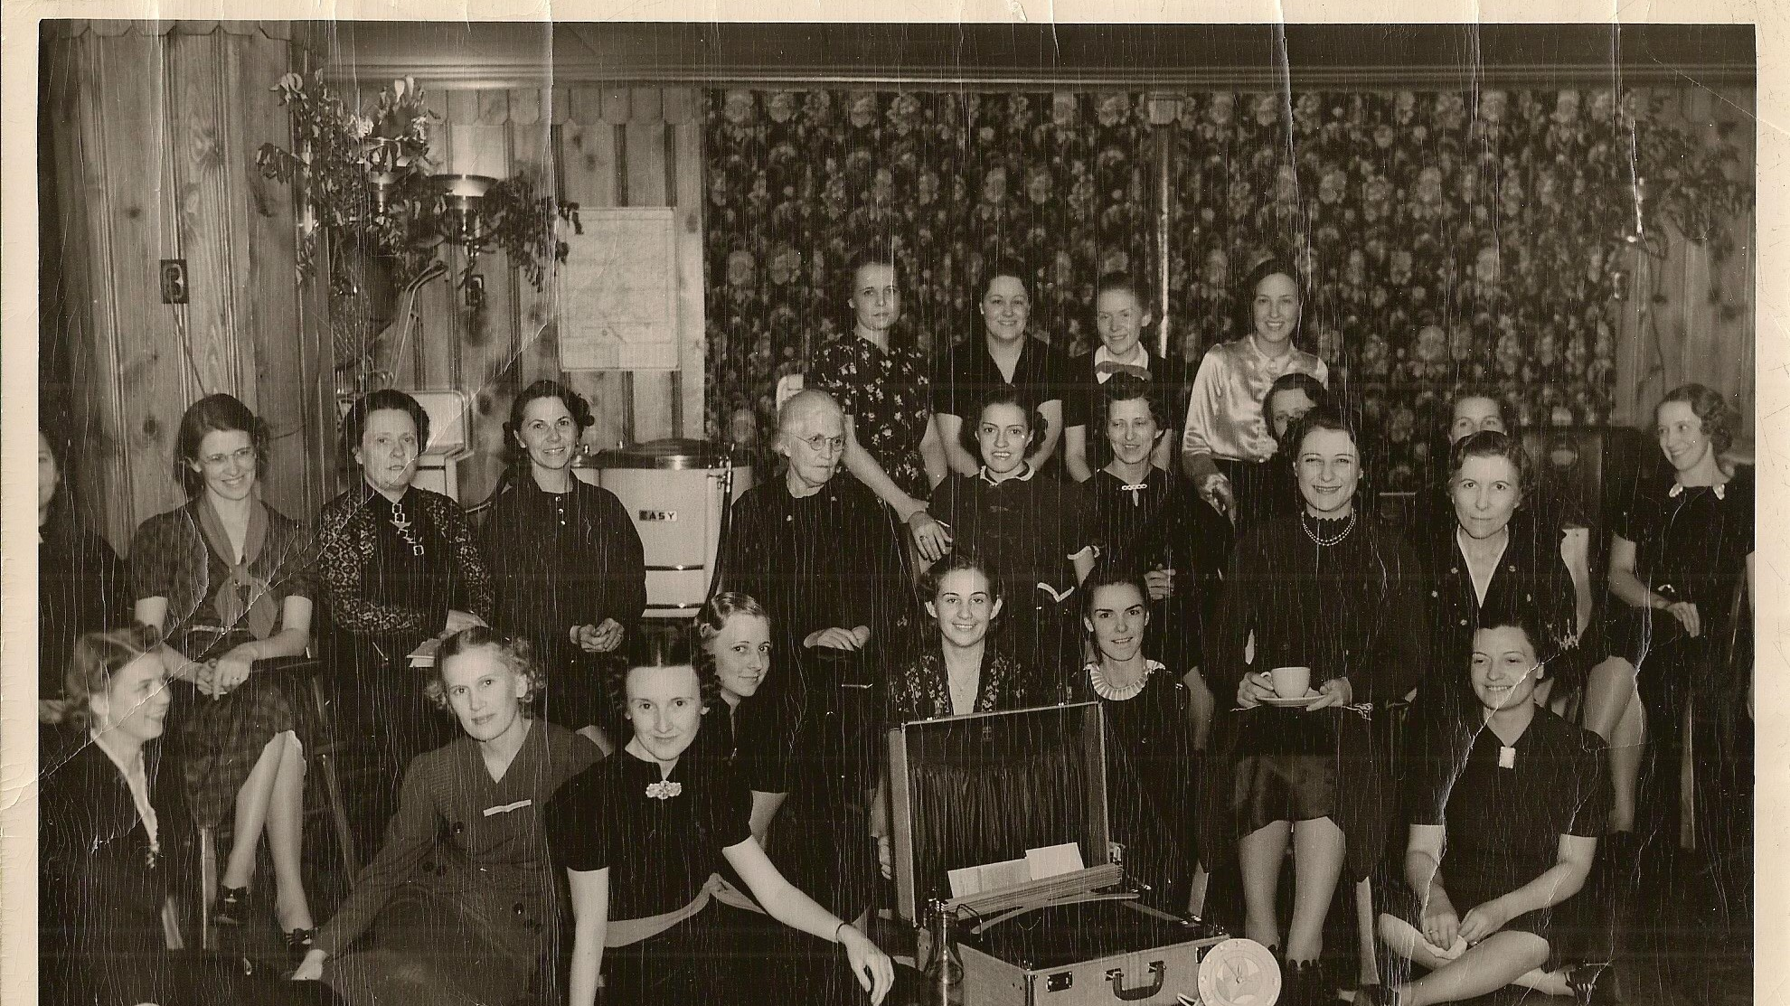
Notes:
Activity 1: Photograph Exploration
Wedding Shower circa 1920, Kansan Newspaper

Slide 3
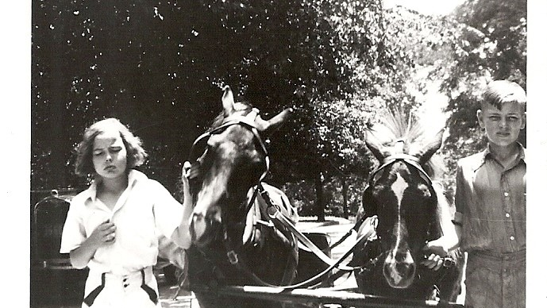
Notes:
Roy Knapp’s Rough Riders
Roy Knapp, a Wyandotte County resident, owned a cleaning business and was a founding member of the Sheriff’s Posse. In 1922, he combined his love of horses and his admiration of children and formed the Roy Knapp Rough Riders.
Youth between the ages of 4 and 17, who were interested in horsemanship and “roughing” it, could become members of the “Rough Riders”, a local group that met for more than 30 years near Wyandotte County Lake Park at 3832 N. 87th Street in Bethel. The kids’ dude ranch gave pony rides on local trails, but grew in 1926 into rodeo performances, parades, and horse show acts. The size of the group varied between 30 and 50 members, and they performed more than 20 years at the American Royal. The Rough Riders were famous nationally for their long trail rides and rodeo performances in Kansas, Missouri, Wyoming and South Dakota.

Slide 4
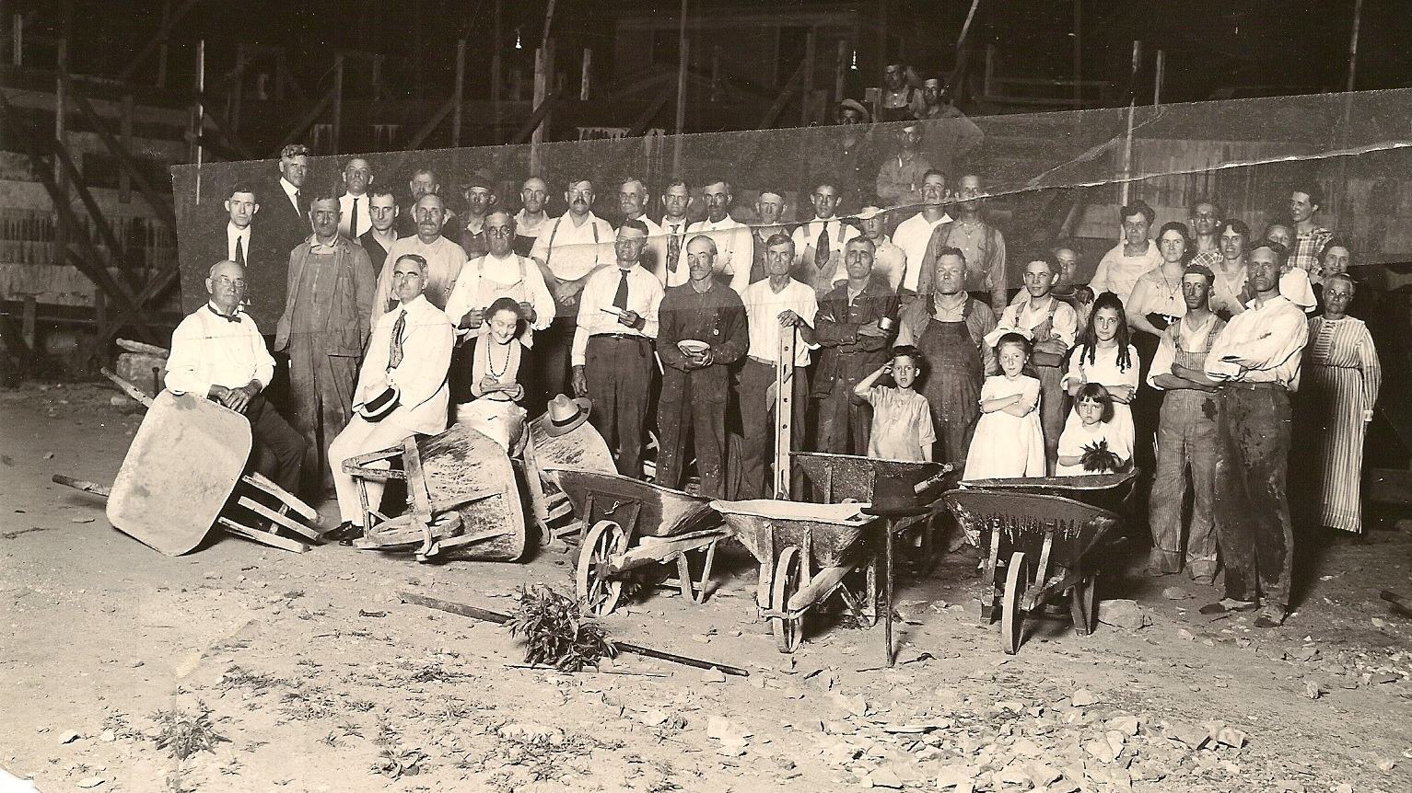
Notes:
Building the Argentine Parish House 27th & Metropolitan Ave., c. 1920
In 1921, the Argentine Parish House was built from donated materials, including a discarded steel bridge, and with volunteer labor organized by a coalition of six Protestant churches and community volunteers. The effort was led by Rev. G.W. Durham of the Methodist Episcopal Church. For nearly 65 years, the Parish House was a center of community activities, including athletic contests such as boxing and basketball, as well as social activities such as dances and club meetings. https://khri.kansasgis.org/
Can you imagine coming together with your neighbors to build a community center?

Slide 5
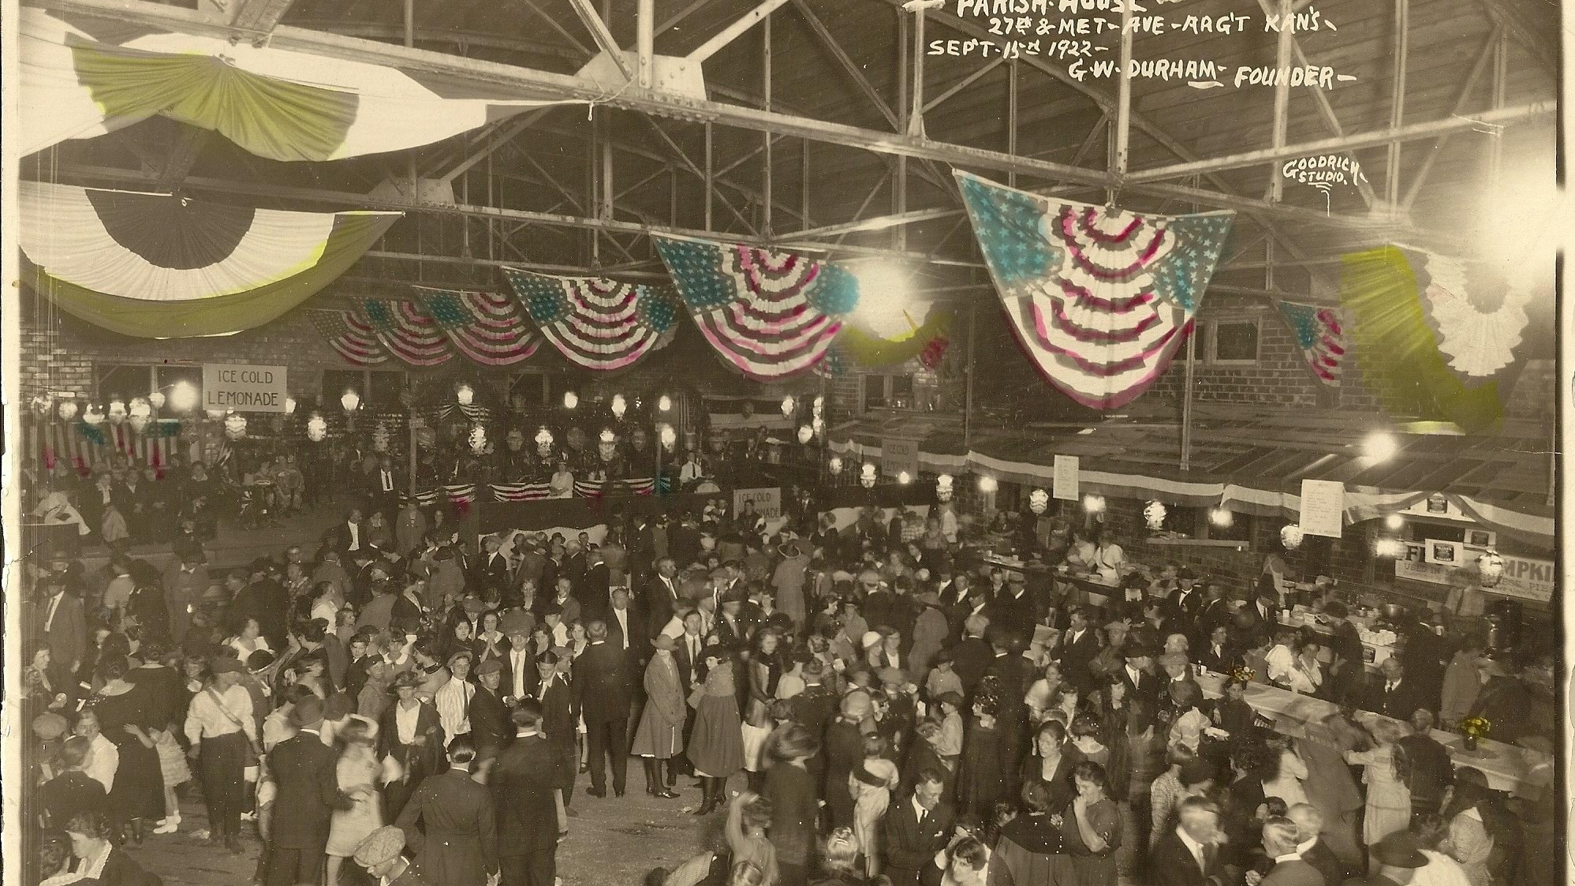
Notes:
Parish House Dance 27th & Metropolitan Ave., Argentine, KS, Sept, 15, 1922.
Used for basketball, boxing, dances, and club meetings for many years.

Slide 6
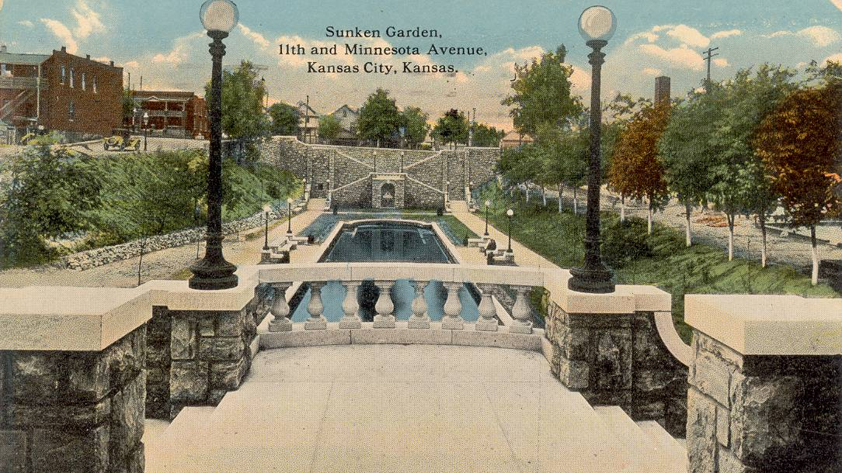
Notes:
By 1911, KCK had 20 parks on 232 acres, including Sunken Garden.
It was filled in during the Great Depression when the Works Progress Administration provided jobs

Slide 7
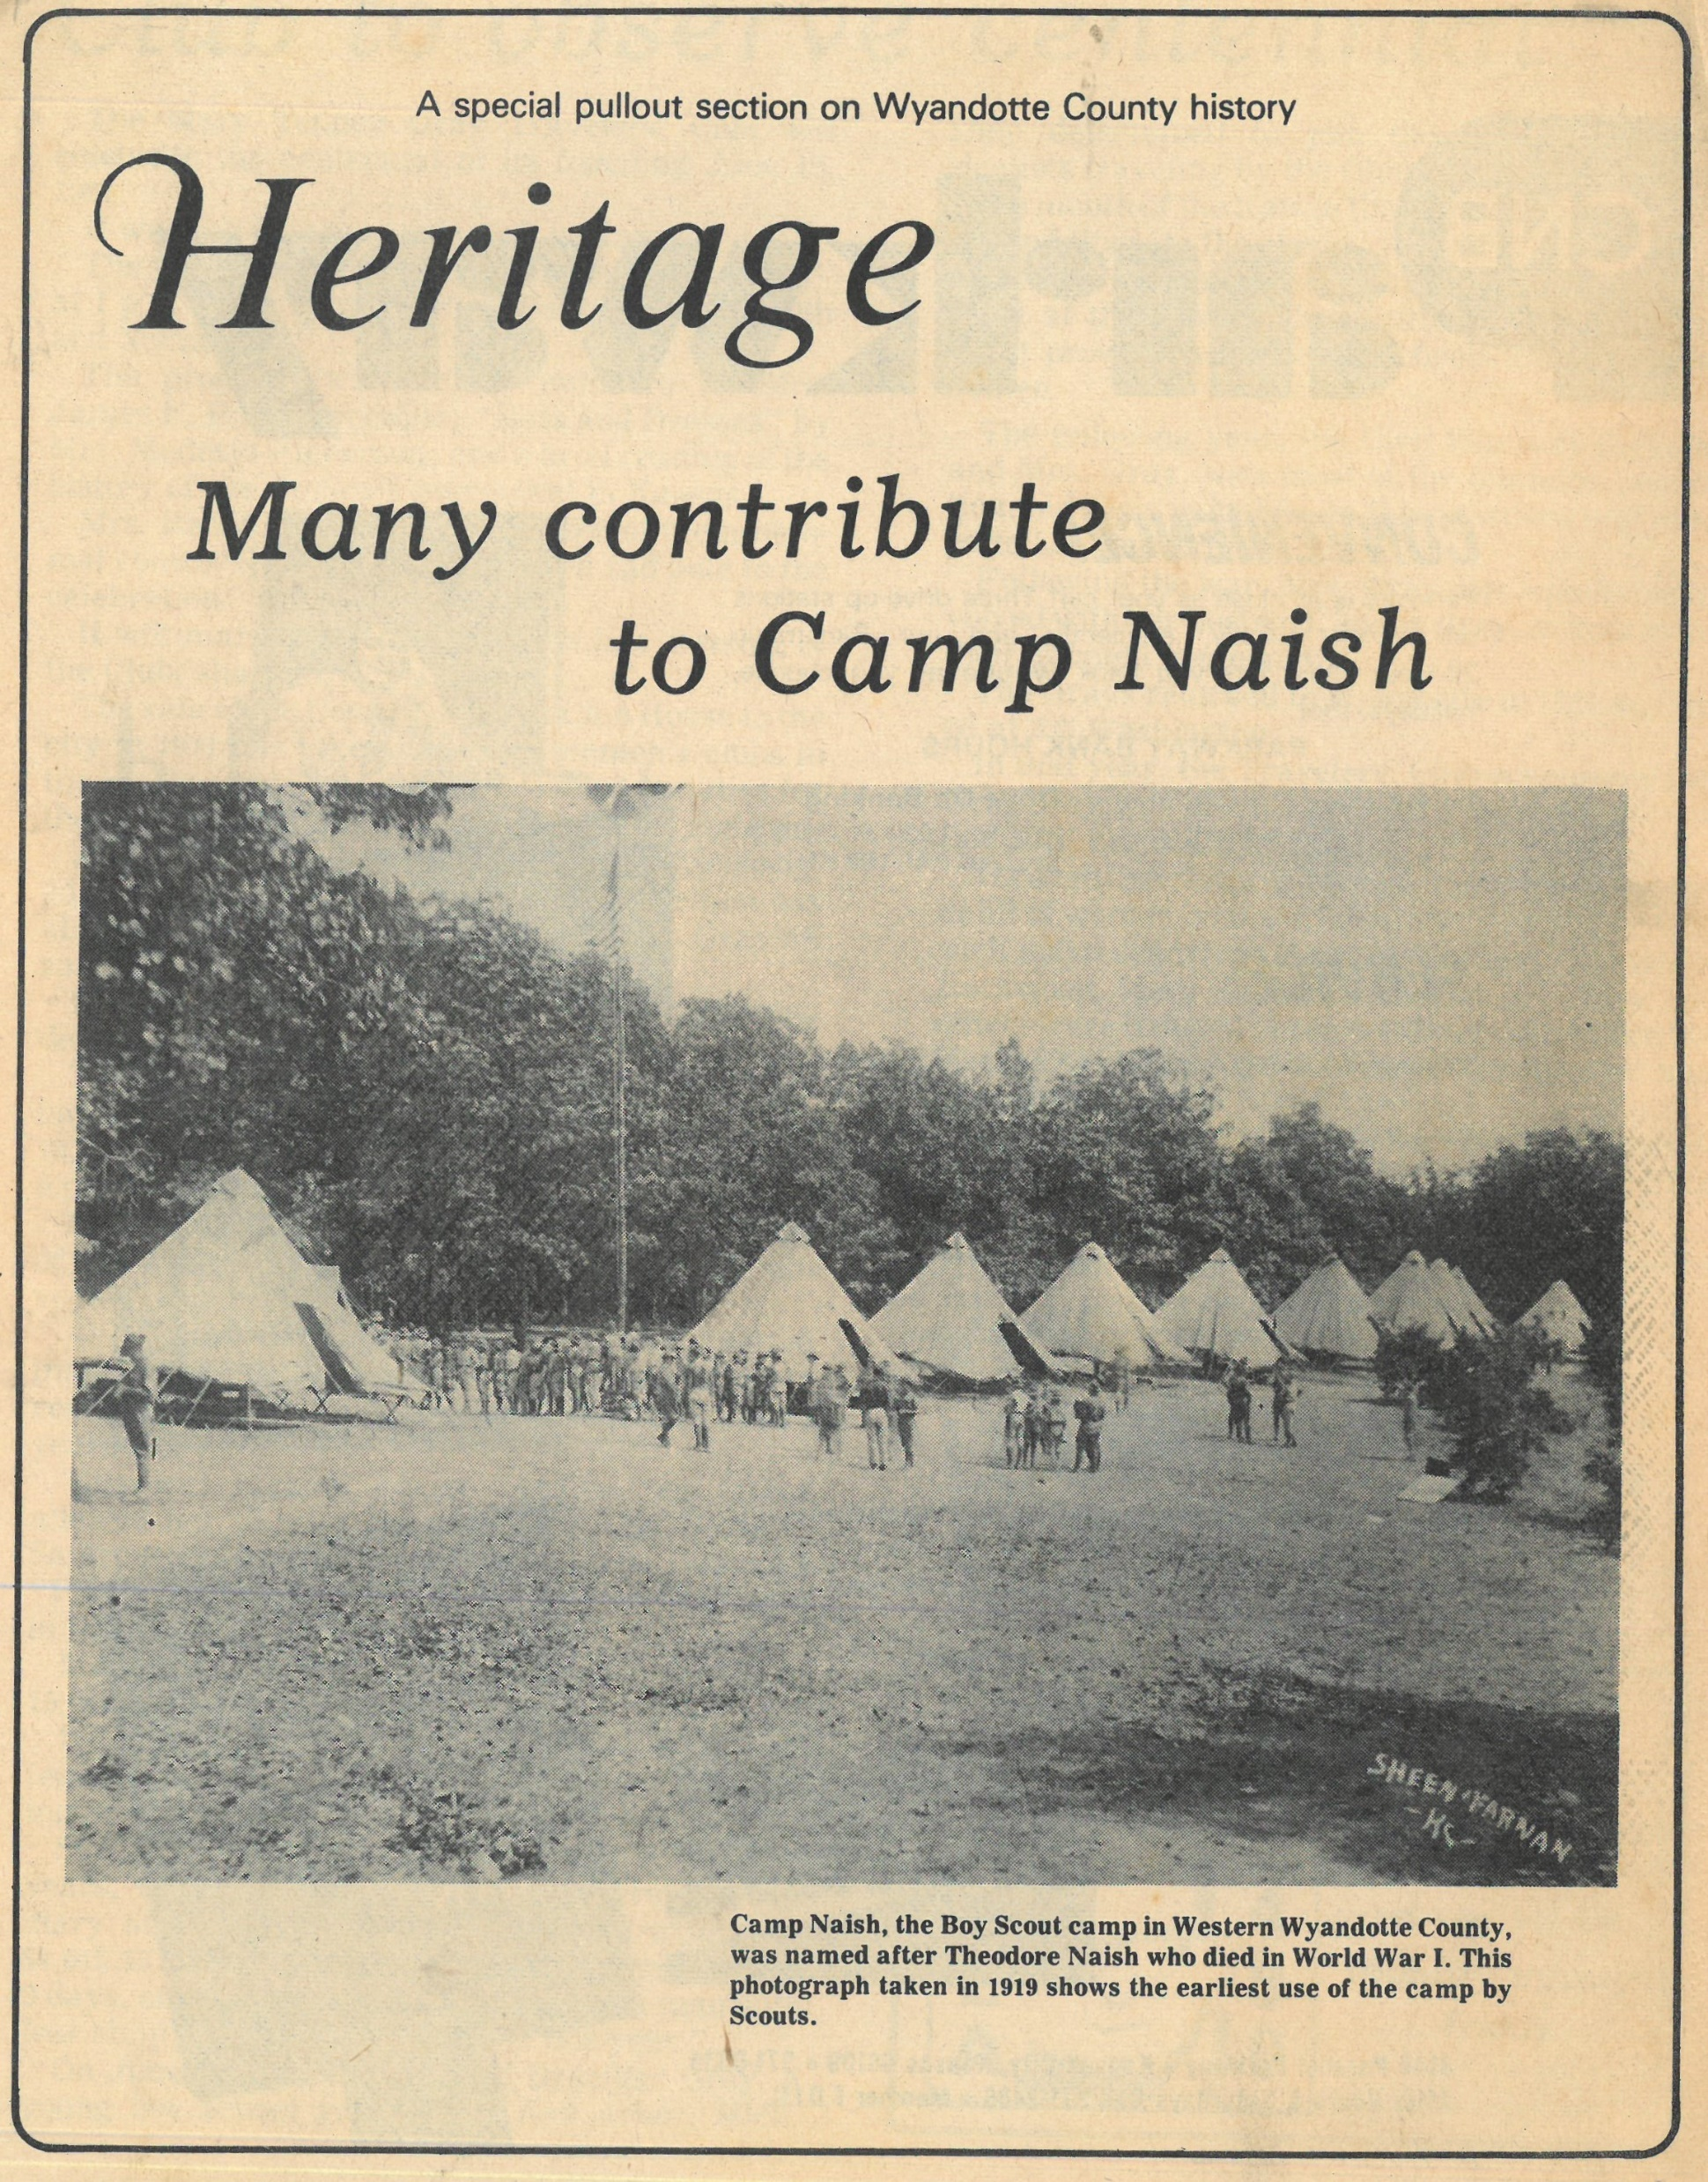
Camp Theodore Naish
Opened in the early 1920s
Boy Scout camp between Bonner Springs and Edwardsville
Notes:
Is anyone a scout?
Have you been to this camp?

Slide 8
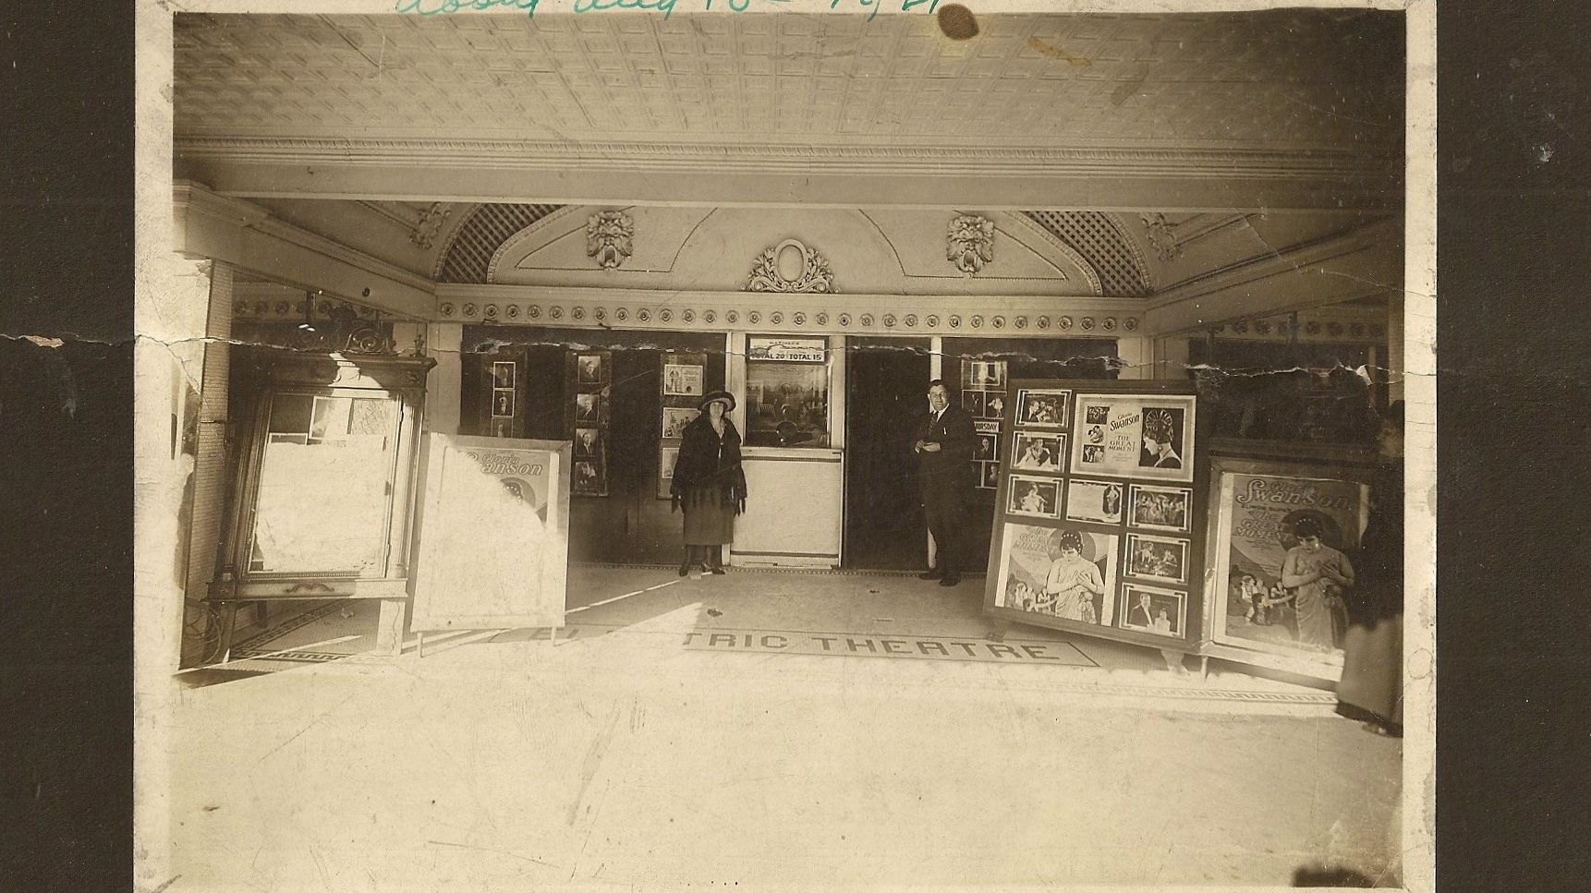
Notes:
Electric Theatre, 546 Minnesota Ave, August 1921
Opened in 1906 with 400 seats. It was enlarged to 1850 seats in 1922 and was a showplace that lit up the street.

Slide 9
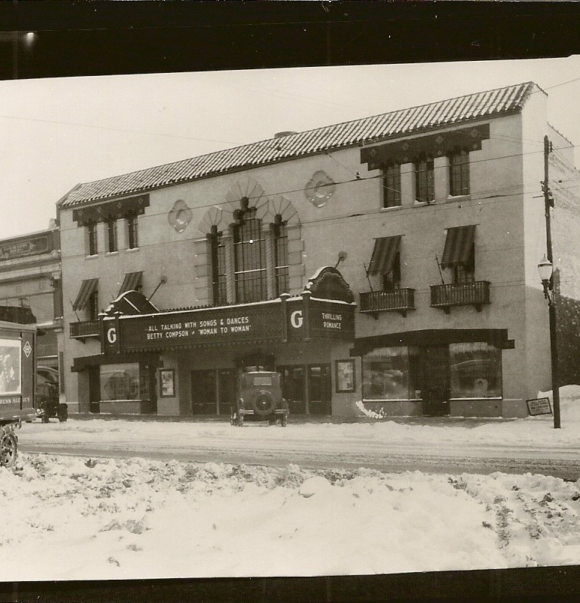
Granada Theater
The Granada Theater is the last standing historic movie theater in the county. The theater had its premier opening on May 22, 1929. The opening received three full pages of press in the Kansan newspaper and for the next forty years it was a dominant movie theater in KCK. The building was added to the National Register of Historic Places in 2005.

Slide 10
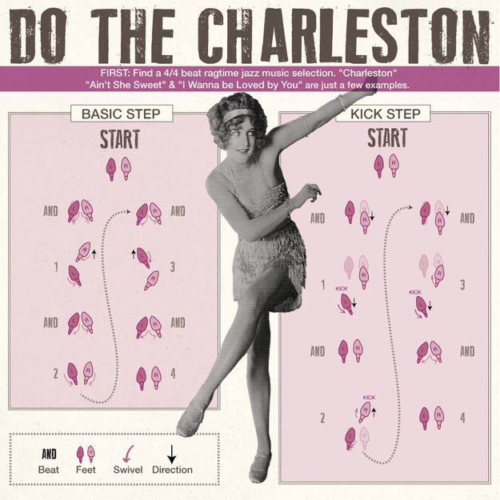
Charleston Dance
Notes:
Activity 2: Learn the Charleston
The 1920s are often remembered the music and the dancing. The Charleston was a popular dance of the time.
In 1919 the U.S. Congress passed an amendment to the Constitution making alcoholic beverages illegal. The ban took effect in 1920. It started a period known as Prohibition. During prohibition alcohol went underground and resulted in more problems than it solved. Prohibition became so unpopular that Congress passed another amendment in 1933 to end it. The 1920s are often most remembered for prohibition, jazz, and flappers who danced their cares away.
Activity 3: Sports & Games will be available in the educational trunk (post Covid)

Slide 11
