Slide 1
Junius G. Groves
Notes:
Julius G. and Matilda Groves
Born in slavery on April 12, 1859, in Louisville, Kentucky, Junius George Groves came to Kansas at the age of 19 as an Exoduster. He worked at the meat packing houses in Armourdale and later moved to Edwardsville.
Here Groves purchased 80 acres of land and began to raise white potatoes. His business prospered and he became known as the "Potato King of the World" because he reportedly grew more bushels of potatoes per acre than anyone else in the world. https://www.kshs.org/kansapedia/junius-g-groves/12075

Slide 2
Notes:
No Small Potatoes Junius G. Groves and His Kingdom in Kansas was written by Tonya Bolden, illustrated by Don Tate, published in 2018.
The full book is available for check out from the museum or is available for purchase in hardback or as an eBook online.

Slide 3
Notes:
Born in slavery on April 12, 1859, in Louisville, Kentucky, Junius George Groves came to Kansas at the age of 19 as an Exoduster.

Slide 4
Notes:
Exodusters
The end of the Civil War didn’t necessarily mean a better life for freed African Americans. In the South these same people who had farmed the cotton plantations as slaves, were now faced with renting farmland to make a living growing cotton. Many families began to look for ways to leave the South.
Kansas seemed to be one solution. The ability to homestead made Kansas seem to be the ideal place to live. In 1855 the Kansas Territorial census showed 151 free blacks and 192 slaves living in the territory. After being freed from slavery, many began to come to Kansas during the 1860s and 1870s. In 1870 there were 17,108 blacks in the state. By 1880 the number of blacks living in Kansas had increased to 43,107.
Large numbers of blacks came between 1879 and 1881. These people were called Exodusters. The name comes from the exodus from Egypt during Biblical times. Most Exodusters arrived by steamboats landing in the river cities of Wyandotte, Atchison, and Kansas City. https://kshs.org/kansapedia/exodusters/17162

Slide 7
Notes:
Do you think there is a lot of risk in farming? Many risks include weather, bugs, drought, bad seeds, etc.
Would you be willing to take big risks?
Would you be willing to live with very little, to make your dreams come true?

Slide 10
Notes:
Why might he have been more successful than his neighbors?

Slide 11
How do we know if a story is true?
Bibliography & Citations
Primary Sources
Photographs
Maps
Letters
Secondary source
Newspapers
Books
Websites

Slide 12
Notes:
Point out Edwardsville
Where is your school?

Slide 13
Notes:
Map 1884
Groves’ first property near Edwardsville. Purchased from Rosanna Conner Stephenson, a member of the Wyandot Tribe.

Slide 14
Notes:
1887 Map
By this point Groves had acquired two more farms.

Slide 15
Notes:
1923 Map
He purchased even more land over time. At the height of his success he owned over 500 acres.

Slide 16
1915 Kansas State Census
Notes:
Snip of Kansas Census - Census tells import stories about past
J. Groves owned his farm with a mortgage in 1915. He was 55 years old.
His wife Matilda was 52
Multiple children lived at home
Also shows gender and race

Slide 17
Groves Mansion
Notes:
Groves and his wife, Matilda, built a 20-room mansion in 1910, which featured the latest comforts of the day—electricity, hot and cold running water, and telephones.
In the early 1900s, he founded the community of Groves Center near Edwardsville, selling small tracts of land to African American families. He also built a golf course for African Americans, possibly the first such course in the country.

Slide 18
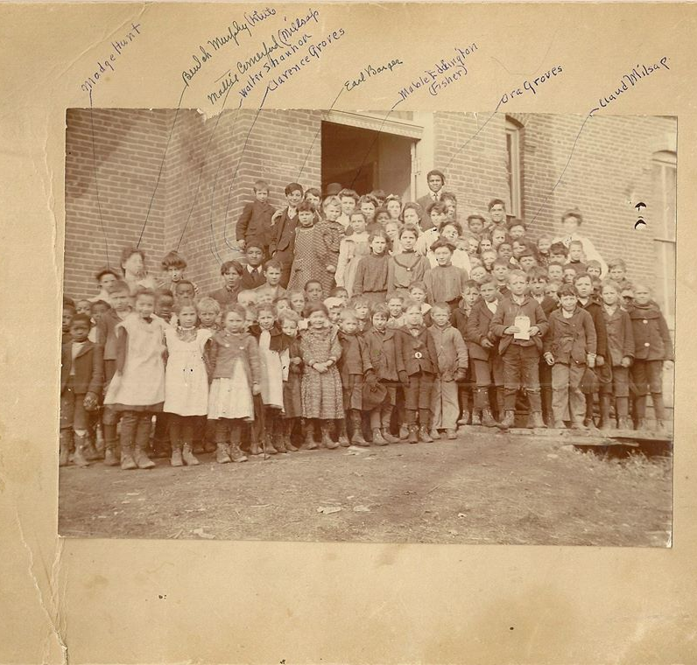
Education
The Grove children attended Edwardsville School
Oldest son, Charles graduated from Manhattan State Agricultural School became farm manager
Notes:
Groves valued education and wanted his children to be ready to help with the family business. In 1920, only 20% of the population graduated high school. Groves had at least two children who attended college.

Slide 19
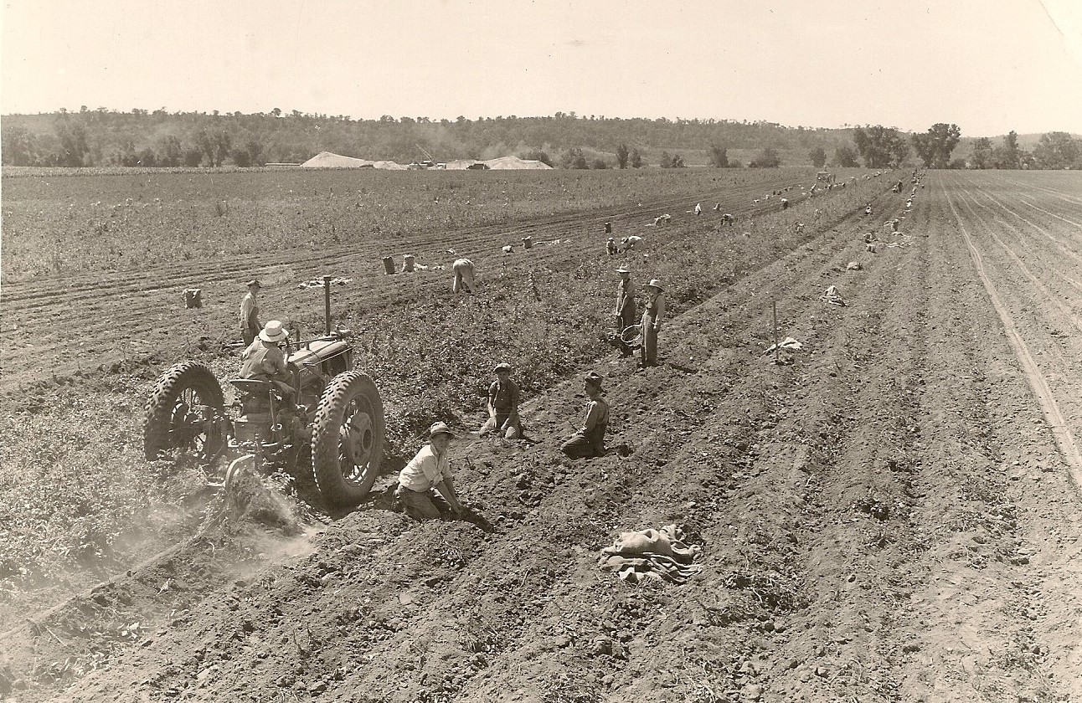
Becoming King
In 1903 – The Potato King grew 30,000-70,000 bushels of potatoes
Notes:
1885 –Groves had 30 acres of Irish potatoes, 5 acres of corn
In the 1890s, 230 sacks of Kaw Valley potatoes would bring $56.10
1895 – 400 acres of Irish potatoes, 160 acres of corn, plus many acres of animal feed, and 566 fruit trees (by 1905 no fruit trees were listed)
Produced enough farm products that he convinced the Union Pacific Railroad to build a special spur line to his property, allowing him to ship even more produce faster.
1 year 295 acres produced 72,150 bushels of white potatoes – more productive than all others
Claims his best harvest was 396 bushels of potatoes per acre, while his neighbors reported 250-300
1913 “Groves’ new potato of his own breeding is a wonder.”

Slide 20
Notes:
Cabbage – Sauerkraut factory on Groves’ farm employed 26 people of multiple backgrounds in 1907. He producing a ton of sauerkraut that was shipped all over the country.

Slide 21
Business Failure?
The 1895 Agricultural Census shows Groves had
170 apple trees
6 peach trees
340 plum trees (not producing fruit)
50 cherry trees (not producing fruit)
In 1896, he was reported to have planted 7,000 fruit trees
By 1905 no fruit trees were listed
What might have happened to the trees?
Notes:
While not every investment worked out, Groves never gave up.
J. G. had several other business interests. He was a partner in the KCK Casket and Embalming Co. and Director in the Twin Cites Business Association in KCK, both African American owned and operated companies. He was a founding member of the Kansas State Negro Business League, the Kaw Valley Potato Association, the Sunflower State Agricultural Association, and the Pleasant Hill Baptist Church Society. He also diversified his investments with oil in Oklahoma.

Slide 22
What Makes an Entrepreneur?
An Entrepreneur is a person who organizes and manages any enterprise, especially a business, usually with considerable initiative and risk.
What skills and characteristics do entrepreneur have?
Do you know anyone who owns their own business?
Can you name a famous entrepreneurs?
Notes:
Shark Tank
Henry Ford, Thomas Edison, Steve Jobs, Andrew Carnegie, Bill Gates
Walt Disney's Laugh-O-gram Studio building in Kansas City

Slide 23
Entrepreneur verses Inventor
An Inventor is a person who creates a new process, appliance, machine, or article
Can you think of any inventors?
Not every idea works, many inventors fail many time before the succeed
Some inventions were created through mistakes
Notes:
Henry Ford, automobile
Thomas Edison, lightbulb
Alexander Graham Bell, telephone
Wright Brothers, flight

Slide 24
Mistakes that Worked
Naval mechanical engineer Richard James was looking to create something that would stabilize machines while onboard ships. The slinky was created in 1943, when he accidentally knocked over one of his stabilizing springs, and it "walked" down a stack of books.
Post-it Notes were invented by 3M scientists Arthur Fry and Spencer Silver. Silver was tasked with developing new, stronger adhesive, but instead he accidently created the post it adhesive. Fry produced the idea of using it for the small, yellow squares of paper to become sticky-back notes.

Slide 25
Silly Putty was an Accident
During World War II, engineer James Wright was trying to create an inexpensive substitute for synthetic rubber. When he dropped boric acid into silicone oil, he got a substance that was stretchier and bouncier than rubber, with a weird added feature: when you flattened it against a newspaper or comic-book page, it picked up a perfect copy of the print it touched.
The government didn’t want his “nutty putty,” but a few years later, businessman Peter Hodgson noticed what a hit the stuff was at a party. He renamed it “Silly Putty” and marketed it as a toy, packaging it in colorful plastic eggs because he put it out around Easter time.

Slide 26
It took Many Years for Velcro to Stick
In 1941, Swiss engineer George de Mestral noticed that burdock burrs kept sticking to his clothes and his dog's fur. He examined the burrs under a microscope and discovered that the hooks that made up the burr would stick to anything made of a loop.
De Mestral spent the next 14 years attempting to duplicate what he saw under that microscope before introducing Velcro to the world in 1955.
Velcro was intended to be used for clothing as a "zipper-less zipper," but that idea was not initially successful.
In the early 1960s, Velcro received a huge boost in popularity when NASA used Velcro on their space suits.
In 1968, Velcro replaced shoelaces for the first time.

Slide 27
Grow Your Own Business
What would your business be?
How would you get started?
How might it grow?
Design an ad for your new business
Notes:
Learn about 10 young entrepreneurs
https://www.investopedia.com/10-successful-young-entrepreneurs-4773310
Have students create an advertisement for their new business
Discuss their ideas

Slide 28
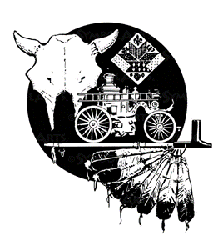
Junius G. Groves the Potato King
This content is provided by the Wyandotte County Museum
It is made possible through a Freedom Frontier National Heritage Area grant funded through the Barton P. and Mary D. Cohen Charitable Trust.
These documents are free to use for educational purposes.
Please contact the museum for additional classroom aids, questions or comments.

