Slide 1
Citizenship and Voting Rights
Throughout history barriers have been created to prevent groups of people from being recognized as citizens.
Without citizenship many people have been prevented from participating in the electoral process.
The Right to Vote has been a hard-fought battle for many groups
Notes:
Activity 1: Discussion
How would you feel if your vote wouldn’t count because of gender or skin color?
Do you think elections may had different results if everyone could vote?

Slide 2
Women’s Suffrage - 19th Amendment
The National American Woman Suffrage Association recognized Kansas as a liberal and forward-thinking state in the fight for suffrage. The Association adopted the Kansas state flower, the sunflower, as its emblem. The sunflower became an easily recognized symbol during suffrage campaigns.
In 1912, Kansas voters approved the Equal Suffrage Amendment to the state constitution, giving women the right to vote in the State.
On the National Level, the 19th Amendment - guaranteed women the right to vote in 1920
But this did not mean that everyone could vote, there were still many battles ahead

Slide 3
Native American Rights
1919 Native Americans who served in the military during World War I are granted US citizenship.
1924 The Indian Citizenship Act grants citizenship to Native Americans, but many states nonetheless make laws and policies that prohibit Native Americans from voting.
Notes:
In 1947 Legal barriers to Native American voting removed. The Voting Rights Act of 1965 and subsequent laws passed in 1970, 1975 and 1982 built stronger voting protections to allow Native Americans to vote without intimidation, literacy tests, poll taxes and fraud.

Slide 4
Immigration
The Immigration Act of 1924 limits the number of immigrants allowed into the United States yearly through nationality quotas. The law favors immigration from Northern and Western European countries. Just three countries, Great Britain, Ireland and Germany account for 70 percent of all available visas. Immigration from Southern, Central and Eastern Europe was limited. The Act completely excludes immigrants from Asia.
Immigrants can only vote if they become naturalized citizens

Slide 5
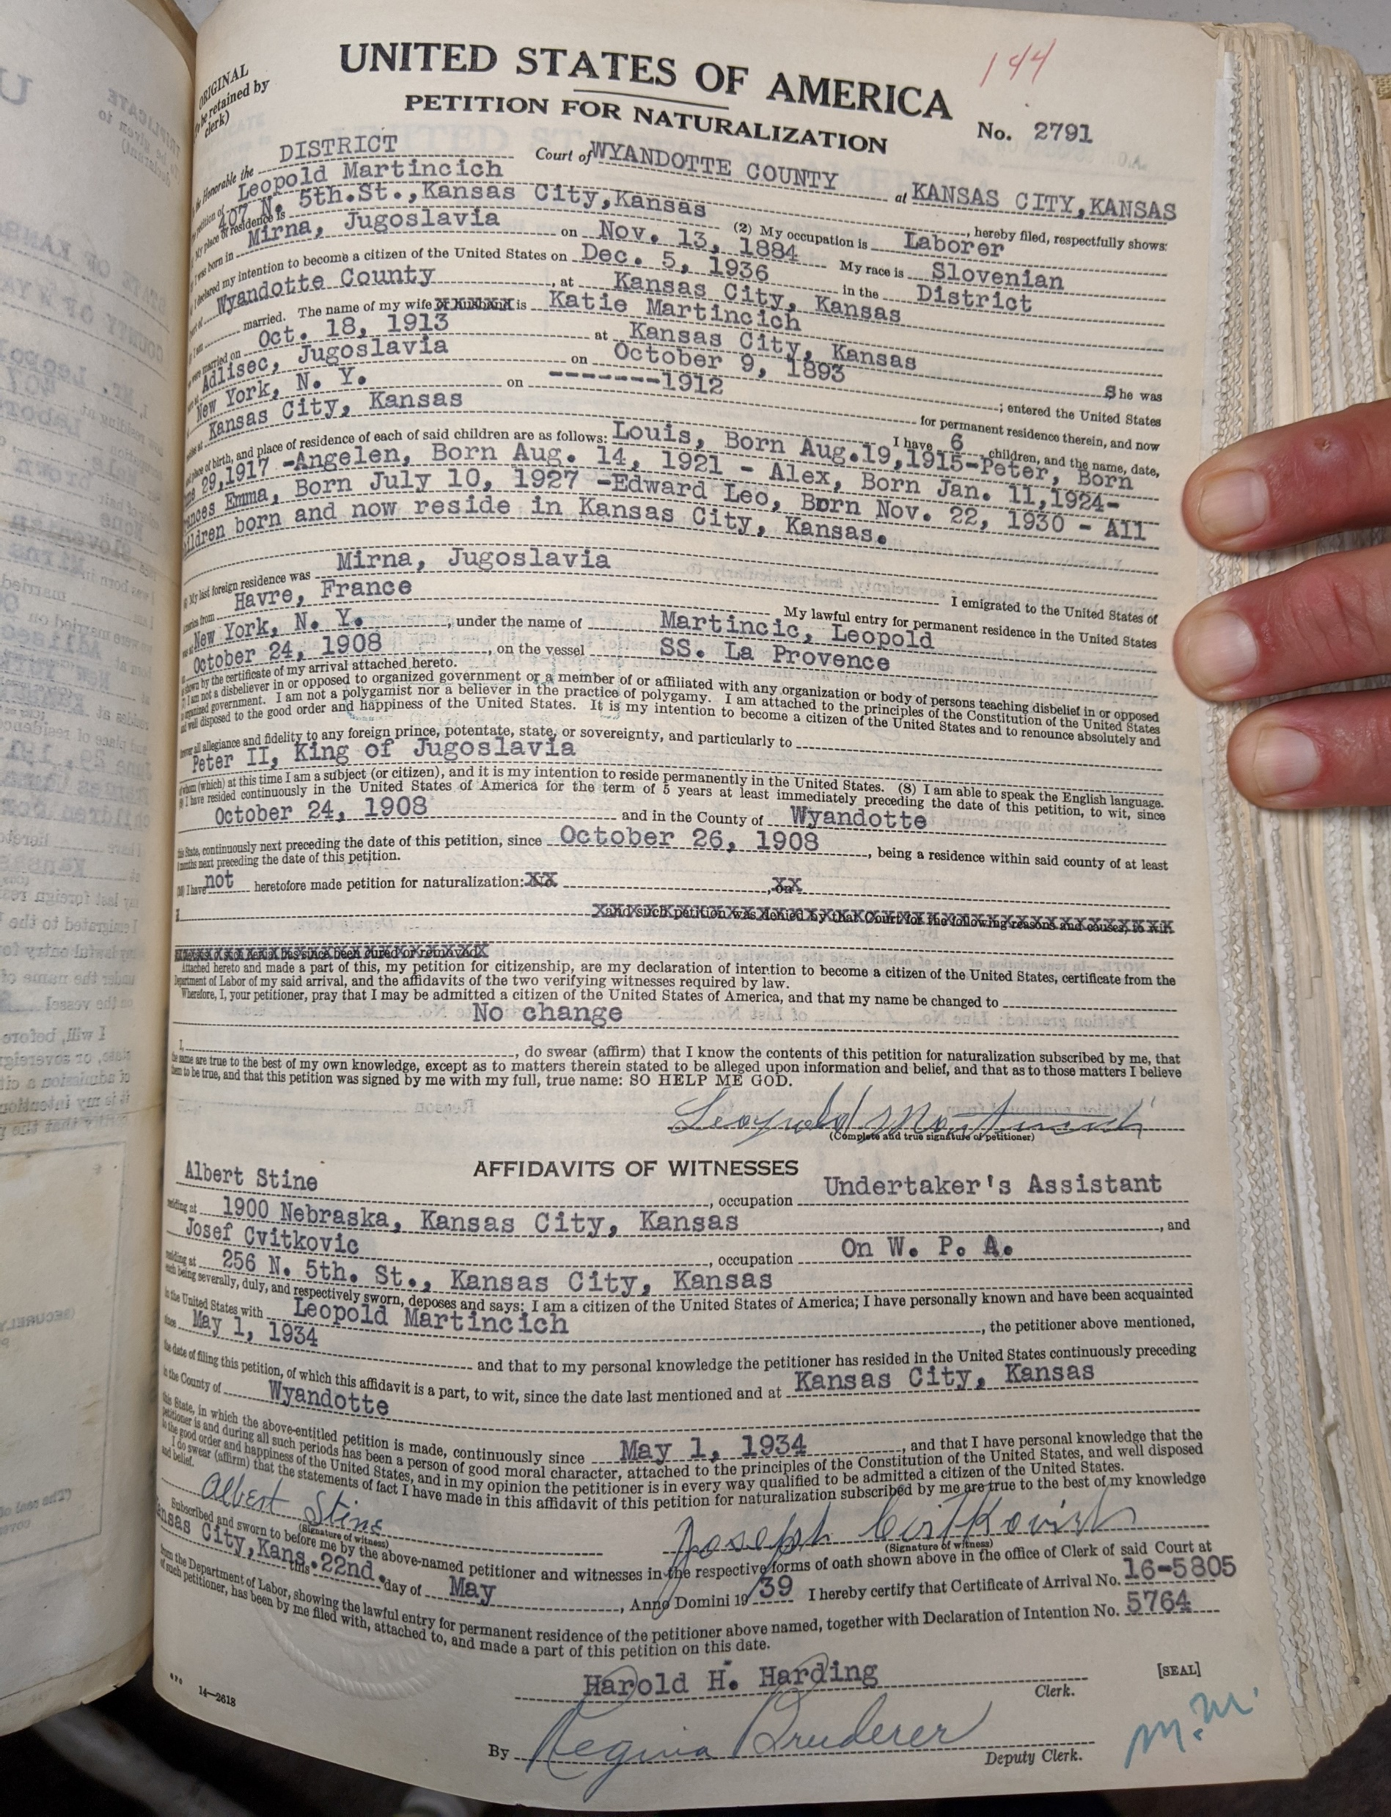
Naturalization
Naturalization is the process by which U.S. citizenship is granted to a lawful permanent resident. It is a voluntary act; naturalization is not required.
Prior to September 27, 1906, any "court of record" (municipal, county, state, or Federal) could grant United States citizenship.
The Wyandotte County Museum has the County Naturalization & Declaration of Intent Records.

Slide 6
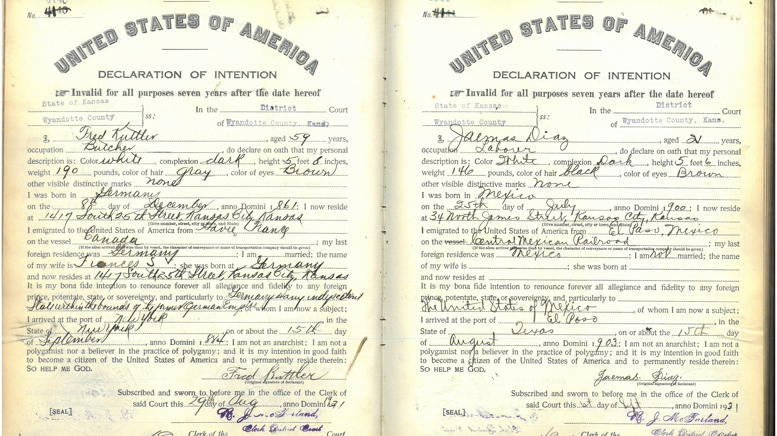

Slide 7
Beyond the 1920s
1866: Civil Rights Act grants citizenship but not the right to vote to all persons born in the U.S.
1965: The Civil Rights Act outlaws discrimination based on race, color, religion, sex, or national origin.
1971: Drops voting age from 21 to 18
1975: Voting Rights Act expanded to protect language minorities
1982: Congress requires new voting protections for people with disabilities

Slide 8
Mock Election
Your class is having a party, there is a choice between pizza and tacos. The class will get to vote for their favorite.
First only the boys will vote (keep the results hidden). How do the girls feel about being left out?
Then the girl’s votes will be added, how do the results compare?
Notes:
Activity 2: Mock Election

Slide 9
