Slide 1
1920s Education
By 1918, every state required students to complete elementary school
In the 1920s, most children attended neighborhood schools
Literacy and citizenship became focal points in American public schools
Public schools were often segregated
Parochial schools were popular, which focused on education, religion, and culture. Classes were sometimes taught in native languages.

Slide 2
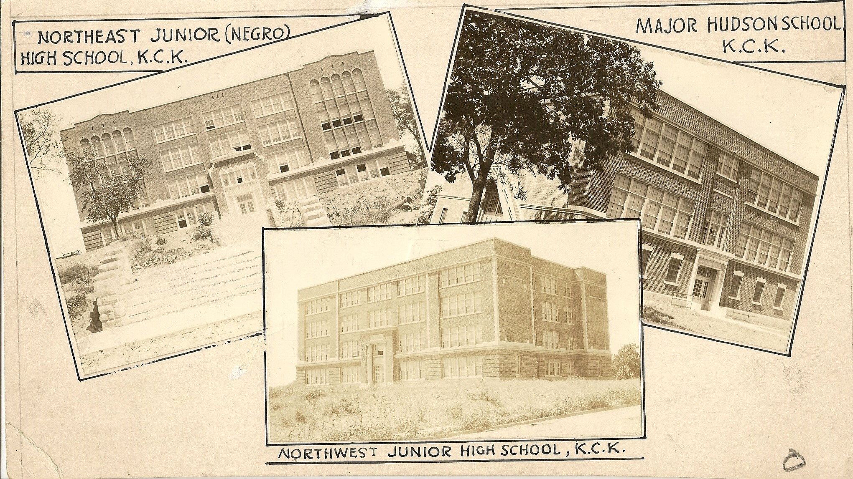
Notes:
Major Hudson Elementary, Northeast and Northwest Jr. High Schools were all built 1923/24.
Northeast was the first Jr. High built exclusively for African Americans students of KCK at 4th and Parallel.
Northwest was built for white students at 18th and Haskell
Major Hudson School was built as a segregated elementary school for white students in Rosedale. Hispanic students were denied entry into Hudson, at the same time Mexican American students could attend classes in the basement of Emerson and Ingalls.
Major Hudson Elementary School was the site of a segregation controversy of national significance. In September 1924, four Mexican schoolchildren were denied admission by a group of Anglo parents in what contemporary media described as a "near race riot". Over the course of the next 18 months, at the persistent urging of Mexican diplomats, the U.S. State Department intervened and eventually succeeded in requiring Kansas City, Kansas School District to educate the Mexican students. As part of the larger controversy over the creation of segregated Mexican schools in the "separate but equal" era following the Supreme Court's 1896 Plessy v. Ferguson decision, Major Hudson stands out in that - unlike Emerson Elementary in Argentine and John J. Ingalls in Armourdale - Mexican students were never educated in the new building. While classes for Mexican students had been formed in the basements of the other two schools, Mexican students were denied admission to Major Hudson altogether. Instead, the school district appointed a teacher to instruct Mexican pupils at the old Melville School that Major Hudson replaced. According to school district records, the Melville School was "no longer needed" and ceased operations in 1940. Mexican-American students were integrated into Major Hudson, which operated continuously as an elementary school until it was closed due to declining attendance in 1983. The building was sold in 1985 to a private developer, who converted the building into Wyandotte County's first residential condominium development. Source: https:// Mexican American students could attend classes in the basement. khri.kansasgis.org/

Slide 3
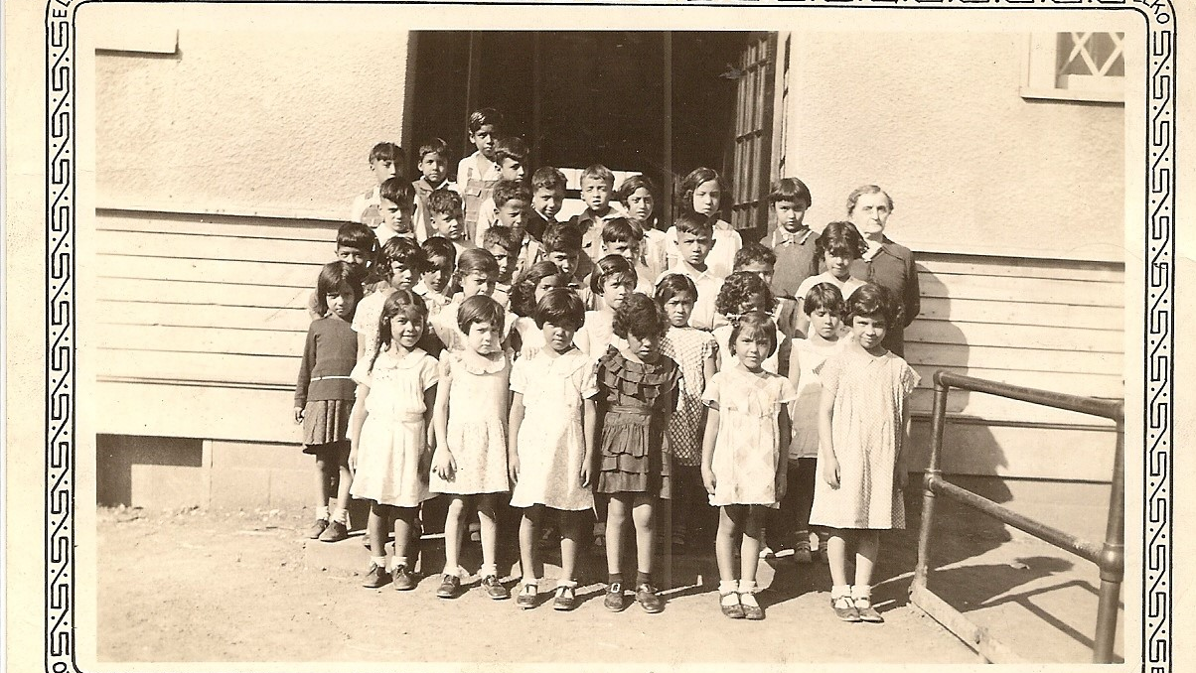
Notes:
Clara Barton School (segregated Mexican American) – 1st Grade Class
Clara Barton School was the first school built for the sole use of Mexican-American children in KCK. Located at 25th and Cheyenne in Argentine, it operated from 1924 until the 1951 flood destroyed the school.
1924 Clara Barton school for Hispanic Children built: Clara Barton was located at 25th and Cheyenne Ave., on the north side of the Santa Fe Railroad's Argentine yard (across the quarter-mile long Goddard viaduct from Argentine proper). Sited near the foot of the "Old Southern Bridge" that carried Argentine Blvd. across the Kansas River from Armourdale, Clara Barton was located in part of Argentine that Mexican workers called "El Campo," one of many railroad labor camps established by the Santa Fe railroad in towns throughout the Midwest and Southwest. The building was originally built as a three-room, segregated school for Mexican and Mexican-American children, established after four years of lobbying by civic leaders in Argentine and Anglo parents from Argentine and Armourdale, who objected to attendance and co-mingling of Mexican students with their children. (Before the construction of Clara Barton, Mexican children had been restricted to basement classrooms at Emerson Elementary in Argentine and John J. Ingalls in Armourdale.) Miriam Cheney, who had previously taught Mexican students at the nearby Methodist Mexican Mission, was appointed the school's first principal. Approximately 125 students ranging in age from first through eighth grade were educated in classes averaging a 40:1 pupil:teacher ratio. Two additional rooms were added, one in 1928 and another in the mid-1930s. The building was named after the founder of American Red Cross, and is attributed to Rose & Peterson Architects. Source: https://khri.kansasgis.org/

Slide 4
College and University Education
In the 1920s, the High School Graduation rate was approximately 20%
College was out of reach for most people, with only 44% of High School Graduates even dreaming of attending a University
Attendance was considered a privilege and was often reserved for the financial and social elite
Higher education was very formal in comparison to today, including teacher-student interaction, lectures, and formal dress in class
Teachers and professors were held in very high esteem

Slide 5
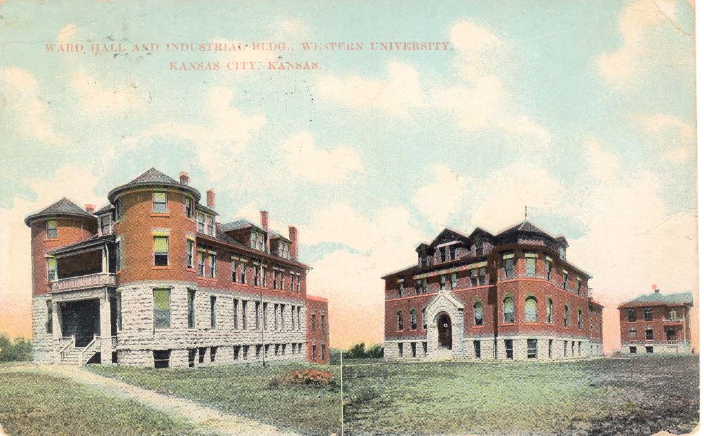
Notes:
The Quindaro Freedman’s School (later Western University) was founded in September 1862. It was the first public school for African Americans in Kansas. In 1881, the deed to the school was transferred to the African Methodist Episcopal Church, who rebranded it Western University.
Western University provided a large range of educational and vocational training –from music to blacksmithing, carpentry, and plumbing.
State support for the school diminished during the Great Depression, and Western University would never recover.

Slide 6
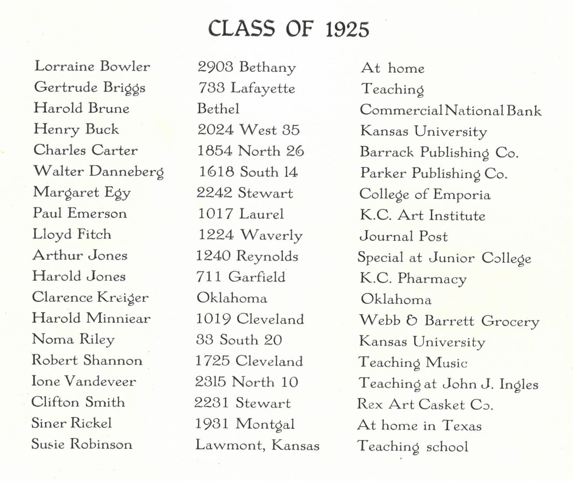
Kansas City, Kansas Jr. College, Class of 1925
Notes:
Includes Name, Address, Where Now list from 1927 Owaissa Yearbook.
In 1923, KCK voted in favor of having a junior college. The two-year college opened as a racially segregated college in 1923 with 43 college freshmen.
The white branch of this new junior college was held at Central High School, and the African-American was held at Sumner High School.
The Jr College desegregated in 1951, four years prior to Brown vs Board of Education.
KCKCC moved to the Green Grass Campus on 72nd and State Avenue in 1966.

Slide 7
Education Comparisons
How many of you expect to go to college?
If the year was 1920, do you think you would be able to attend High School?
How would you feel if you were denied entry to a school based on your race or social standing?
Notes:
Activity 1: Education Comparisons

Slide 8
