Slide 1
Junius G. Groves
Notes:
Introduce the story of Groves
Photograph Julius G. Groves and wife Matilda
Has anyone heard of him? Why do you think this is?
Born in slavery in April 12, 1859, in Louisville, Kentucky, Junius George Groves came to Kansas at the age of 19 as an Exoduster. He worked at the meat packing houses in Armourdale and later moved to Edwardsville. Groves purchased 80 acres of land and began to raise white potatoes. His business prospered and he became known as the "Potato King of the World" because he reportedly grew more bushels of potatoes per acre than anyone else in the world.
https://www.kshs.org/kansapedia/junius-g-groves/12075

Slide 2
Notes:
No Small Potatoes Junius G. Groves and His Kingdom in Kansas was written by Tonya Bolden, illustrated by Don Tate, published in 2018.
The full book is available for check out from the museum or is available for purchase in hardback or as an eBook online.

Slide 4
Notes:
Exodusters
The end of the Civil War didn’t necessarily mean a better life for freed African Americans. In the South these same people who had farmed the cotton plantations as slaves, were now faced with renting farmland to make a living growing cotton. It was quite rare for a southern black to own his own land. In addition, violence against blacks was increasing. Many families began to look for ways to leave the South.
Kansas seemed to be one solution. After all, Kansas had been associated with freedom because of the events during the Bleeding Kansas era and the fame of John Brown. In addition to this, the ability to homestead made Kansas seem to be the ideal place to live. In 1855 the Kansas Territorial census showed 151 free blacks and 192 slaves living in the territory. After being freed from slavery, many blacks began to come to Kansas during the 1860s and 1870s. In 1870 there were 17,108 blacks in the state.
Large numbers of blacks came between 1879 and 1881. These people were called Exodusters. The name comes from the exodus from Egypt during Biblical times. Most Exodusters arrived by steamboats landing in the river cities of Wyandotte, Atchison, and Kansas City. https://kshs.org/kansapedia/exodusters/17162

Slide 6
Source to Story
Notes:
Excerpt form the Brooker T Washington papers
Booker Taliaferro Washington (1856 –1915) was an African-American educator, author, orator, and advisor to presidents of the United States. He became the leading voice of the formerly enslaved, who were newly oppressed by discriminatory laws enacted in post-reconstruction Southern states in the late 19th and early 20th centuries. This collection is a selected edition of his writings, addresses, and correspondence.
Complete in 14 volumes, including a cumulative index volume.
https://www.archives.gov/nhprc/projects/catalog/booker-t-washington

Slide 7
Notes:
Would you be willing to live with very little, to make your dreams come true?

Slide 8
Notes:
Do you think there is a lot of risk in farming? Many risks include weather, bugs, drought, bad seeds, etc.

Slide 10
Notes:
Why might he have been more successful than his neighbors?
What type of sources do you think they used to write this book?

Slide 11
Notes:
Analyze newspaper articles about Groves
How do newspapers compare?
Kansas City Star 1880- present
Kansas City Kansan 1916-2002
Kansas City Advocate 1916-1924
Bonner Springs – Edwardsville Chieftain 1896-2001
Topeka Plaindealer 1899-1927 African American Paper
Edwardsville Visitor 1912-1913 short lived community paper
How else can we learn about his life?

Slide 12
K. C. Times Article 1972
Notes:
This article was written 50 years after Groves passed away. What can we learn about his life and legacy from this article?

Slide 13
Notes:
This article was published in the KC Star in 1910, during Groves’ lifetime.
What do you think about this article?
How does it compare to other sources?

Slide 14
Notes:
Small newspapers published daily activities as news.
Edwardsville Visitor Articles
East Edwardsville Items – Jan 24, 1913
Surprise on J. G. Groves – Apr 18, 1913

Slide 15
Notes:
1910 Census Data
Place of residence
Name of each person at residence
Relationship of each person to head of household
Home data - Owned or rented - Does family own a farm
Personal Description - Sex - Color or race - Age at last birthday - Marital condition (Single, Married, Widowed, Divorced) - Number of years married
Education - Attended school or college - Whether able to read or write
Place of Birth - Each person and his or her parent’s birthplace - If United States give State or Territory - If foreign birth give country in which birthplace is now situated
Native language of foreign born
Citizenship - Year of immigration into the United States - Naturalization - Ability to speak English
Occupation & Industry - Trade or profession, type of work done - Industry or business
Employed (Yes/No)
Veterans

Slide 16
1915 Kansas State Census
Notes:
Snip of Kansas Census - Census tells import stories about past
J. Groves owned his farm with a mortgage in 1915. He was 55 years old.
His wife Matilda was 52
Multiple children lived at home
Also shows gender and race

Slide 17
Notes:
Groves’ property was near Edwardsville. Can you find where your school would be on this map?

Slide 18
Notes:
1886 Map
Groves purchased his first land near Edwardsville from Rosanna Conner Stephenson (member of Wyandot tribe) in 1884.
Note it was also uncommon for a woman to own land at this time.

Slide 19
Notes:
Map 1887
Groves quickly purchased more land to expand his farm operations. By 1887 he had purchased two more farms.
In 1889, he had acquired another.

Slide 20
Notes:
1923 map
He had more than 500 acres

Slide 21
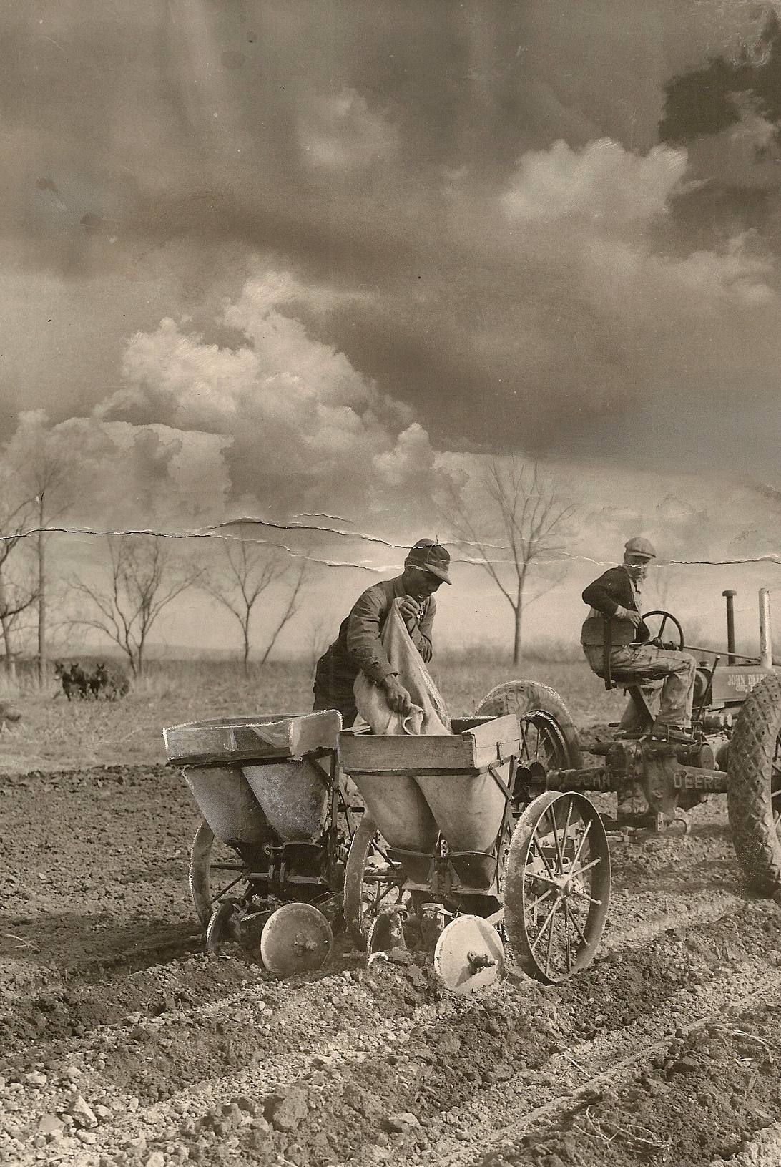
Becoming King
1903 – 1st mention Potato King grew 30,000-70,000 bushels of potatoes, 1,500 tons of cabbage
Notes:
1885 –Groves had 30 acres of Irish potatoes, 5 acres of corn
1895 – 400 acres Irish potatoes, 160 acres of corn, plus many acres of animal feed, and 566 fruit trees (by 1905 no fruit trees were listed)
Produced enough farm products that he convinced the Union Pacific Railroad to build a special spur line to his property, allowing him to ship even more produce faster.
Claims his best harvest was 396 bushels of potatoes per acre, while his neighbors reported 250-300

Slide 22
Notes:
This photo is thought to shows Groves and his cabbage factory employees. What else can you see in this photograph? Does the article help provide any other clues?
In 1913, Groves founded Groves Center, located at 98th and Kaw Drive, providing opportunity for other African American farmers to purchase farmland. Many were also able to earn extra income at the Bonner Springs Cement plant in the off-season.

Slide 23
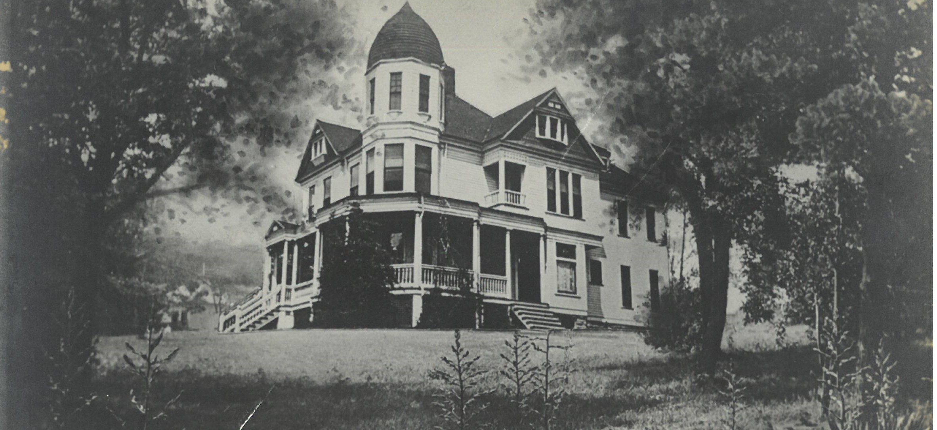
Three Homes on the Hill
Notes:
Neighbor comparisons
After Groves home burned in 1910, he built a new 20-room brick mansion. It featured the latest comforts of the day—electricity, hot and cold running water, telephones, and it had a dance room on the top floor. The basement was used for potato sorting. (This mansion burned in 1964).
Thompson-Murphy house located top right also burned in 1921. It was co-owned by Dr. David Camelin Murphy and his father-in-law Judge M. L. Thompson. Dr. Murphy reportedly helped with the births of several Groves children.
The Edwin Taylor house also belonged to an Edwardsville businessman and County Senator.
The three houses all sat on the hill and all eventually were lost to fire. House fires were common in the early 1900s, with many causes, including open fire stoves and heaters, candles, early electricity, and vandalism.

Slide 24
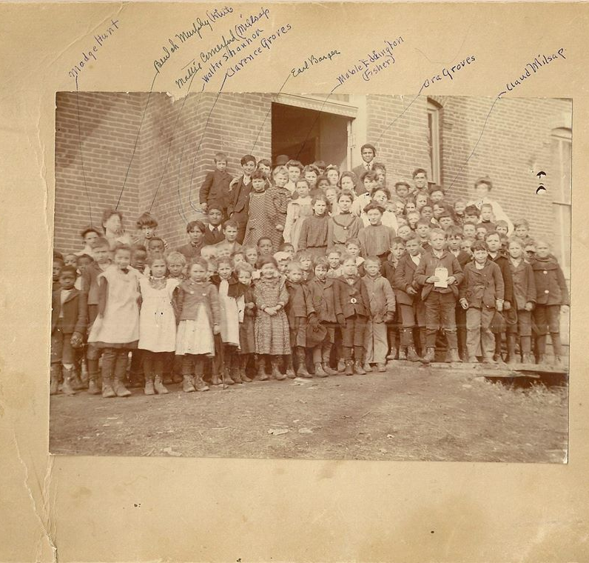
Education
The Grove children attended Edwardsville School
Charles graduated from Manhattan State Agricultural School became farm manager
Walter went to from Highland Park College to learn business
Notes:
At the time it was uncommon for most young people to attend high school or to go on to college. In the 1920s approximately only 20% of the population graduated from high school. Education was important to Groves and he wanted his children to be educated and to grow with the family business.

Slide 25
Notes:
J. G.’s oldest son, Charles, was educated to help run the family business. He died of food poisoning.

Slide 26
Notes:
J. G.’s next oldest son, Walter, studied the business side of farming, but little information has been found about his involvement with the family business. It was clear J. G. wanted him to play a key roll.

Slide 27
From the Booker T. Washington Papers
Notes:
Booker Taliaferro Washington (1856 –1915) was an African-American educator, author, orator, and advisor to presidents of the United States. He became the leading voice of the formerly enslaved, who were newly oppressed by discriminatory laws enacted in post reconstruction Southern states in the late 19th and early 20th centuries. Between 1890 and 1915 Washington was the dominant leader in the US African-American community. In 1895 his Atlanta Compromise called for avoiding confrontation over segregation and instead put more reliance on long-term educational and economic advancement in the black community. The primary goal was to build the community's economic strength and pride by focusing on self-help and schooling. This collection is a selected edition of his writings, addresses, and correspondence.
Complete in 14 volumes, including a cumulative index volume
https://www.archives.gov/nhprc/projects/catalog/booker-t-washington

Slide 28
Local Knights of Pythias, C. 1900 – J.W. Jones, Junius Groves, & Dr. S. H. Thompson
Edwardsville Businessmen c. 1900 – Dr. Murphy, I. A. Thompson, James Michael, & James Trant
Notes:
J. G. had several other business interests and went into partnerships with several local businessmen. He was a partner in the KCK Casket and Embalming Co. and Director in the Twin Cites Business Association in KCK, both African American owned and operated companies.
He was a founding member of the Kansas State Negro Business League, the Kaw Valley Potato Association, the Sunflower State Agricultural Association, and the Pleasant Hill Baptist Church Society.
He also diversified his investments with oil in Oklahoma.

Slide 29
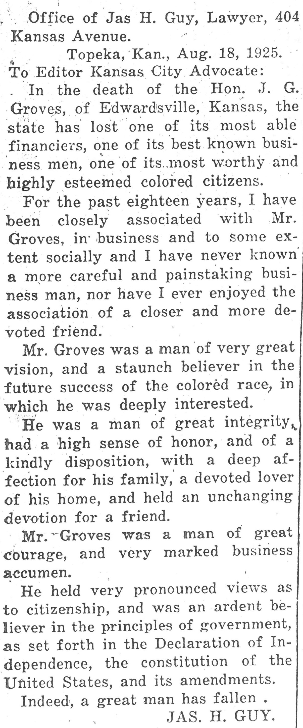

Slide 30
Notes:
Excerpt from J. G. Groves will

Slide 31
Notes:
Map 1940
Matilda inherited the land after J. G.’s death. The “J. G. Groves” marked on this map may have been land owned by his son J. G., Jr.

Slide 32
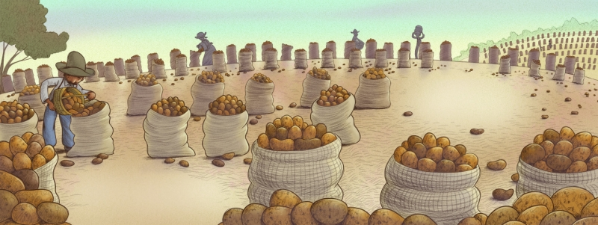
Junius Groves Descendants, Interviewed in 2002
Eddie, born 1926, great-great grandson
Emily, born 1929, wife of great-great grandson
Katy, born 1966, wife of great-great-great-grandson
Marlon, born 1967 great-great-great grandson
Kim, born 1979, great-great-great granddaughter
Alicia, born 1987, great-great-great-great-granddaughter
What valuable lessons have you gleaned from Junius Grove’s life?
Eddie – “Look out for “white folk”! You got to be a conman, keep em on their toes…
Katy – “The thing I was most impressed with in Junius’s life was, though he was a wealthy man he was always helping the poor. He would take a big truck down to Quindaro and pick up those wanted work and bring them out to the fields and give them jobs.”
Marlon – “I picked up his entrepreneur character. I feel I am a skilled businessman and can endure and even fight through the obstacles that I need to for success. Reflecting on his experiences gives me courage. If he could do it back then I know I can do it now.”
Kim “His adventure for life! Through they have left the neighborhood they return here often for their roots. They include a Tuskagee Airman, lawyer, psychologist, cardiologist, engineer, contract, and an international businessman. We were all inspired by his legend.”
Notes:
How stories change with memory and each generation?
pros and cons

Slide 33
Different Experiences and Perspectives
Have there been any benefits to being a descendant of Groves?
Eddie – “There has been no advantages for us being related to Junius. The Klu Klux Klan saw to that. They burned the ol’ mansion down because they didn’t like white folk pickin’ potatoes for my granddad. He was helping the homeless that lived under the train trestles in Edwardsville by giving them jobs and the Klan couldn’t stand it…”
Emily – “We never received any benefits for being in the family.”
Katy – “Yes, we have gleaned property because of the wealth being passed down. We have also experienced pride and self- esteem because of the legacy he left.”
Marlon – “No benefits except and occasional question about our heritage.” As far as the wealth of Junius, because it was an open will the state got most of his wealth and the little that was dispersed between his four sons was frivoled away by foolish business dealings…”
Have there been disadvantages?
Eddie – Lots of disadvantages! They tried to take away everything! We were the only black family in the United States that had an 18 hole golf course along the creek right over there. All Destroyed!”
Emily “No disadvantages. I feel we have been treated on our own merit.”
Marlon – “Possible disadvantages because of the reputation the Groves have had for being cantankerous. You know, trying to make it through all the trails and hardships.”
Kim – “He passed down a bull-headedness. To be in this family you have to be tough and fight for your place…”

Slide 34
Notes:
How can we better preserve legacies for the future?
What other stories should be told?
https://youtu.be/I7-wEW7dl6A

