Slide 1
Community & Immigrants
Have any of you moved here from a different country or state?
Does anyone know a person or family that immigrated from another place?
Could you imagine moving to a brand-new place where you knew no one?

Slide 2
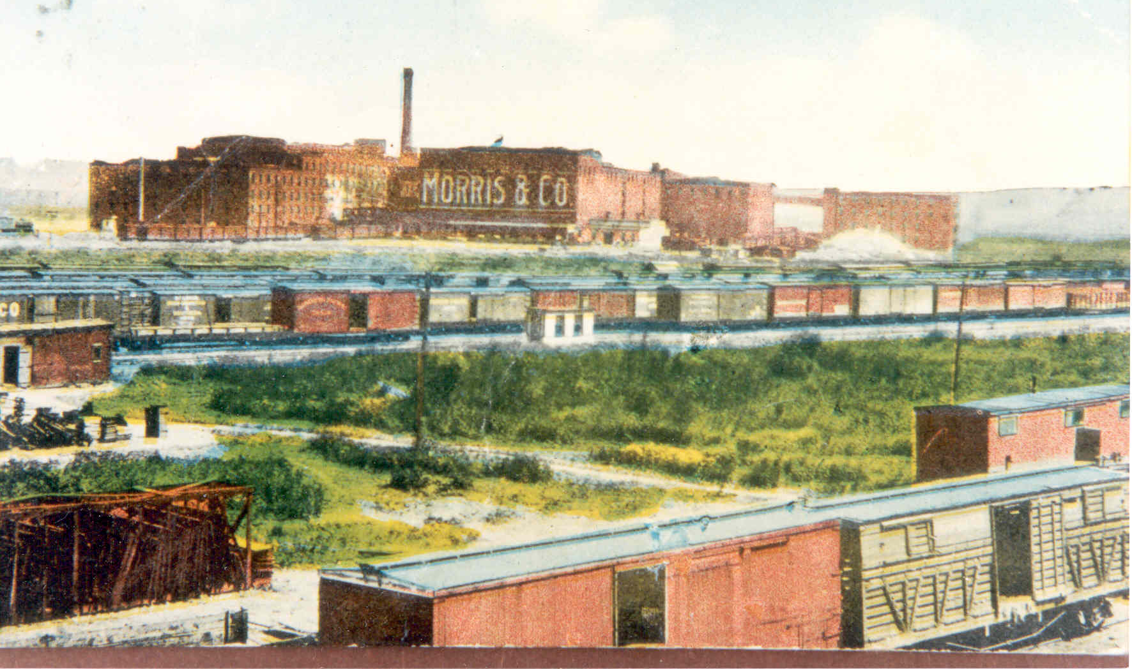
Did you know?
Over one tenth of the KCK population was foreign born in 1920s.
Almost one quarter of the KCK population were the children of immigrants in 1920s.
Notes:
What might motivate people to move to a new country?
Religious freedom, political unrest, employment and economic opportunity
In a 2014-18 study, 17.5% of the KCK population was foreign born. How many of you are and immigrant or know one?
Image in the background shows the railyards with Morris & Co Packing House in the background

Slide 3
Major Population Waves in Wyandotte County
Native American
1854 migration from other states
1850s German immigrants
1860s Sweden, Belgium, & Ireland
1870s African Americans from the south
1900s Eastern Europeans Croatians, Serbians
1910-1920 Mexican Nationals migrated north
WWI ended the first major wave of European immigration
Notes:
KCK population reached 117,395 in 1925.
People immigrated for a variety of reasons, including religious freedom, political unrest and injustice, and employment and economic opportunity.
European Immigrants often found work in the packing houses and many other industries.
1900s Mexican nationals left during the Mexican Revolution, followed jobs working in railroads, meat-packing plants, & farm labor

Slide 4
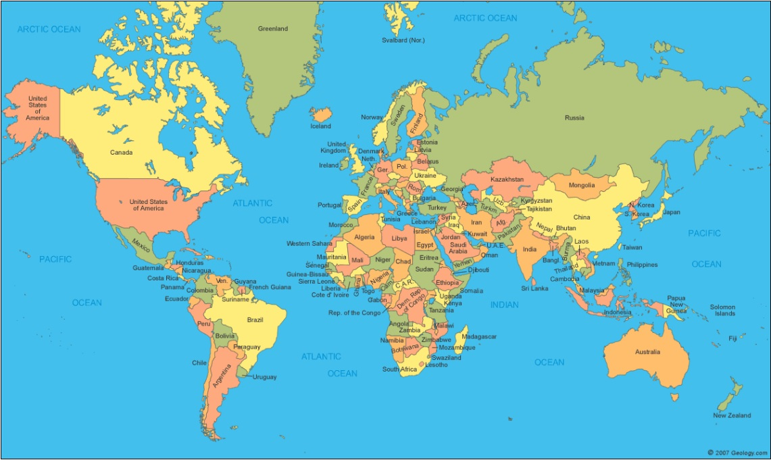
This Photo by Unknown Author is licensed under CC BY-SA-NC
Notes:
Activity 1: Family Heritage
Do you know where your family is from?
Have students point out where their family is from on the map
Do you know your family’s stories?
Activity 2: Show and Tell
Ask students to bring a show and tell object from home that helps tell their family story

Slide 5
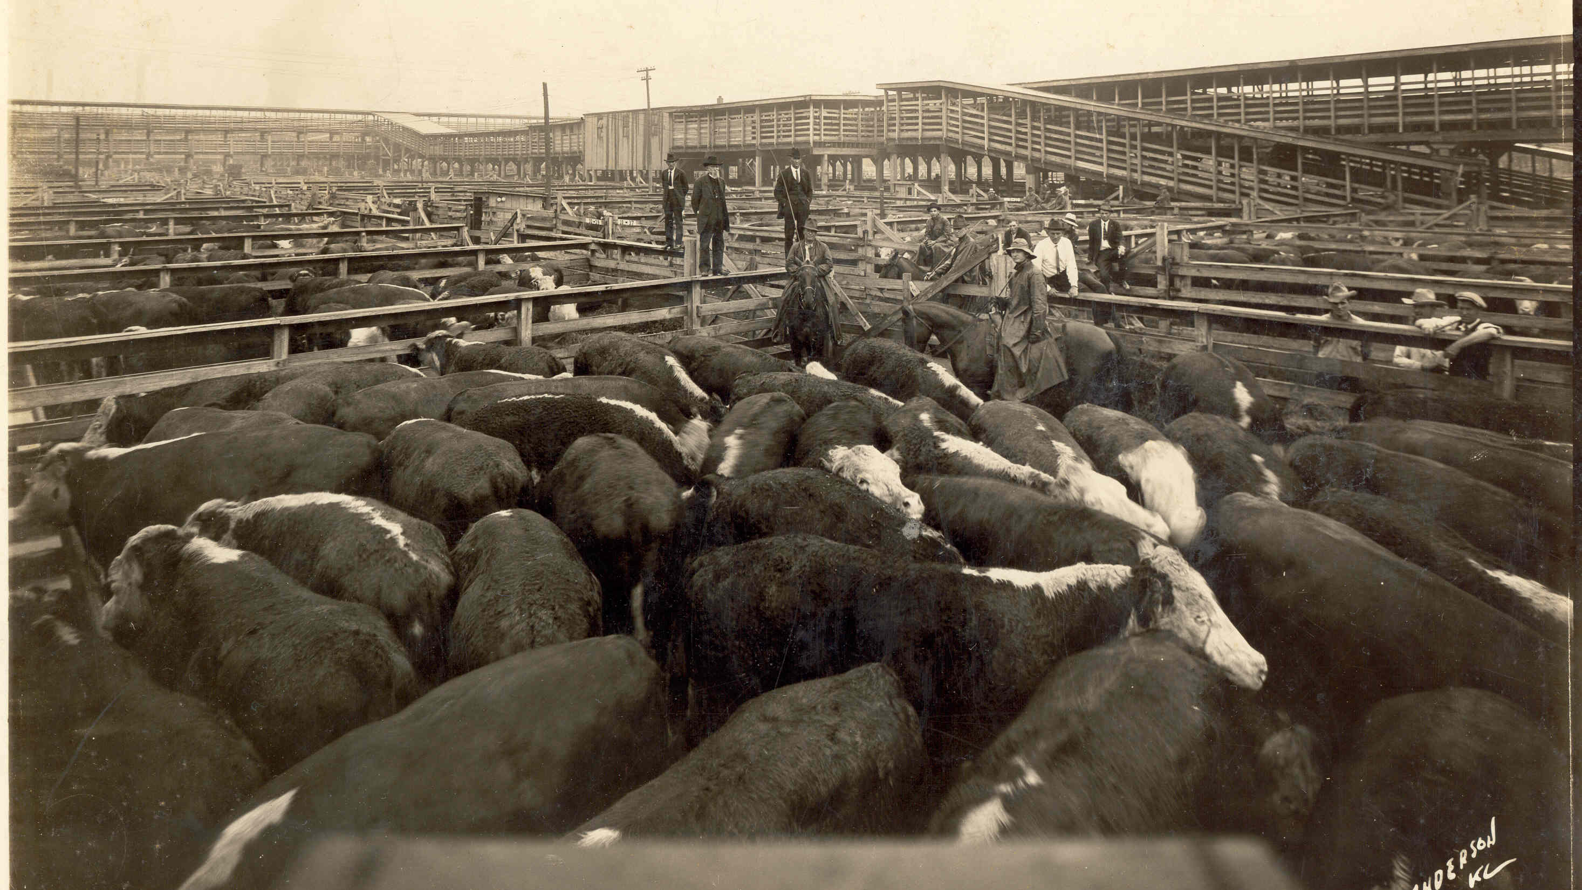
Notes:
Stockyard photo – cattle awaiting slaughter for the meat packing companies
Look closely what can be seen beyond the cattle?

Slide 6
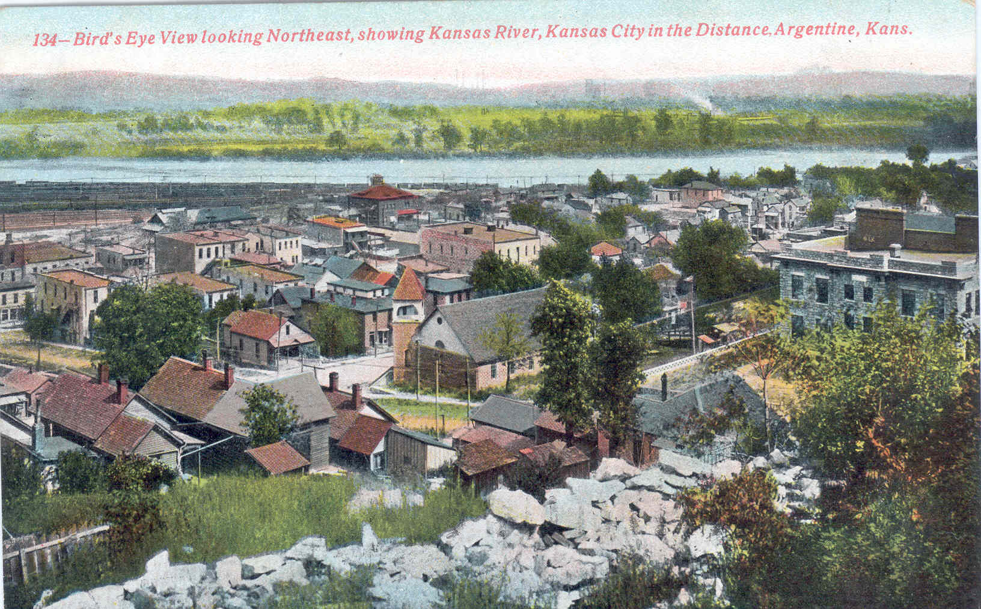
Notes:
Birdseye view of Argentine looking northeast over the Kansas River.
This postcard is made from a black and white photograph with color added.
The Floods of 1903, 1908, 1951 greatly changed the communities along the river as the floods destroyed many homes and businesses. Those that could moved further inland after these floods and new groups of immigrants moved into the less desirable flood plains.

Slide 7
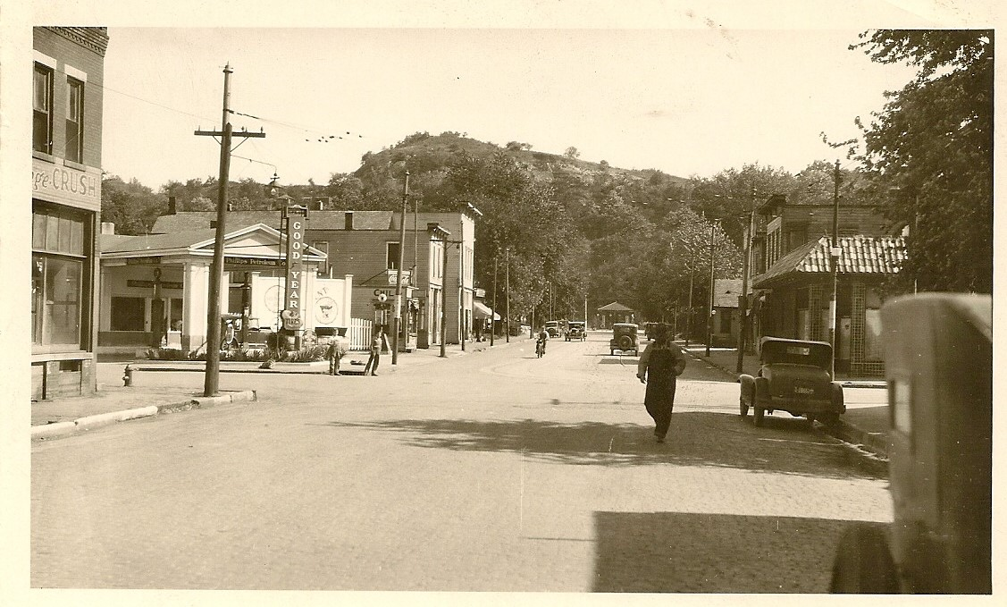
Notes:
26th St Argentine c. 1930.
Possibly South 26th and Strong – This location had a gas station and several restaurants at this time.
How many different things can you find happening in this photo?

Slide 8
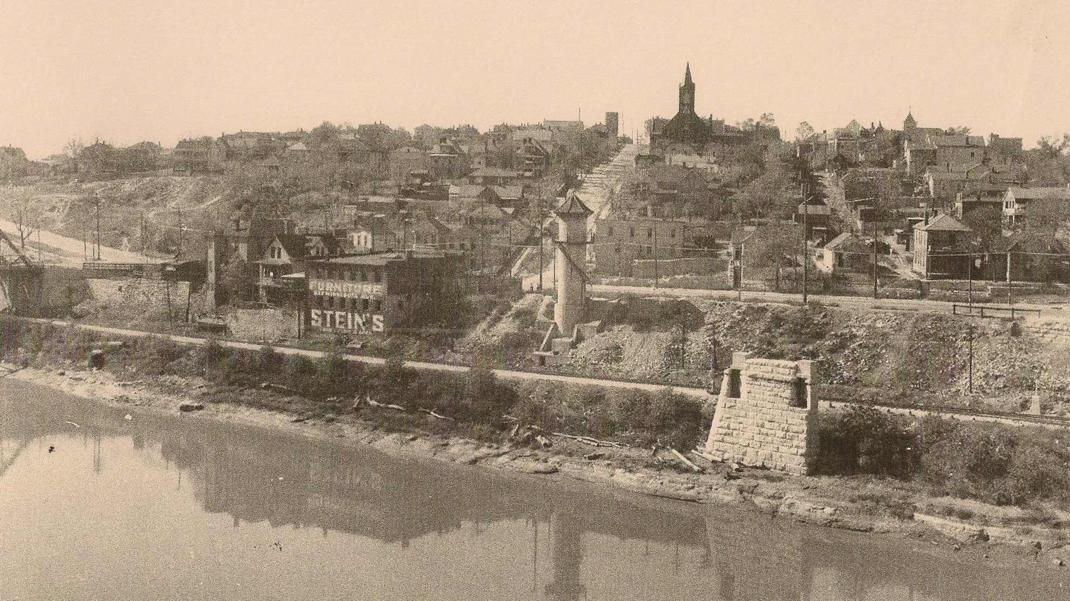
Notes:
Strawberry Hill near 3rd St., & Ann Ave, circa 1937

Slide 9
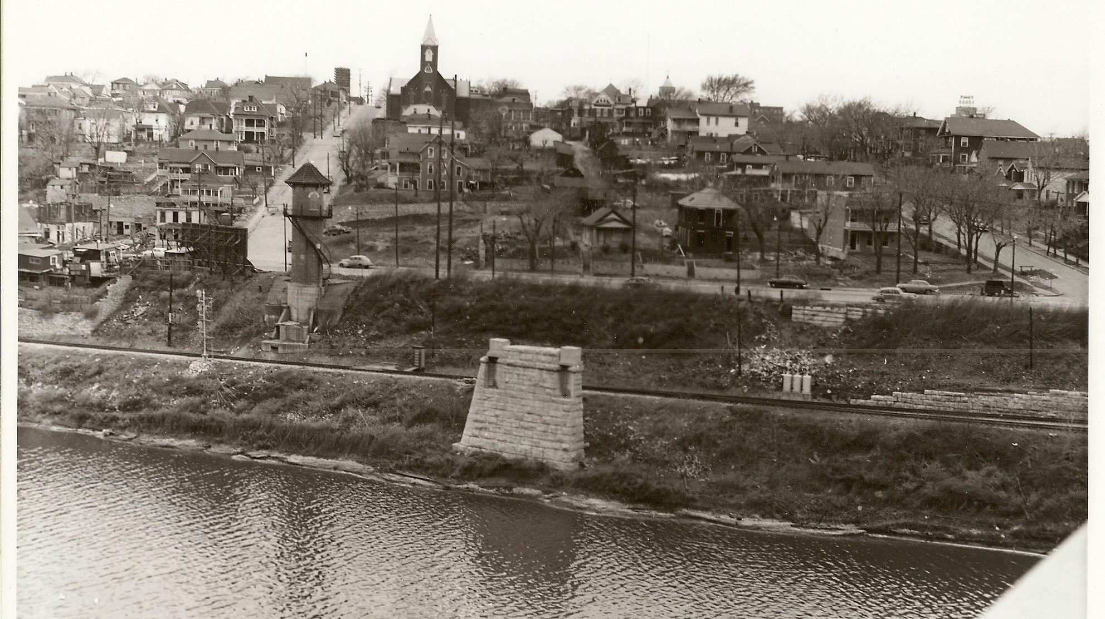
Notes:
Strawberry Hill near 3rd St., & Ann Ave circa 1954.
What has changed?

Slide 10
Roll Play
You just moved here from…
What would it feel like if you just moved to a new place?
How would your life change?
Would the food/clothing/culture of the area be different?
What might you miss from your homeland?
Notes:
Activity 3: Roll Play
Activity 4: Language
What if you spoke a different language than everyone you met, and no one could understand you?
This game will help illustrate this challenge. See I Am From… sheet for cut outs and instructions.

Slide 11
