Slide 1
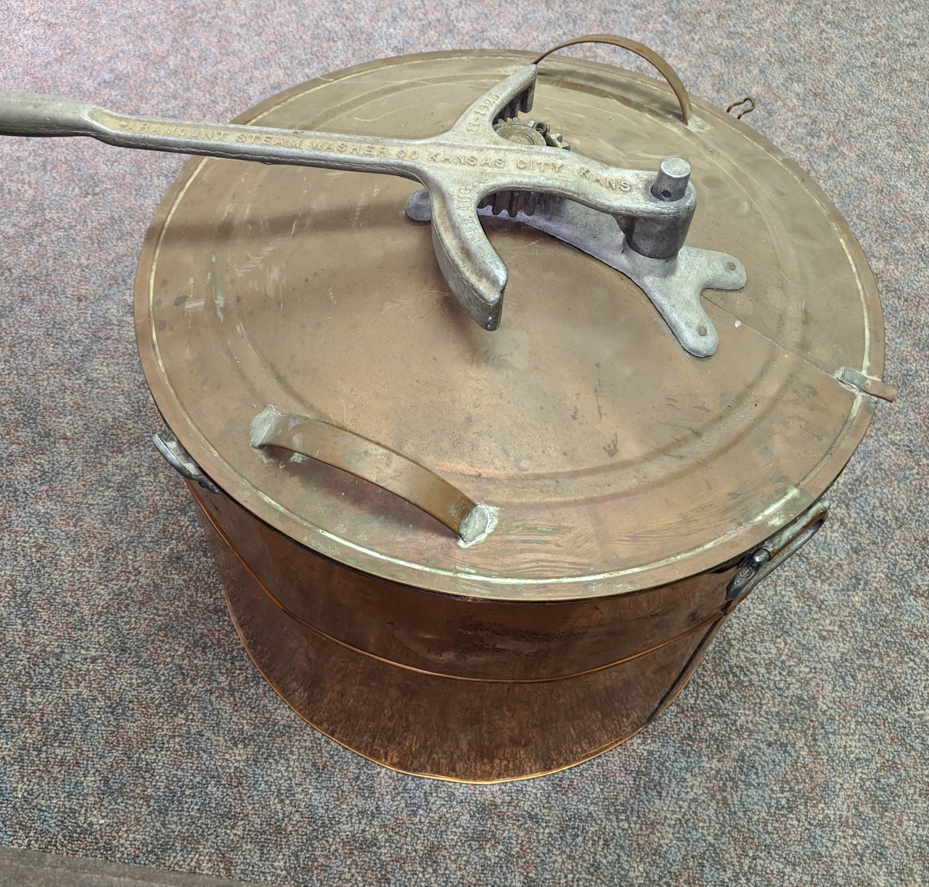
Modern Conveniences
The 1920s saw the advent of many new inventions making their way into daily life.
The Paramount Steam Company operated in Kansas City, Kansas in the 1920s. Any guesses what they produced?
Notes:
This Paramount Steam Washing Machine was produced in KCK. It was patented in 1928.
Hot water, soap, and clothes were placed inside, and the handle was cranked to agitate the clothing. Then they would need to be rung out before hanging to dry.
*Activity 1 & 3: Washing Clothes & Shaving (will be available in educational trunk post Covid, along with more interactives for the other sections)

Slide 2
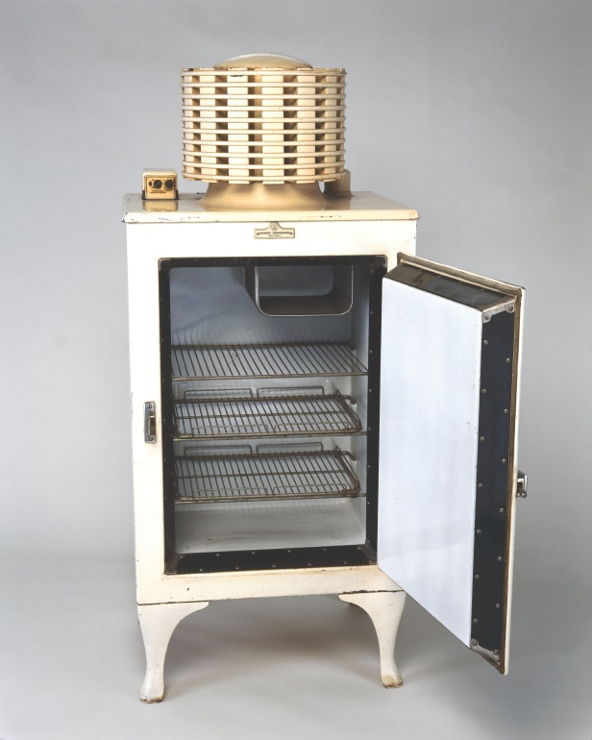
Refrigeration
In 1923 Frigidaire produced the first self-contained unit, introducing Americans to home refrigeration and freezer food storage. It wasn’t until 1929, when Clarence Birdseye offered the first quick-frozen foods to the American public, that frozen food became popular.
Without refrigerators how do you think life would be different?
Notes:
Activity 2: Discussion
Without refrigerators how do you think life would be different?
More trips to the store
No frozen or convenience food
Most food cooked from starch daily
Food spoiled easily and could make people sick

Slide 3
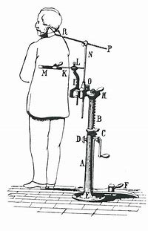
Photography
The earliest instant camera, which consisted of a camera and portable wet darkroom in a single compartment, was invented in 1923 by Samuel Shlafrock. Years later the polaroid camera became famous for printing instant pictures.
If you look closely at early photographs, you can sometimes see props to help people hold poses. These were used because photographs took so long and if a person moved at all during the process the photograph would be blurred. Poses needed to be held for several seconds up to several minutes, depending on the technology.
Hold that Pose
Have everyone pick a pose and hold it for one minute. How many people made it the entire minute?
Notes:
Activity 4: Hold a Pose

Slide 4
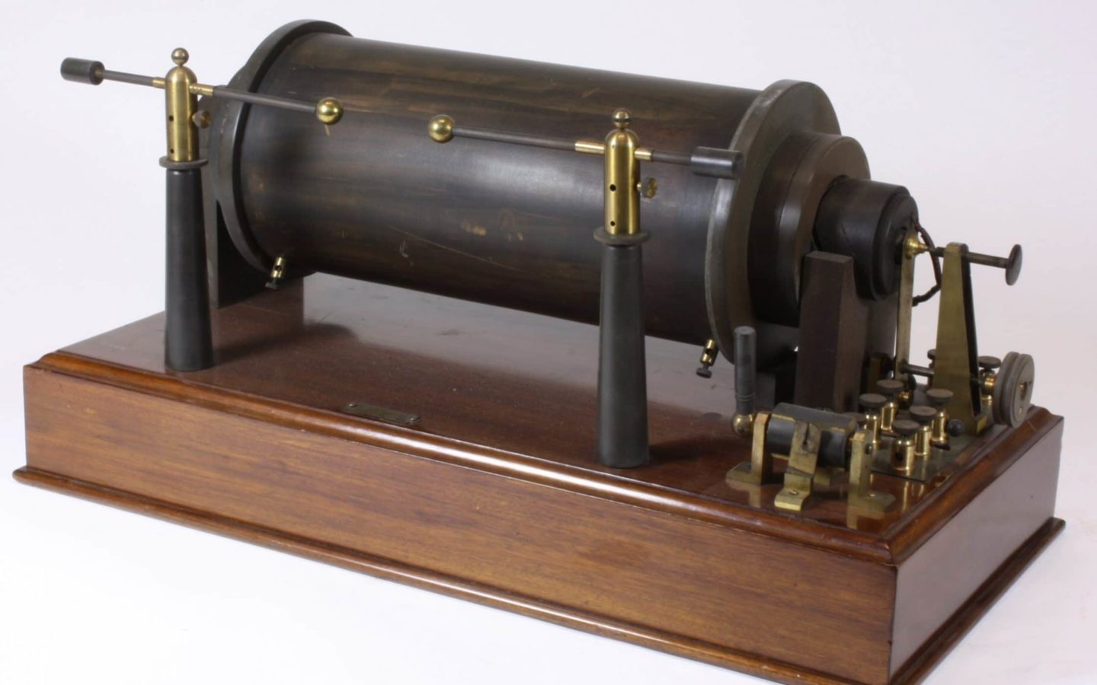
Radio & Television
Can you imagine life without mobile devices, computers, televisions or radios?
Notes:
Activity 5: Radio and TV discussion
How would have life been different?
How would people get their news?

Slide 5
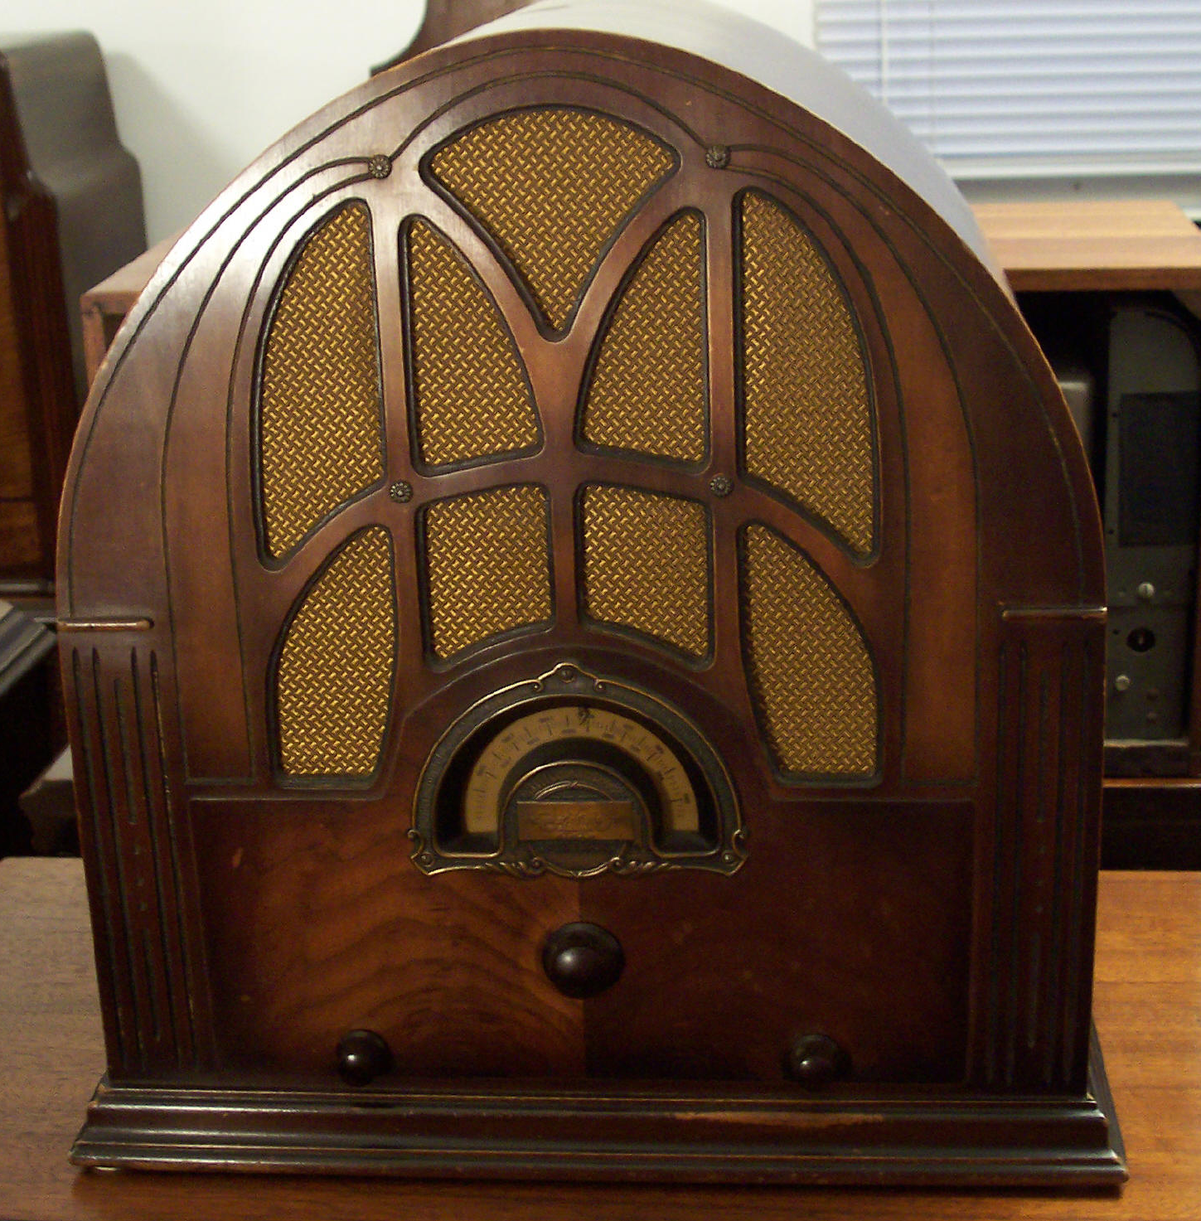
Radio Waves
1920 - America's first Radio Station was KDKA in Pittsburg, PA
Early radio’s center of family entertainment
Source of news, changed how news was delivered
Listen to the first public broadcast, Harding Elected President

Slide 6
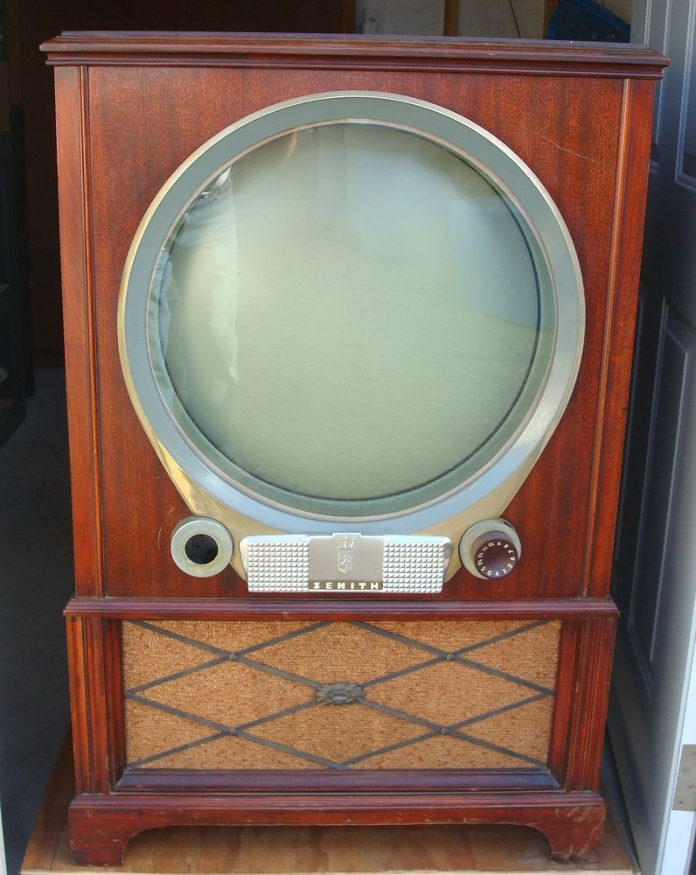
Television is Born
1925 - Television was invented by John Logie Baird.
The first experimental Television broadcast in the US was in 1928.
Silent Cartoon
First Broadcast NBC/RCA 1936

Slide 7
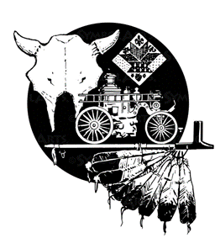



100 Year Educational Trunk
This trunk is provided by the Wyandotte County Museum
It highlights life in Wyandotte County in the 1920s and the enduring struggle for freedom
This trunk is made possible through a Freedom Frontier National Heritage Area grant funded by the Barton P. and Mary D. Cohen Charitable Trust.
These documents are free to use for educational purposes.
Please contact the museum directly for additional classroom aids, comments, or questions.

